Slide 1
Air Masses & Fronts

Slide 2
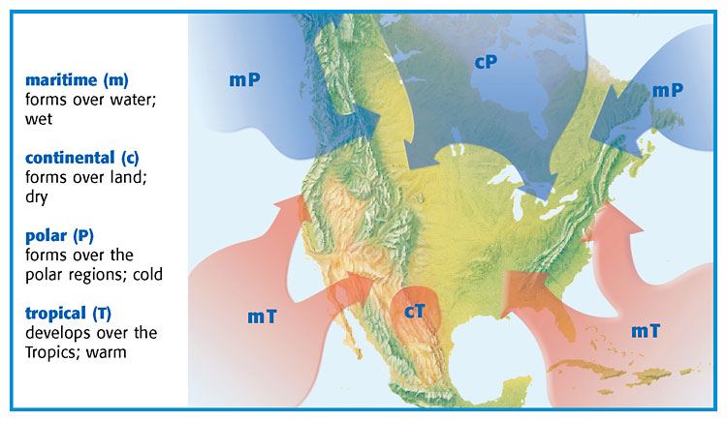
Pg. 490- Air Masses

Slide 3
Air Masses
Air Mass: body of air that has the same temperature and amount of moisture throughout.
Where the air mass forms determines its moisture and temperature.

Slide 4
Where it forms | Type of Weather it brings
Forms over water | wet
Forms over land | dry
Forms in polar regions | cold
Forms over tropical regions | warm

Slide 5
Cold Air Masses
Come from the poles
Bring cold weather
If come from land, bring cold, dry weather.
If come from over water, bring cold wet weather (snow, ice, rain)

Slide 6
Warm Air Masses
Come from tropics/equator
Bring warm weather
If come from land, bring warm, dry weather.
If come from over water, bring warm wet weather

Slide 7
Fronts
Front: area where warm and cold air mass meet.
* masses do not mix because they have different densities

Slide 8
When warm and cold air masses meet, warm air ALWAYS goes up, COLD air ALWAYS goes under.
Air mass is named after what type of air mass is moving in and trying to take over.

Slide 9
Types of fronts:
warm front
cold front
occlouded front
stationary front

Slide 10
Notes:
Occluded front

Slide 11
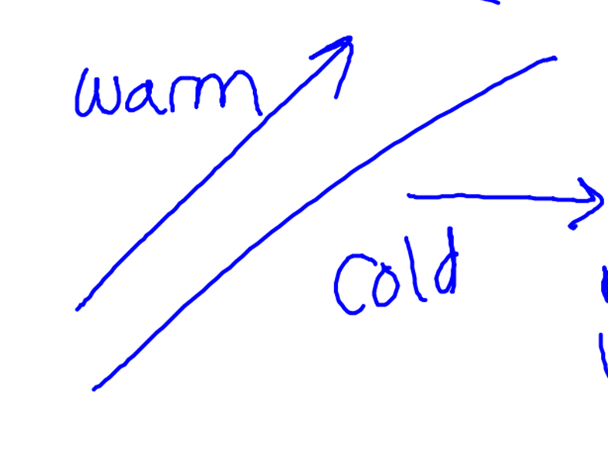
Warm Front
* cold air already there
* warm air moves in, over
cold air
* causes drizzly weather.
* move slower than cold fronts
After Warm Front:
warm, clear weather.
Drawing for
warm front:

Slide 12
Notes:
Occluded front

Slide 13
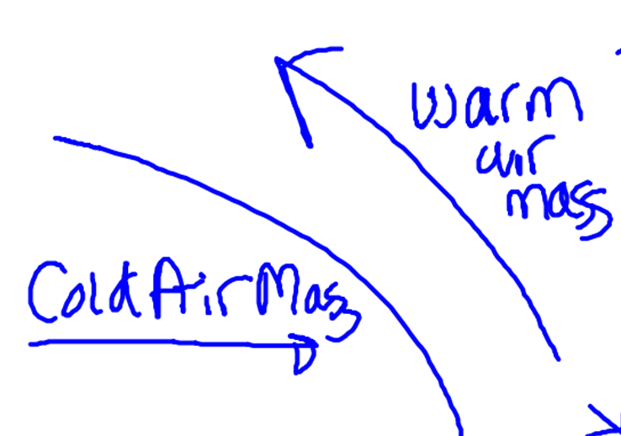
Cold Front
* warm air mass is already there
*cold mass moves in, going under warm mass, pushing warm mass up.
* causes cold weather, thunderstorms, heavy rain & snow
After cold front: cooler and dry weather
Drawing for
warm front:

Slide 14
Occlouded Front
* when a warm air mass is caught between 2 cold air masses.
* Produces cold temperatures, lots of rain & snow.

Slide 16
Notes:
Occluded front

Slide 17
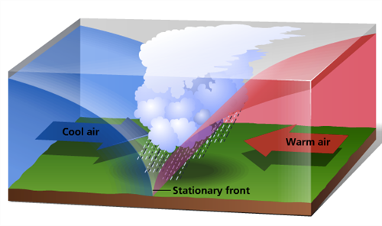
Notes:
Stationary front

Slide 18
Stationary Front
*forms when a cold and warm air mass meet, but neither are strong enough to push the warm mass up.
* stay separated
* cause cloudy,
wet weather
* stuck for a while; move very slowly
Drawing:

Slide 23
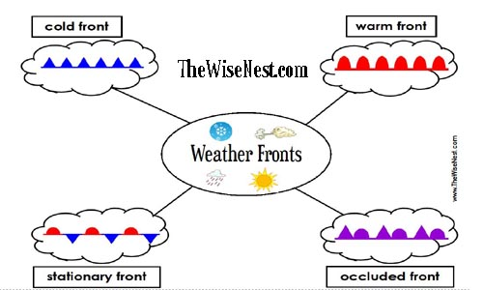

Slide 24
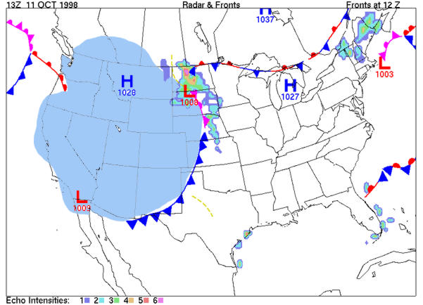

Slide 25
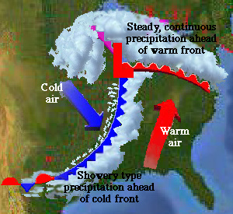

Slide 26
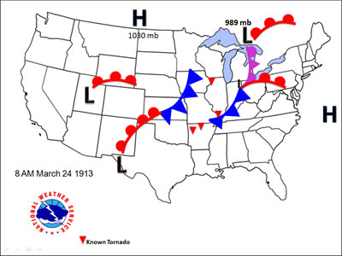
Montana
Canada
Wyoming
CO
OK
TN
New Mexico
GA

Slide 27
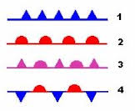

Slide 28
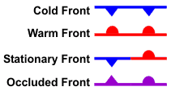

Slide 29
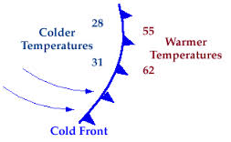

Slide 30
