Slide 1
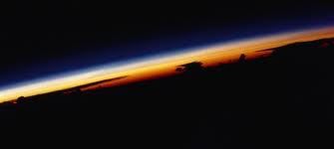
Composition and Structure of the Atmosphere
Comprehensive Science 1

Slide 2
HOMEROOM Friday the 13th…..
Turn in SIGNED conference forms to receive surprise
Remember: Next week is conference week; which means early release is all next week!

Slide 3
Success Starter- 10/13/17
Warm up: Complete Pre-Test silently
Once finished with pre-test, receive a KWL chart and title “Atmosphere”. Fill in “What I know” ONLY

Slide 4
Work session
Open discussion of Atmosphere
Bill Nye Notes
Discuss and review Video Notes
If we have time, password activity.

Slide 5
Closing
Retest instructions
Have a great weekend

Slide 6
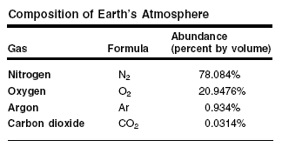
What is the Composition of Earth’s Atmosphere?
Consists of
Nitrogen
Oxygen
Carbon dioxide
Water vapor
Other gases
Particles of liquid and solids

Slide 7
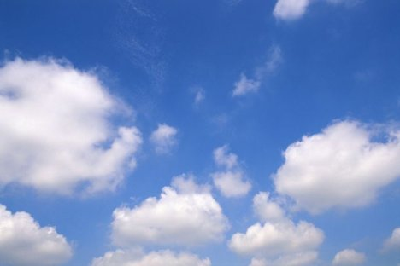
What’s in The Air?
Oxygen and nitrogen make up 99% of dry air
Argon makes up most of the rest (1%)

Slide 8
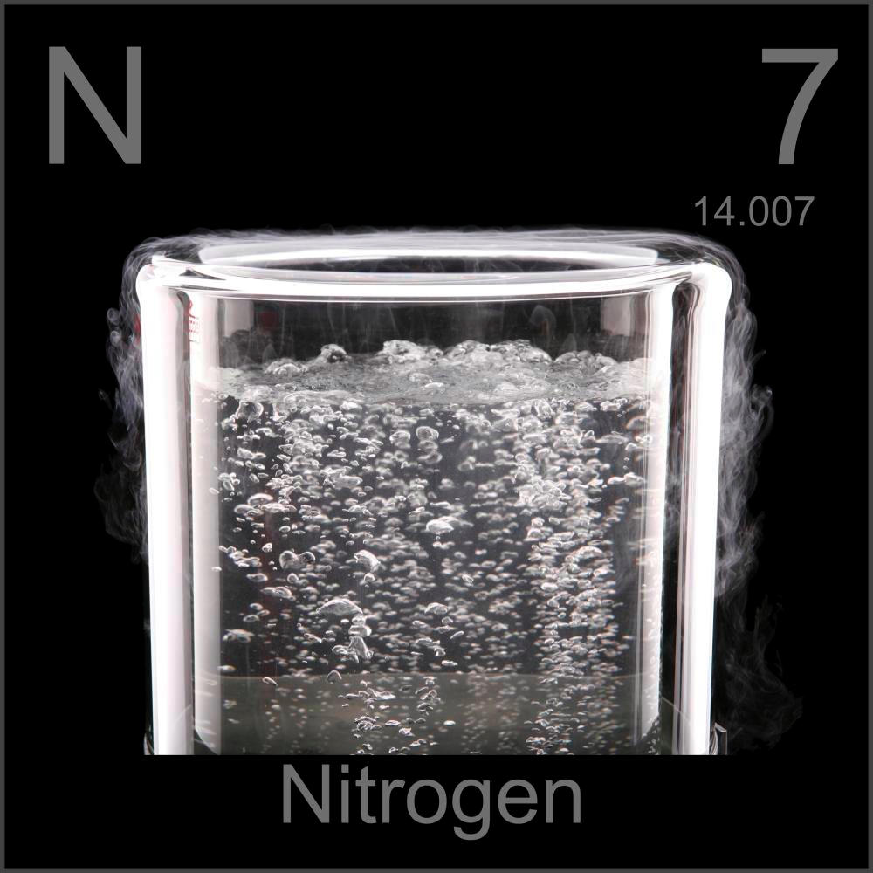
Nitrogen in the Atmosphere
Most abundant gas in the atmosphere
Occurs in all living things
3% of weight in the human body

Slide 9
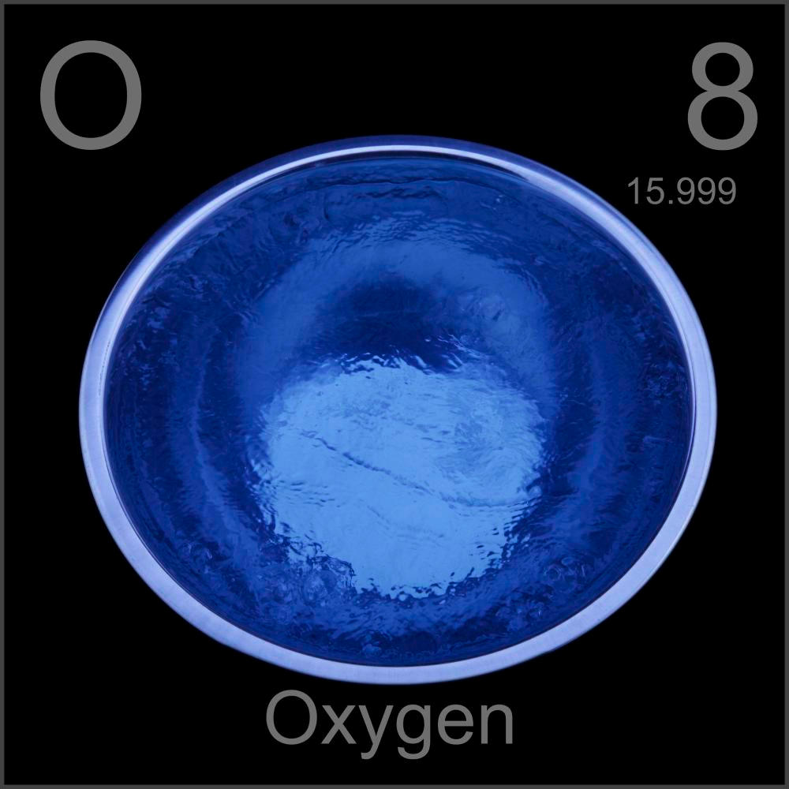
Oxygen in the Atmosphere
Second most abundant gas (21%)

Slide 10
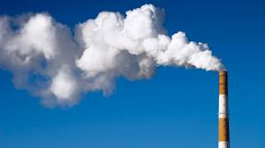
Carbon Dioxide in the Atmosphere
Less than 1% of the atmosphere

Slide 11
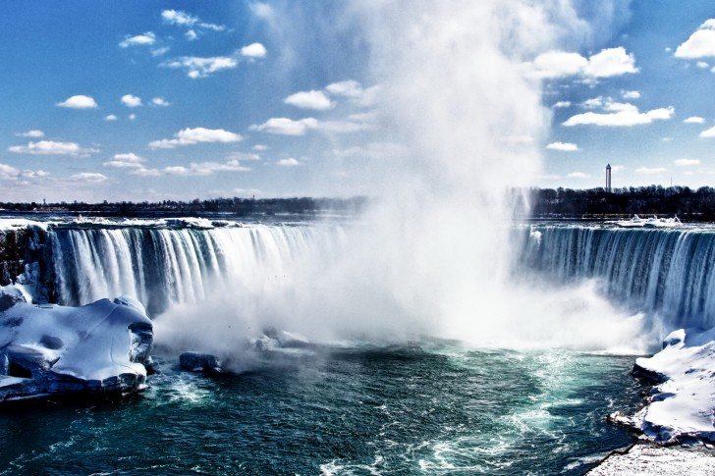
Water Vapor in the Atmosphere
Air that contains water in the form of gas
Not the same as steam(tiny droplets of water)
Amount varies from place to place
Causes the formation of rainfall from clouds

Slide 12
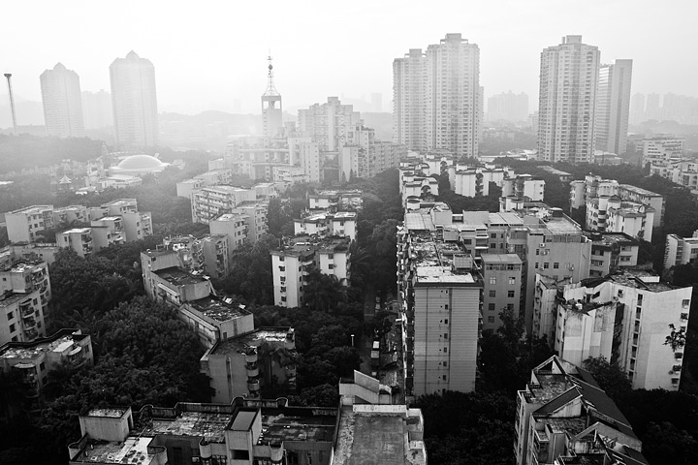
Particles in the Atmosphere
Dust
Smoke
Salt
chemicals

Slide 13
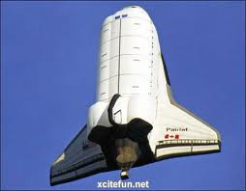
I Feel It in the Atmosphere!
As a balloon reaches an altitude of 3 kilometers, you realize the air is getting colder. At 6 kilometers, you begin to have trouble breathing. The air is becoming less dense. It’s time to go back down

Slide 14
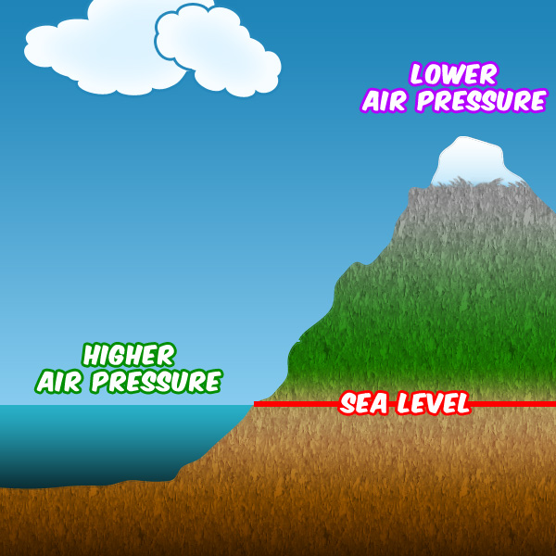
Air Pressure
Air pressure= the measure of the force with which air molecules push on a surface

Slide 15
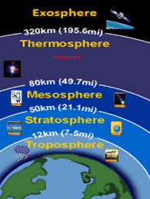
What Are the Four Main Layers of the Atmosphere?
Troposphere
Stratosphere
Mesosphere
Thermosphere

Slide 16
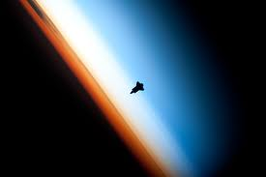
What is the Troposphere?
The layer of the atmosphere in which Earth’s weather occurs.
Inner, lowest layer of the Atmosphere
Tropo- “turning” or “changing”
Conditions are more variable than other layers

Slide 17
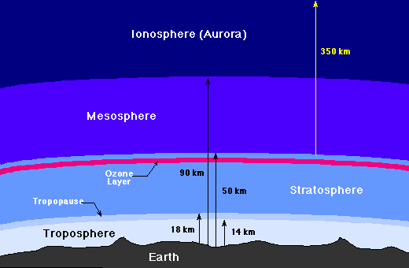
What is the Stratosphere?
Second layer of the atmosphere
Contains the ozone layer
Extends from the top of the troposphere to 50km above Earth’s surface

Slide 18
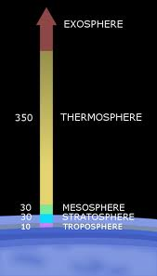
What is the Mesosphere?
Layer of the atmosphere that protects Earth’s surface from being hit by most meteoroids
Meso= “middle”
Begins 50km above Earth’s surface and ends at an altitude of 80km

Slide 19
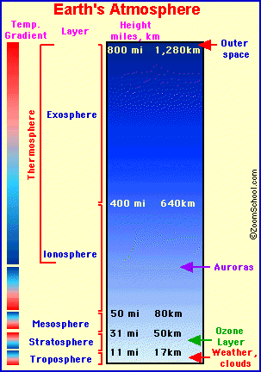
What is the Thermosphere?
Outermost layer of the Earth’s atmosphere that extends from 80km above Earth’s surface outward into space
2 layers
Ionosphere-lower layer
Exosphere-outer layer

