Slide 1
Chemical Weathering

Slide 2
Process by which rocks break down as a result of chemical reactions.
Hint: rocks usually change color or become smoother. DISSOLVE or into different minerals.
CHEMICAL WEATHERING

Slide 3
1. Water
2. Acid precipitation
3. Acids in ground water
4. Acids in living things
5. Air
These agents weaken bonds between the mineral grains of rock.
Agents of chemical weathering

Slide 4
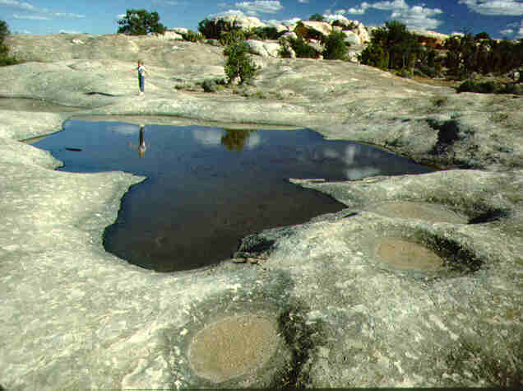
Water
Causes rock to be broken down by dissolving minerals from a rock over a long period of time (sometimes 1000s of years).

Slide 5
Water
Causes rock to be broken down by dissolving minerals from a rock over a long period of time (sometimes 1000s of years).

Slide 6
acid precipitation
acids in ground water
acids in living things
Weak Acids Include

Slide 7
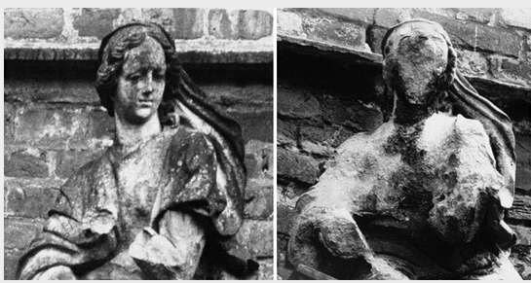
Acid Precipitation (weak acid)
Rain, sleet, or snow that contains a high concentration of acid.
Normal precipitation is acidic, acid precipitation contains more acid than normal.

Slide 8
Rain, sleet, or snow, that contains a high concentration of acids.
Acid precipitation

Slide 9
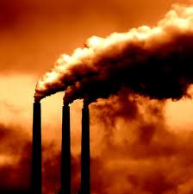
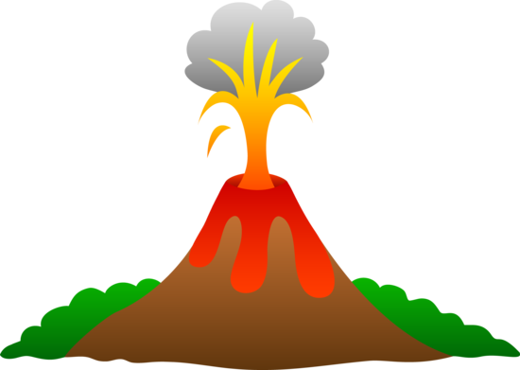
Where does acid PRECIPTATION come from?
Small amounts of nitric or sulfuric acids from volcanoes.
Air pollution from fossil fuels (coal & oil) give off gases & combines with water to form acid rain.

Slide 10
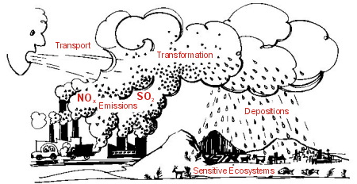
Acid PRECIPITATION
Compounds from burning coal, oil and gas react chemically with water forming acids.
Acid precipitation causes very rapid chemical weathering

Slide 11
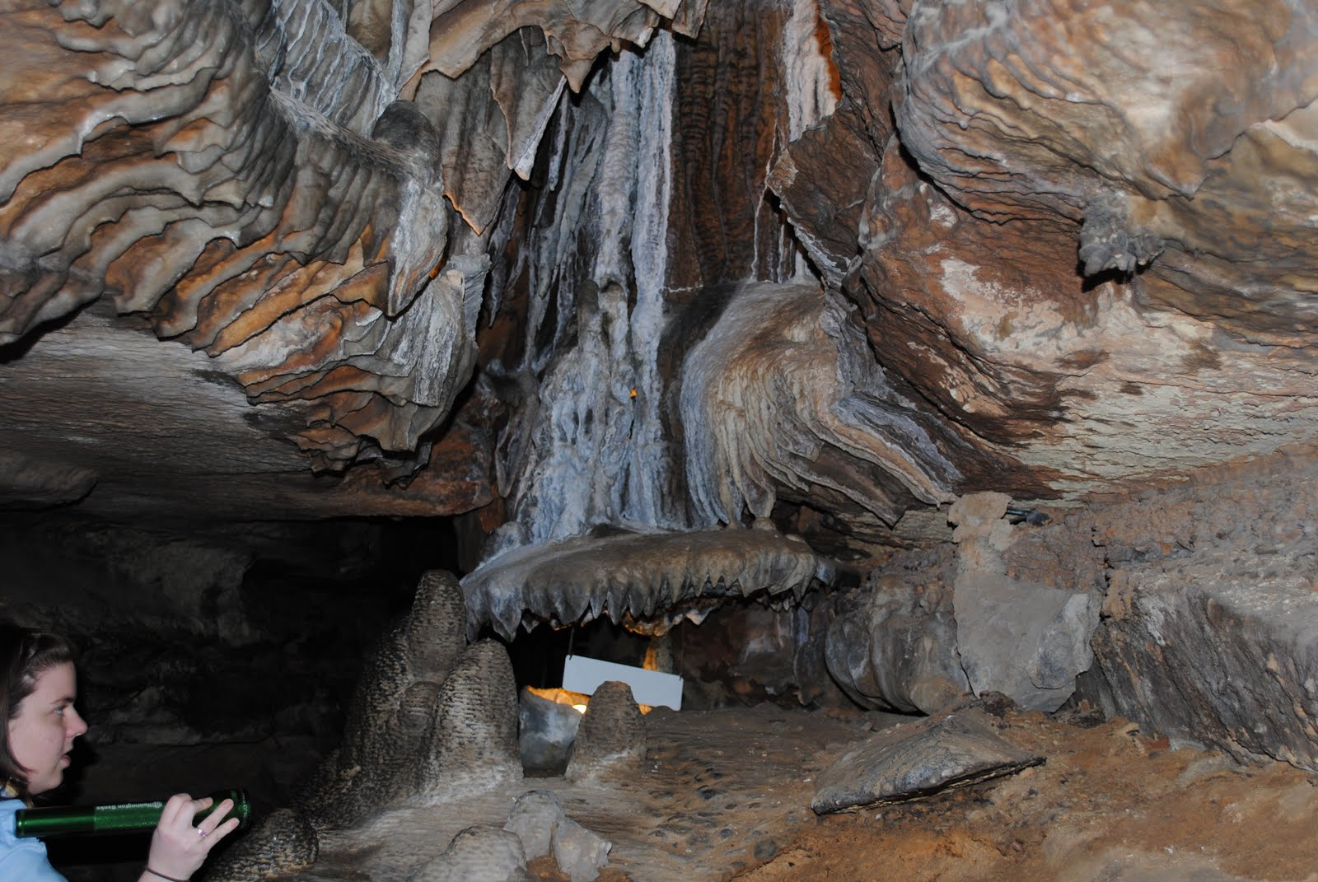
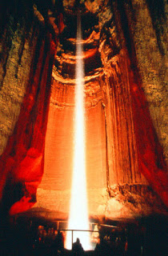
Ruby
Falls
What created this?
Notes:
http://chattanoogadiscounts.blogspot.com/2012/07/ruby-falls-chattanooga.html

Slide 12
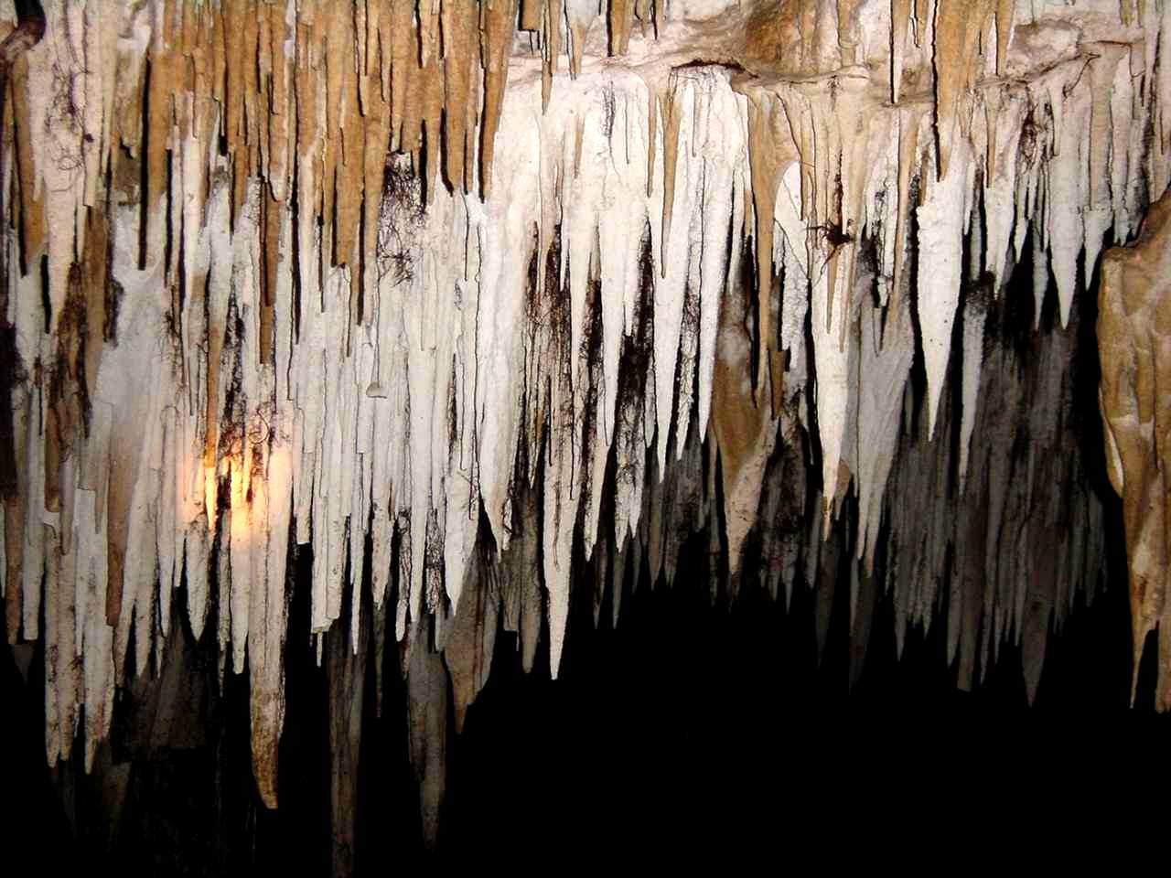
Acids in Groundwater (weak acid)
Some groundwater contains weak acids like carbonic & sulfuric acid.
These weak acids react with rocks, causing a chemical reaction.

Slide 13
Acids in Ground water
When groundwater touches limestone, it dissolves limestone to form caves over thousands of years.
Ex: Karst topography / Caverns
Ex: stalactites, stalagmites

Slide 14
Karst Topography
Acids in ground water….
Causes karst topography (sink holes, disappearing streams, caves)
Created by chemical weathering of limestone.
https://www.nps.gov/media/photo/gallery.htm?id=318A0C5A-155D-451F-6771B101D8195C02
Notes:
A type of landscape in rainy regions where there is limestone near the surface, characterized by caves, sinkholes, and disappearing streams.
Created by chemical weathering of limestone

Slide 15
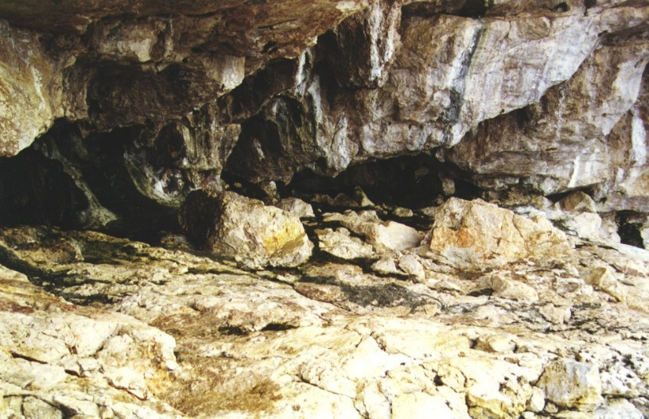
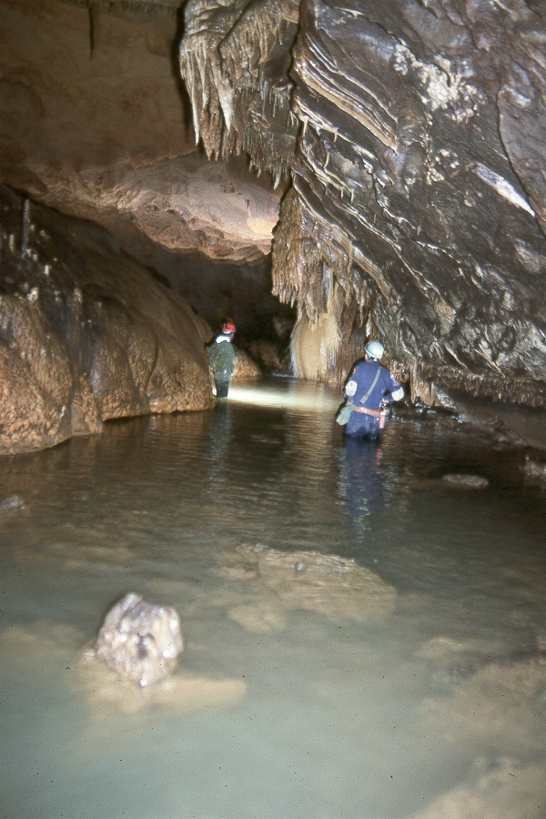
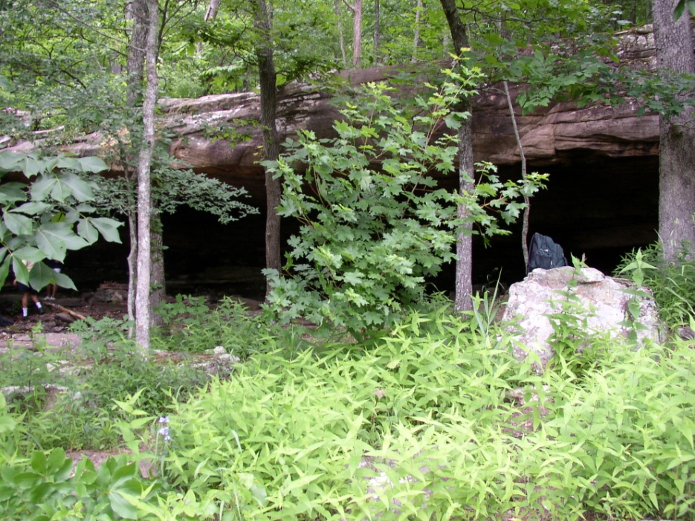
Features of Karst: Caves

Slide 16
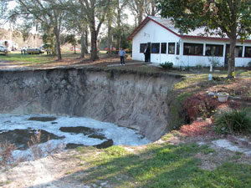
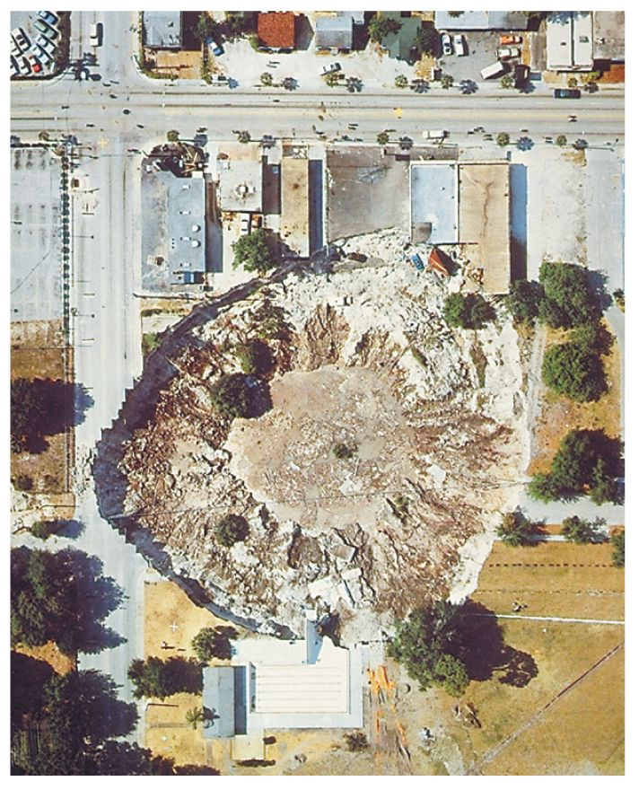
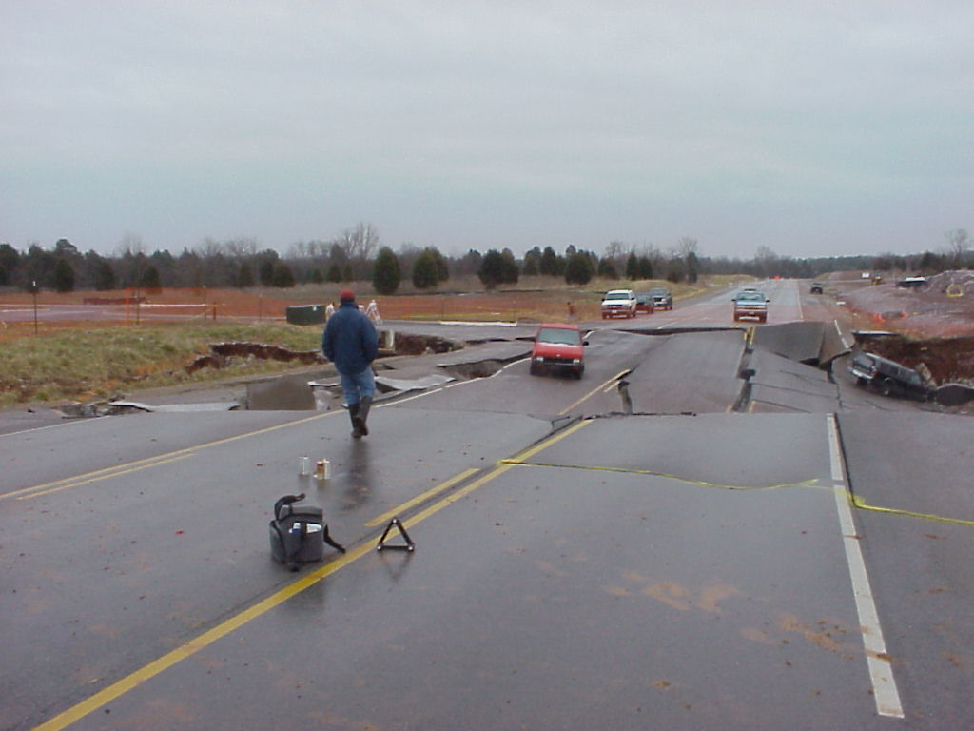
Features of Karst: Sinkholes

Slide 17
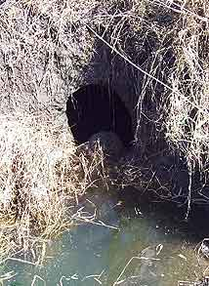
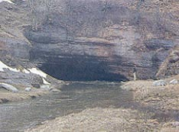
Features of Karst: Disappearing Streams

Slide 18
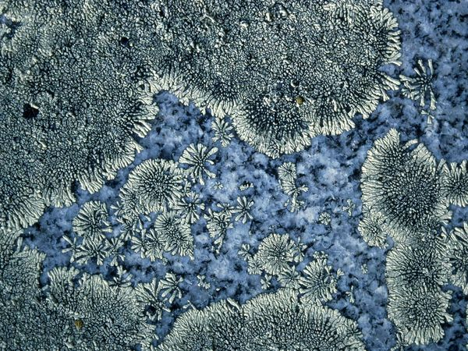
National Geographic Photos
What is this that is causing chemical weathering?

Slide 19
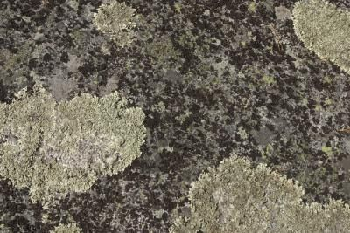
Acids in Living Things (weak acid)
1. Lichens produce acids that slowly break down rock.
2. Roots & 3. and decaying plants release acids that dissolve minerals, thus weakening the rock.

Slide 20
Acids in Living things
Lichens produce acids that slowly break down rock
Roots and decaying plants release acids that dissolve minerals, thus weakening the rock.

Slide 21
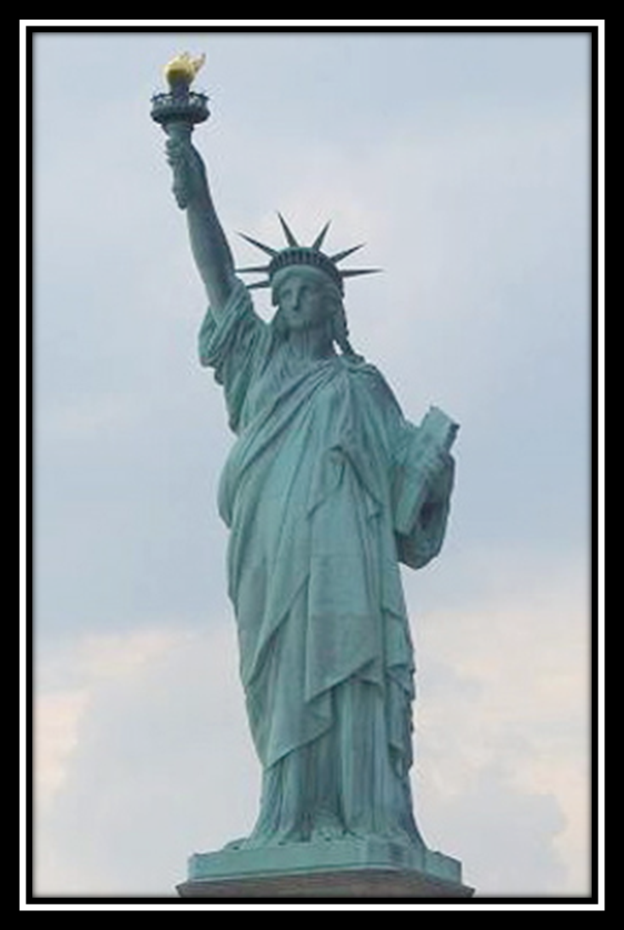
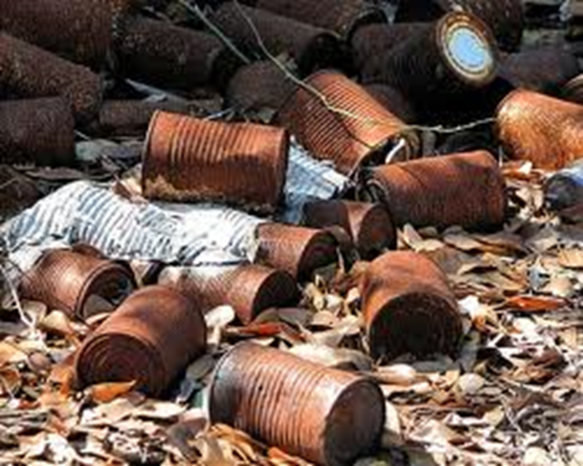
What Agent of Weathering Caused this?

Slide 22
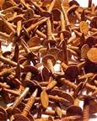
AIR
Oxygen in the air reacts with iron, causing it to rust. This process is called oxidation.

Slide 23
Oxidation
A chemical reaction in which an element (iron) combines with oxygen to cause rust.
Water speeds up this process.
Examples: Causes aluminum cans, bikes, & cars to rust.

Slide 24
Air
Oxidation
Oxygen in the air reacts with iron, causing it to rust. This process is called oxidation.
A chemical reaction where iron combines with oxygen to cause rust.
Ex. aluminum cans, bikes, & cars
Water speeds up this process.

Slide 25
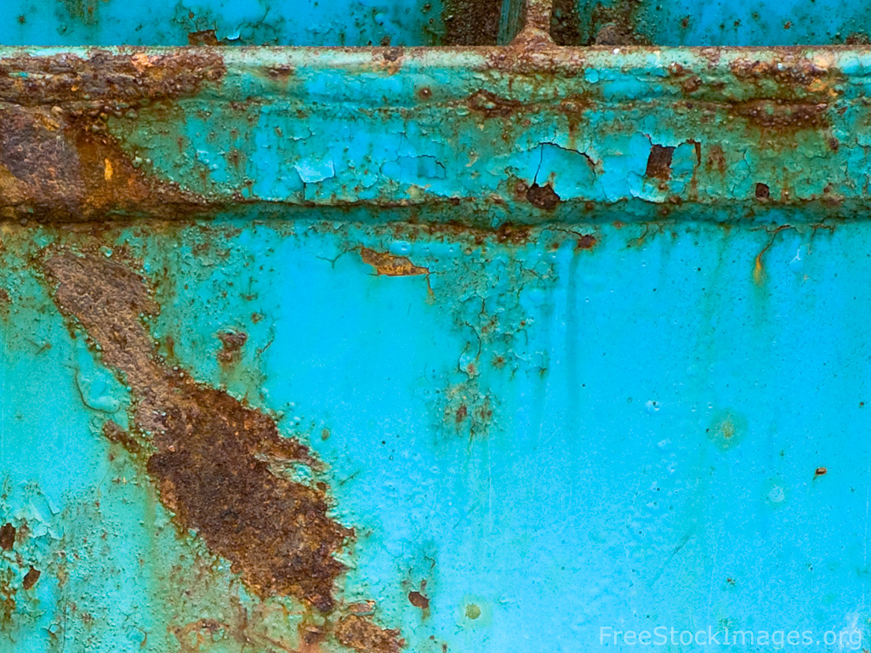
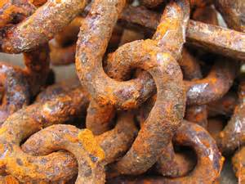
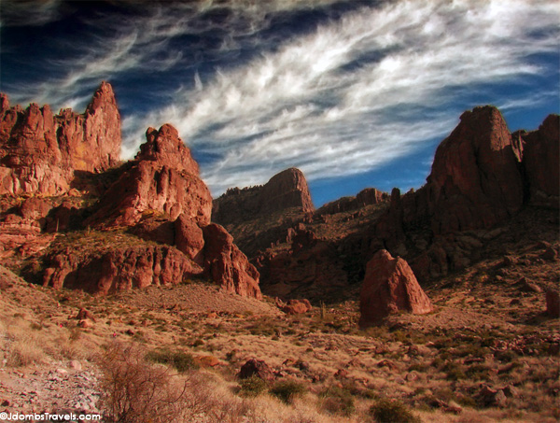
Iron+ oxygen= rust
Process is oxidation

