Slide 1
Opening
Why do we have rules and procedures?

Slide 2
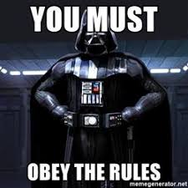

Slide 3
New year / new start

Slide 4
Be On Time...be prepared...
Everyday you will need something to write with, notebook paper, and your IAN.
NEVER leave home without it!

Slide 5
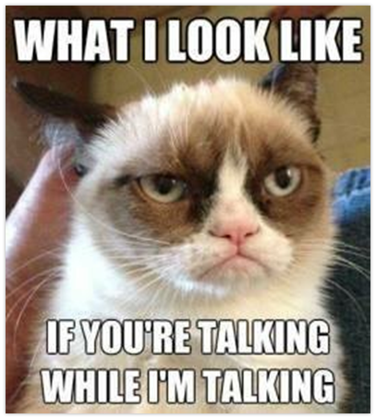
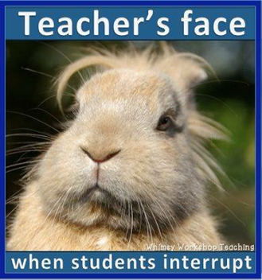
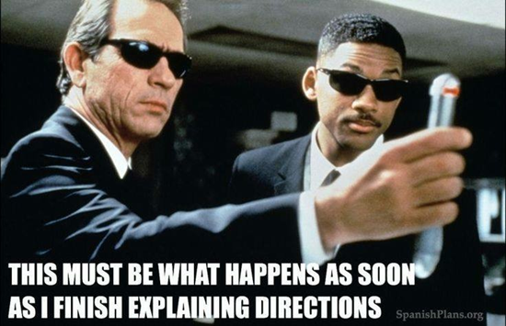
Be Respectful...
Seriously, do I need to explain more?

Slide 6
What does being respectful look like?
Please don’t talk while I am talking. Raise your to be called upon.
Keep hands and feet to yourself.
Listen to instruction the first time it is given.
Please do not argue with teacher.
Be ON TIME – Tardy is late and a distraction!
Opinions and ideas are welcome ☺

Slide 7
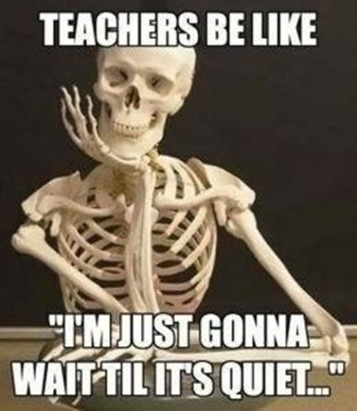
Silence is a virtue...
I will ring the bell and raise my hand and ask you to give me five.
I will count down from 5-1.
By the time I get to 1, I will expect you to be QUIET.

Slide 8
How will I get your attention?
I will ring the bell and raise my hand and ask you to give me five.
I will count down from 5-1.
By the time I get to 1, I will expect you to be QUIET.

Slide 9
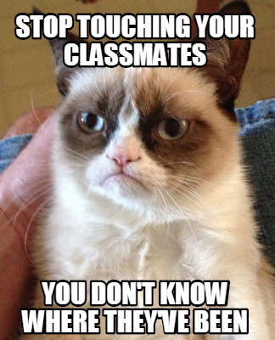
Keep yourself to yourself...

Slide 10
What does being prepared look like?
Come to class with:
IAN – EVERYDAY
Something to write with.
Blank notebook paper
ALL homework and science folder (2 pocket)

Slide 11
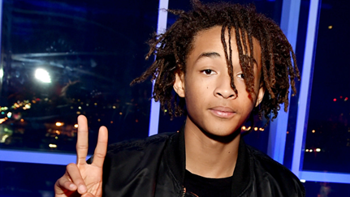
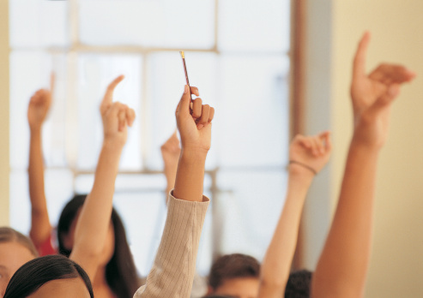
Speak loudly...but silently!...
Two fingers for "I need to use the restroom"
Raise your hand to ask a question
Hand over your nose to ask for a tissue
Raise a pencil to ask to sharpen

Slide 12
What are silent hand signals?
Raise your hand for permission to speak or move around the room.
Raise your pencil to ask to sharpen. Go to sharpener and wait for a break in instruction before you sharpen.
Raise 2 fingers to ask to use the restroom.
Put your hand over your nose to ask for a tissue.

Slide 13
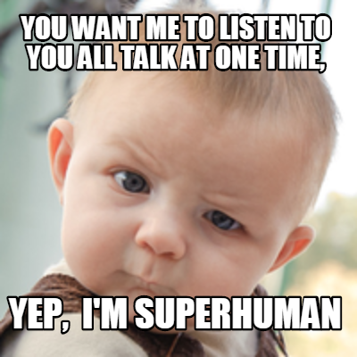
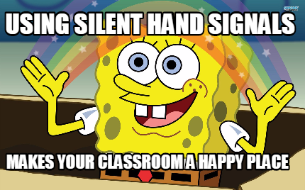
Raise your hand for permission...

Slide 14
Is it ok to get up and walk around the room at any time?

Slide 15
Ms. Brown does NOT do bugs and/or rodents!!!!!!!! No eating or drinking in classroom

Slide 16
I should NOT see and/or hear cell phones

Slide 17
Table Positions
A – Material Retriever: gets materials from class period drawer
B – Paper Collector: quietly collect all papers from table and put in correct color bin
C – Return Materials: collect materials from table, place back in class period drawer
D – Communicator: collaborate with table, speak for table when a question is asked to table.

Slide 18
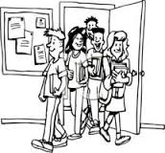
How to enter the classroom
Line up outside the door and stand against walll
When the door is open, come in quietly, get out materials, and begin warm – up
If materials are needed, the Materials Manager will get materials.
If papers need to be collected, the Paper Collector will get papers and turn them in to the correct bin.

Slide 19
Accept responsibility!

Slide 24
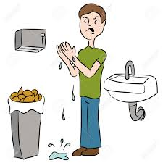
Bathroom expectations
Use your inside voice.
Respect others’ privacy and school property.
Keep your hands, feet and objects to YOURSELF.
Keep phones/electronics and headphones put away( In book bag/locker)
Flush toilet and wash your hands.

Slide 25
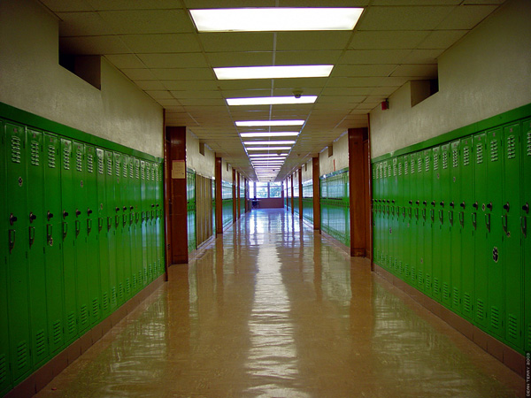
Hallway expectations
Keep your hands, feet and objects to yourself.
Walk on right side of the hallway directly to your destination.
When walking in a LINE, walk single filed 3 squares from the wall.
Keep phones/electronics and headphones put away(In book bag/locker).
SILENT voices during transitions with teacher.
Use inside voice during all transitions.

Slide 26
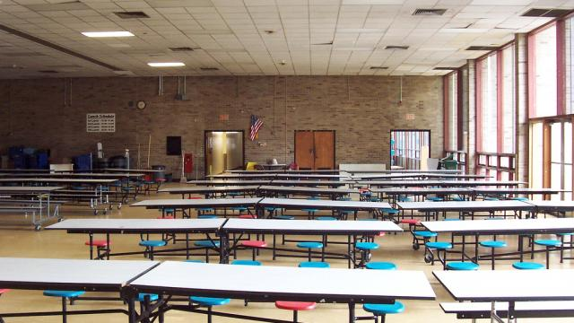
Cafeteria expectations
Use your inside voice only
Keep hands, feet, objects, and food to yourself.
Go to your assigned table / get permission before leaving your seat.
Clean up your area before you leave
You may NOT use your phone during lunch
- No headphone or phone use in the hallway
- No pictures, Snapchat, or texting other students

Slide 27
How to exit the classroom
Stay in seat until dismissed
Collect all personal belongings and take them with you
- All found belongings will be placed in the classroom
‘Lost and Found’
- If not claimed, it will be donated.
Pick up at least 1 piece of trash off the floor.
Quietly exit out EXIT door only

Slide 28
Ring Reward System
Three areas to earn rewards.
Opening (Includes entering the classroom and warm-up) - Orange
Work Session - Green
Behavior - Blue

Slide 29
What you will earn?
1 ring a day – not a very good day, but we all survived ☹
2 rings – minimal redirection but could do better
3 rings – great day ☺

Slide 30
What makes a GREAT day?
Opening: class came in and started warm-up / starter
Work session: class worked productively, minimal off-task behavior, completed / made progress on assignments
Behavior class had minimal
Redirection
Speaking out
Out of seat
Classroom interruptions

Slide 31
What is your reward
15 rings per week will get 10 minutes free time on Friday.
All four classes will compete against each other. The class with the most rings at the end of the semester will earn a pizza party.

Slide 32
Classroom jobs (2 week terms)
Attendance Clerk:
Duty confirm absences with teacher during attendance.
(must be able to communicate well with teacher)
Ring Recorder:
Duty – During closing, record rings and on Friday and document rings earned on class chart.
(must be neat and organized)

Slide 33
Classroom jobs continued…
Paper Distributor:
Duty – When done with warm up, pass out any papers in your periods graded bin.
(must work quickly during warm-up to have time to pass out papers)
Table washer: (3rd period only)
Duty - Wash tables after lunch; must be trustworthy
You will be compensated at the end of the 2 week term

