Slide 1
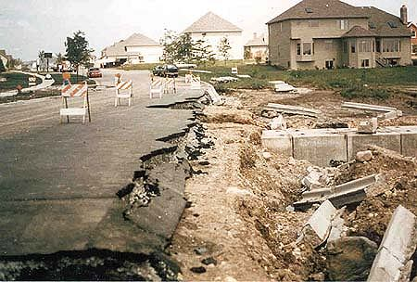
Erosion
The process by which water, ice, wind or gravity MOVES fragments of rock and soil.

Slide 2
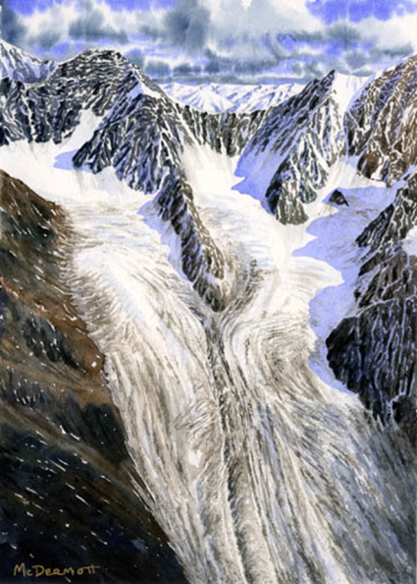
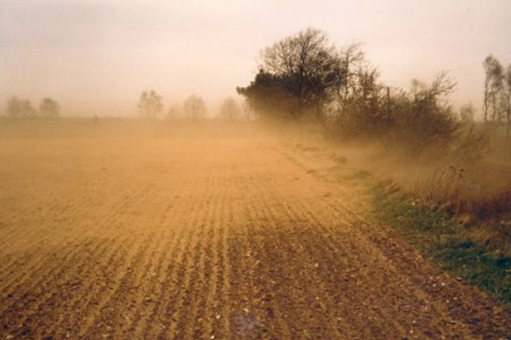
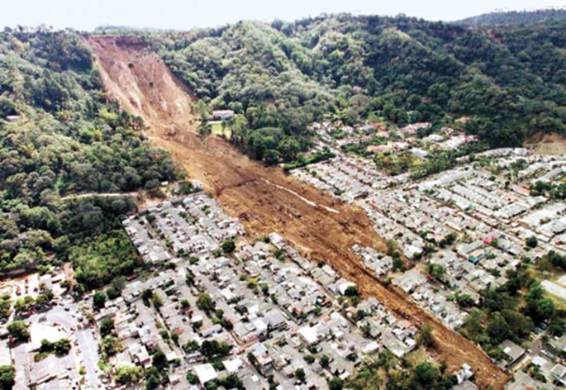
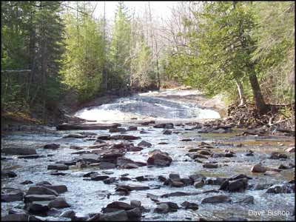
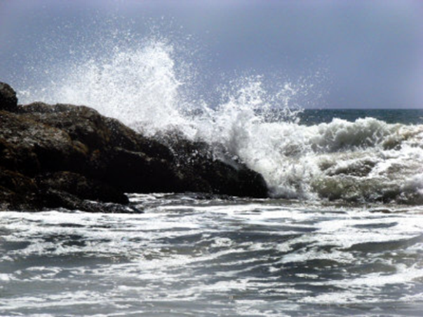
Natural Agents of Erosion
Natural agents of erosion:
Wind
Moving water
Gravity (landslides)
Waves
Glaciers (rivers of ice)

Slide 3
EROSION by (Moving) WATER
Most powerful and causes the most erosion

Slide 4
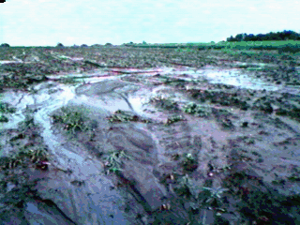
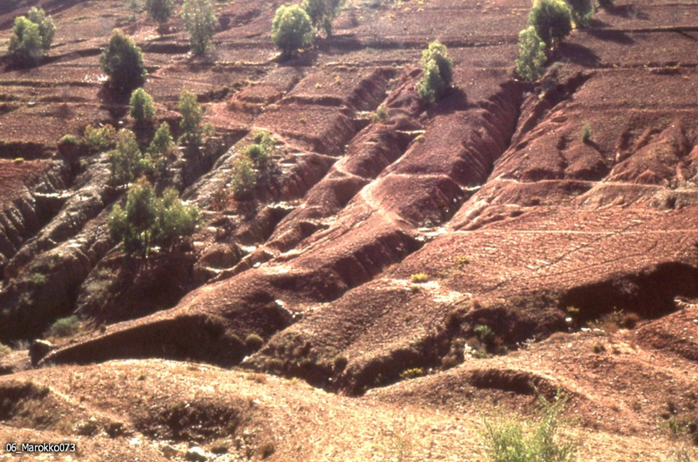
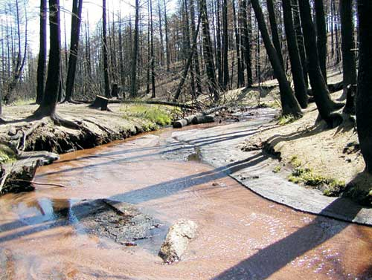
Water Erosion
Rivers, streams, and runoff

Slide 5
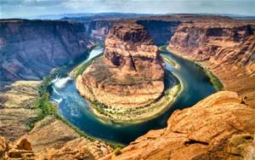
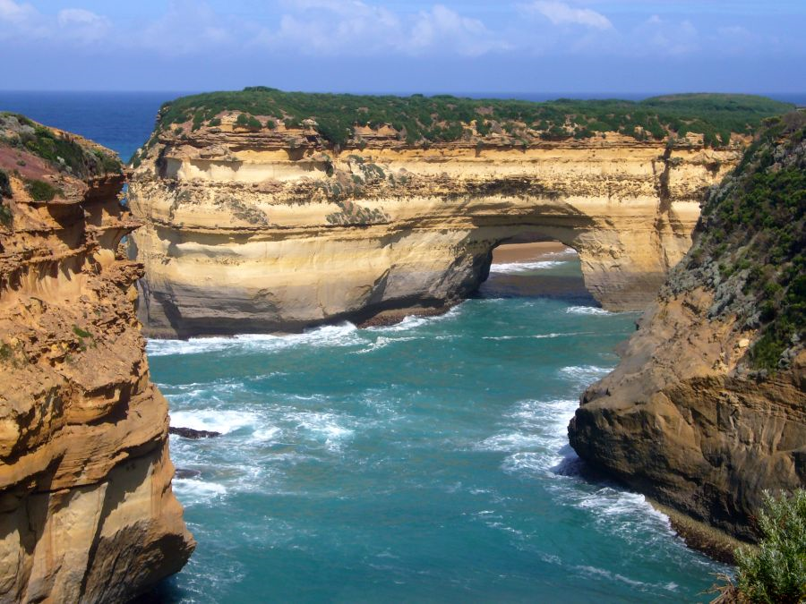
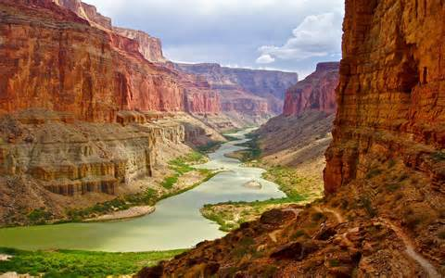
Rivers create canyons (over millions of years)

Slide 6
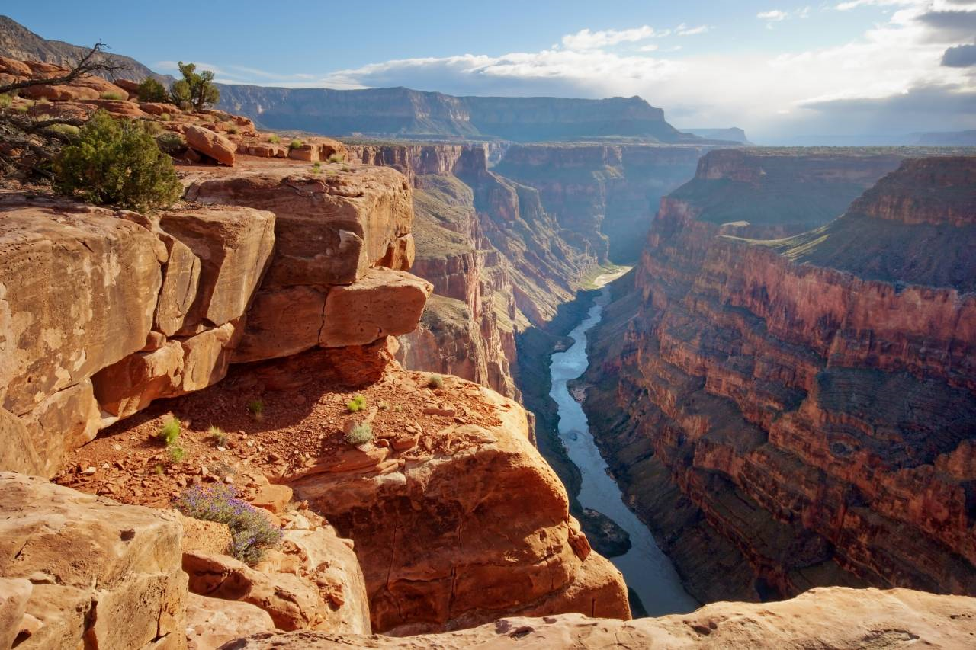

Slide 7
Rivers form V-shaped valleys.
(over 1000s of years)

Slide 8
EROSION by WAVES

Slide 9
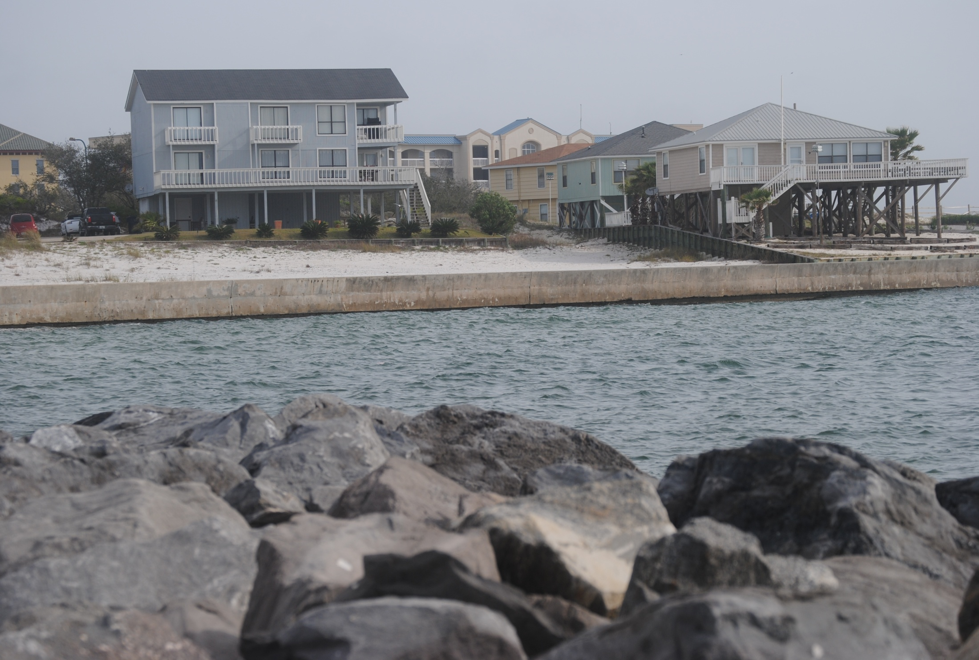

Slide 10
Breaking of waves on a beach can wash away or move sand along the beach.
The larger the waves, the faster is the rate of erosion.

Slide 11
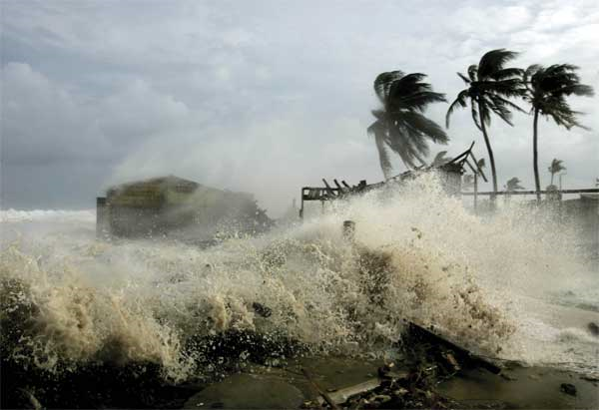
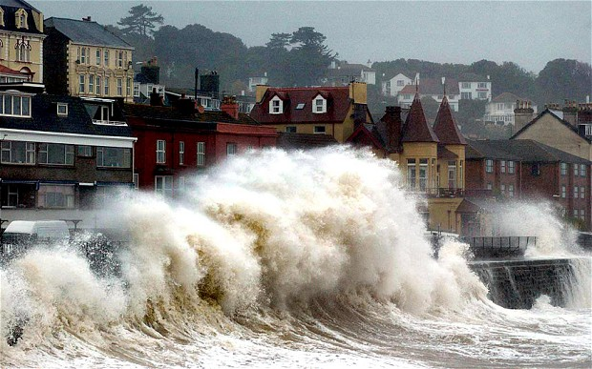
Hurricanes create large waves that erode beaches and cliffs

Slide 12
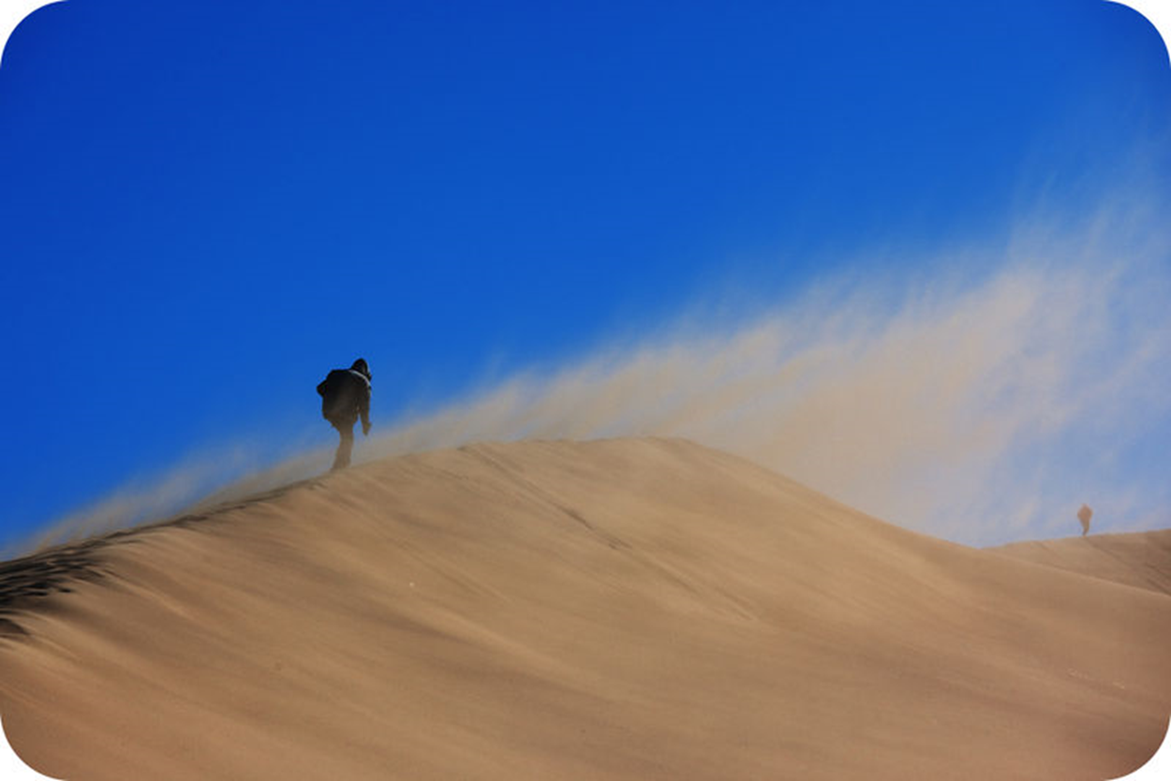
EROSION by WIND Create sand dunes in desert.

Slide 13
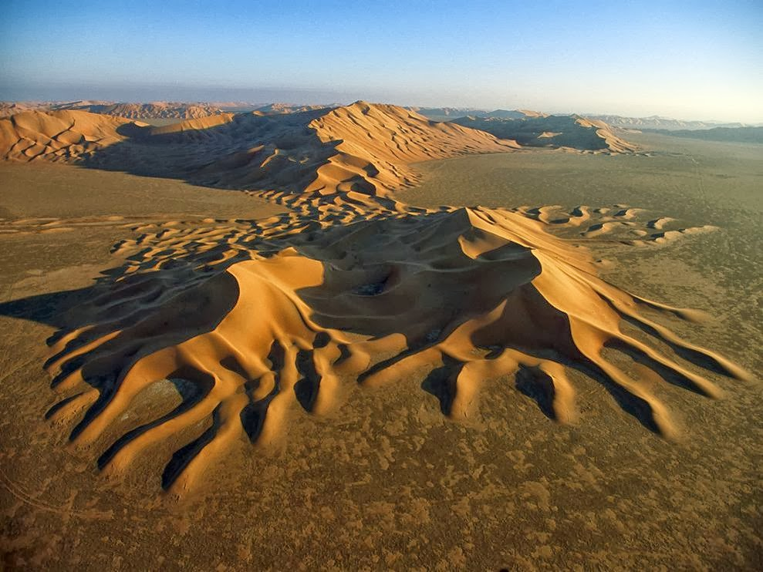
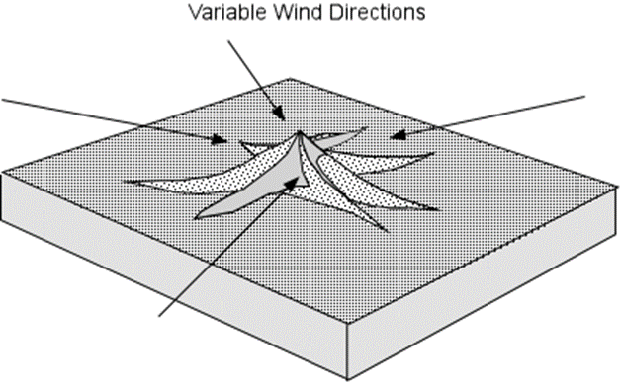
These unique sand dunes are created by wind erosion coming from all sides, and pushing the sand together.
Notes:
team8-2science.blogspot.com

Slide 14
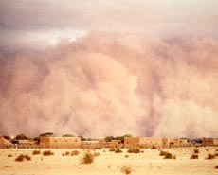
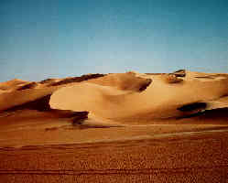
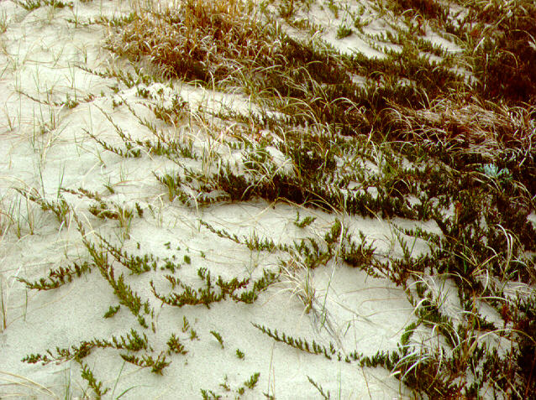
Wind Erosion- -moves sand on beaches and blows lose dirt away.

Slide 15
EROSION by GRAVITY

Slide 16
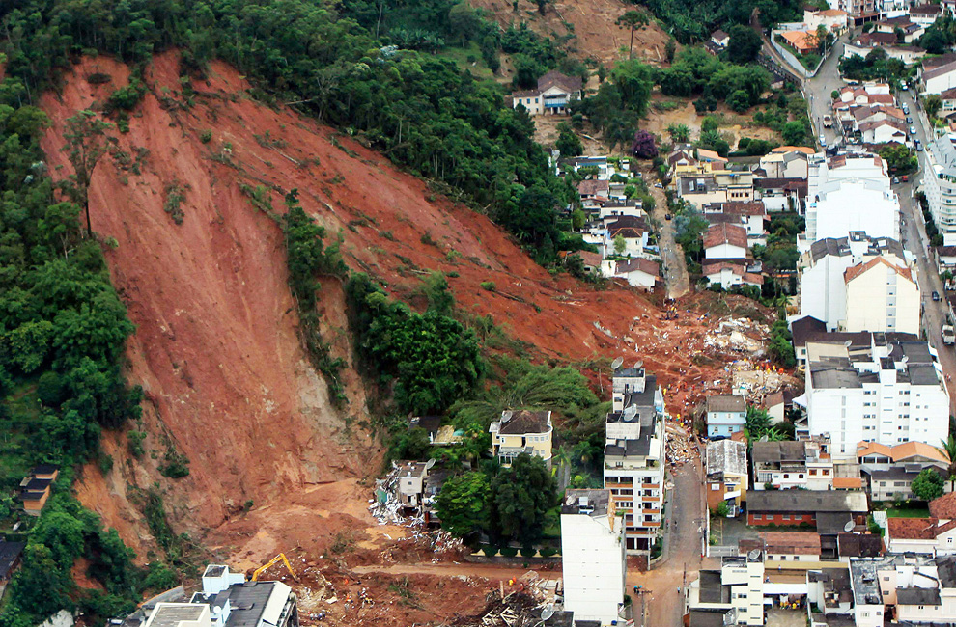
http://www.boston.com/bigpicture/2011/01/landslides_in_brazil.html
Notes:
Landslide in Brazil Jan. 2011

Slide 17
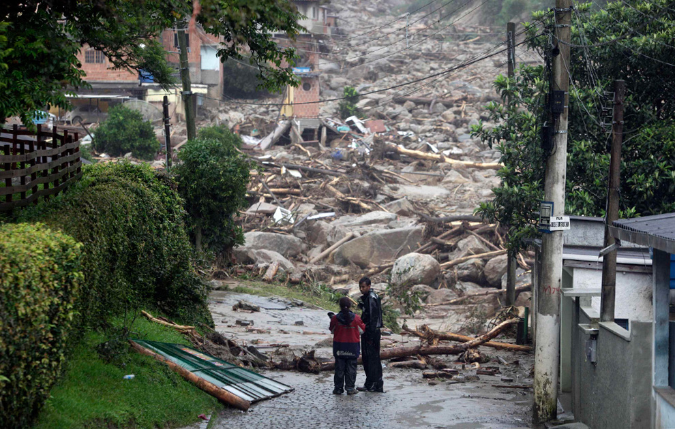
http://www.boston.com/bigpicture/2011/01/landslides_in_brazil.html
Notes:
Landslide in Brazil Jan. 2011

Slide 18
EROSION by ICE (GLACIERS)

Slide 19
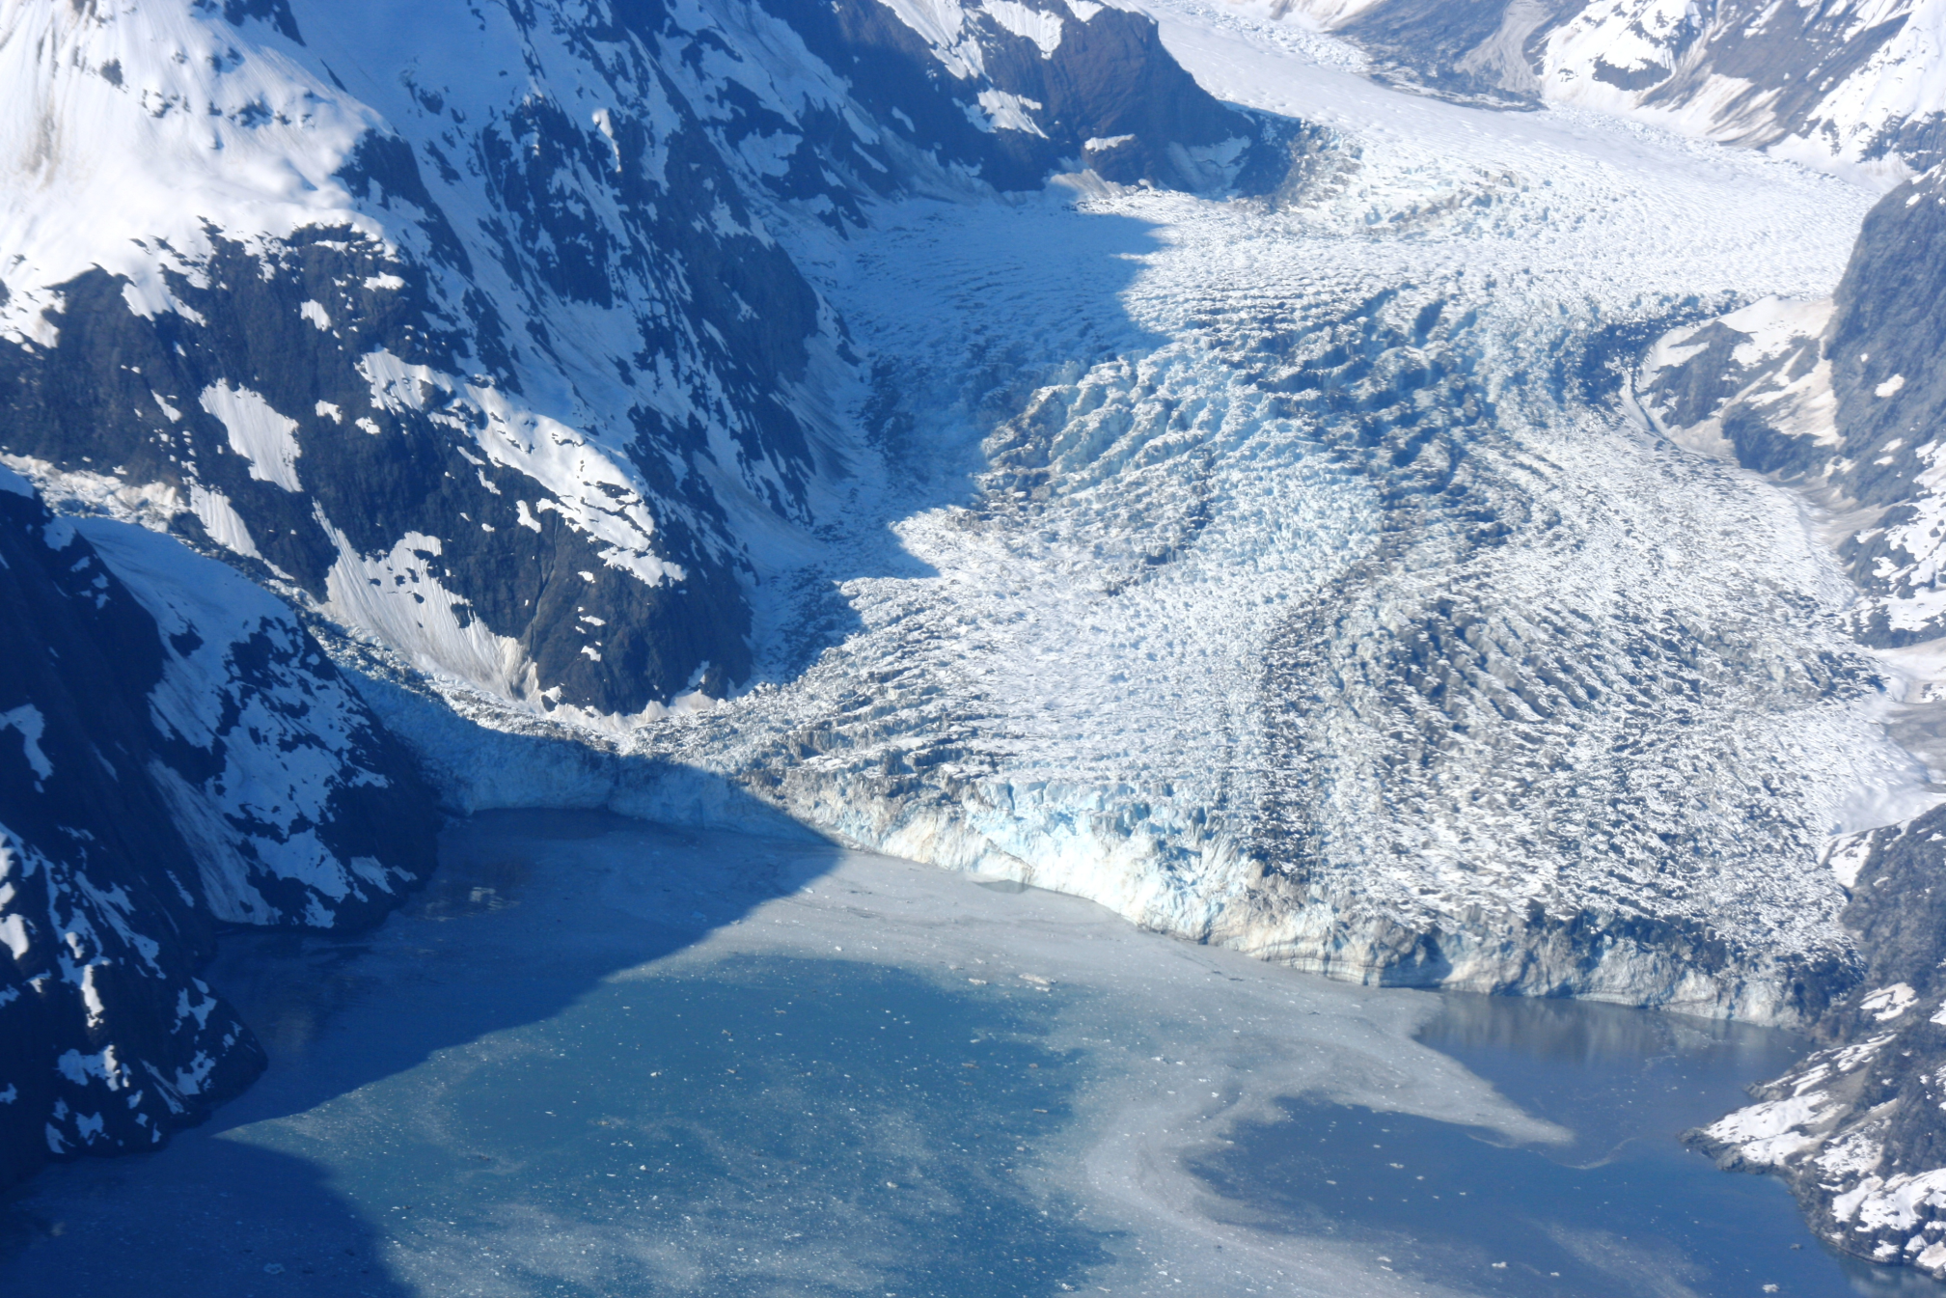
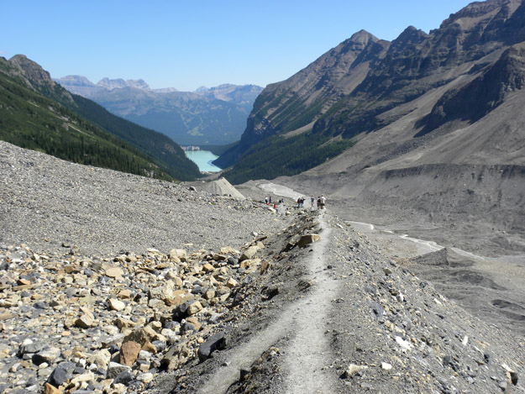
Notes:
nd ...
3888 x 25924095.4KBmichigannature.wordpress.com

Slide 20
Animation of Glacier Moving
http://us.yhs4.search.yahoo.com/yhs/search?hspart=ironsource&hsimp=yhs-fullyhosted_003&type=dsites_14_10_ie&param1=1&param2=sid%3D31839de17939e6a56409d7d8cb1a0c68%26ulng%3Den-US%252Cen%253Bq%253D0.5%26b%3DFirefox%26ip%3D162.224.134.54%26p%3Dmysearchdial%26x%3DB8AC6FC999E12505%26dt%3DS799%26f%3D4%26a%3Ddsites_14_10_ie&p=time+lapse+video+of+glaciers+moving
Called: Awesome Glacier Iceberg Time Lapse ~ Moving, Colliding, Falling, Floating, Melting Ice!
Start at 2:25

Slide 21
create U-shaped valleys

Slide 22
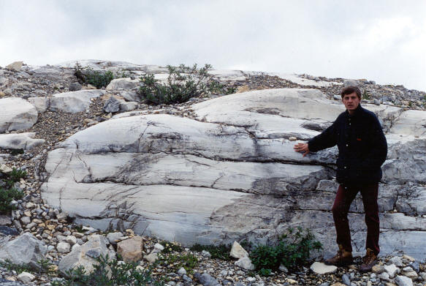
Ice Erosion
Glaciers

Slide 23
Striations: scratches in rock created by glaciers dragging boulders and sediment underneath.
https://www.youtube.com/watch?v=HVZjcOujr4E
Notes:
www.haddens.com.au

