Slide 1
Work Session:
1. Complete this week’s DRAW on igneous rock.
2. Review Questions
3. Begin Igneous Rocks Notes

Slide 2
Closing:
Take a sticky note and write your name at the top. Explain:
Intrusive igneous rock:
Extrusive igneous rock:

Slide 3
Warm Up:
1. How are igneous rocks formed?
2. Intrusive rocks are formed above or below the earth’s surface?
3. Extrusive rocks are formed above or below the earth’s surface?

Slide 4
Warm Up:
Explain:
1. Mafic
2. Felsic

Slide 5
Work Session:
1. Complete Unfinished Work/Conference with Teachers
2. Igneous Rock Vocabulary Activity.
3. Mineral Vocabulary Activity

Slide 6
Closing:
Take a sticky note and write your name at the top. Explain:
Felsic:
Mafic:

Slide 8
Intrusive (large crystals and is coarse-grained)

Slide 10
Extrusive (small or microscopic crystals, fine-grained)

Slide 11
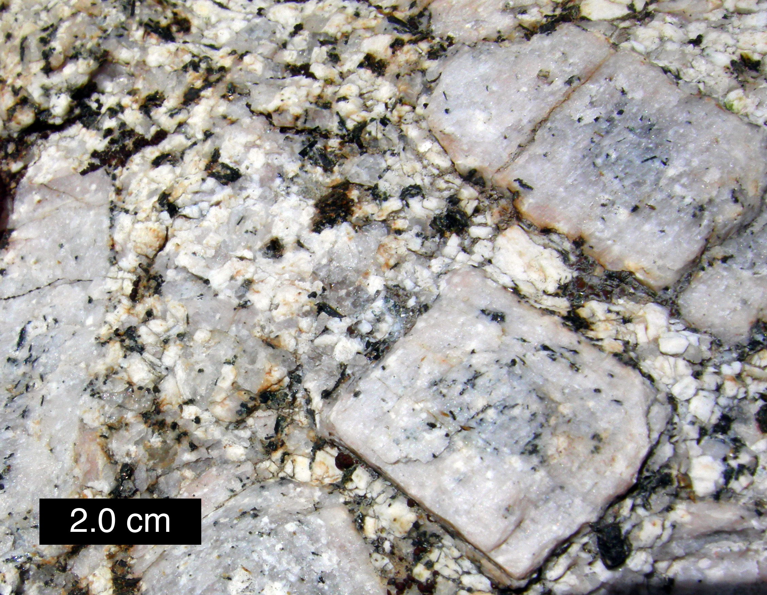

Slide 12
Intrusive (large crystals, coarse-grained)

Slide 14
Extrusive (small or microscopic crystals, fine-grained)

Slide 15
Intrusive: formed when magma cools inside the Earth. Cooling happens slowly so large crystals form (coarse-grained).
Extrusive: formed when lava cools outside the Earth (think exit). Cooling happens quickly so only small-microscopic crystals form (fine-grained).

Slide 16
Work Session:
1. Complete this week’s DRAW on igneous rock.
2. Complete the mineral lab.
3. Complete the mineral acrostic.
4. Rd. pg. 66-69 (quest. 1-4, 6-7) Rd. pg. 70-73 (quest. 1-4, 6-7)

Slide 17
Closing:
Take a sticky note and write your name at the top. Explain:
Intrusive igneous rock:
Extrusive igneous rock:

Slide 18
Warm Up:
1. What is the difference in mafic and felsic?
2. What is the difference between intrusive and extrusive?
3. STUDY for the QUIZ!

Slide 19
Work Session:
1. Igneous Rock Password
2. Quiz
3. Complete the igneous/mineral vocabulary drawings.
4. Complete rd. pg. & questions

Slide 20
Closing:
Take a sticky note and write your name at the top. Explain:
How long did you study?
What questions or concepts were difficult?

Slide 21
Rock Samples
#1- Gabbro
#2- Rhyolite
#3- Pumice
#4 –Obsidian
#5- Basalt
#6- Granite

Slide 22
Warm UP:
1. What are three out of the 5 characteristics of a mineral?
2. What is streak?
3. What is luster?

Slide 23
Warm Up:
1. Intrusive means magma cooled ________ the Earth.
2. Extrusive means lava cooled ________ the Earth.

Slide 24
Igneous rock
Large Crystals
Intrusive rock
Magma
At or near surface
Cools slowly
Inside Earth
Fine Grained
Small Crystals
Extrusive Rock
Cools fast
Lava
Coarse-grained

Slide 25
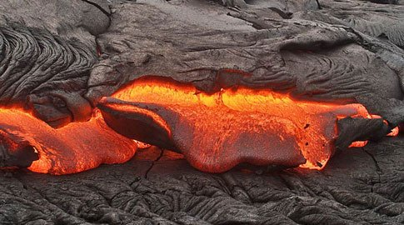
Look how quickly lava begins to cool!
Notes:
http://www.popsci.com/files/imagecache/article_image_large/files/articles/sci0505disaster_485x270.jpg

Slide 26
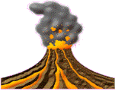
Igneous Rocks
form from the cooling of molten rock (lava and magma).

Slide 27
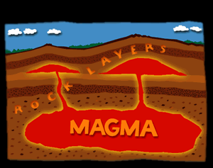
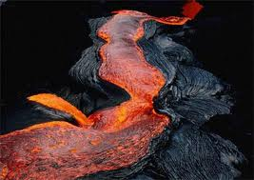
Are lava and magma the same?
MAGMA: molten material found beneath the surface of the earth.
LAVA: molten material found on the surface of the earth.

Slide 28
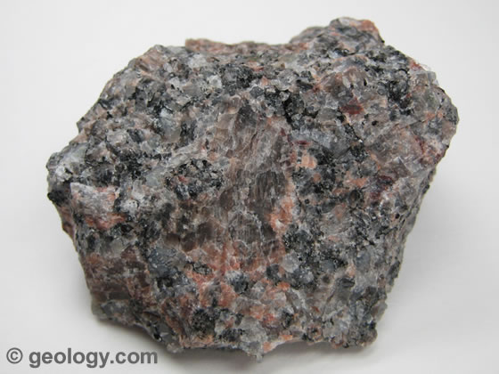
Classified by Formation:
Intrusive Rock is formed when magma hardens beneath Earth’s surface.
Inside the Earth
(Granite)

Slide 29
Igneous Rocks
Intrusive Igneous Rocks: magma pushes into surrounding rock below the Earth’s surface, and cools slowly.
http://www.windows.ucar.edu/tour/link=/earth/geology/ig_intrusive.html&edu=high&fr=t

Slide 30
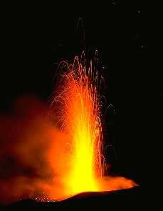
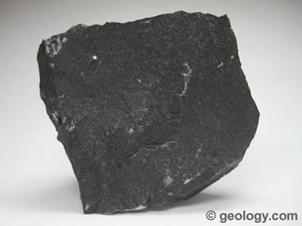
Classified by Formation:
Extrusive Rock is formed from lava erupted onto Earth’s surface, then cools and hardens. Exits the Earth
(Basalt)

Slide 31
Igneous Rocks
Extrusive Rocks: forms when magma erupts onto the Earth’s surface (lava), cools quickly with very small or no crystals formed
http://www.windows.ucar.edu/tour/link=/earth/geology/ig_intrusive.html&edu=high&fr=t

Slide 32
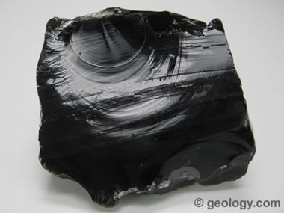
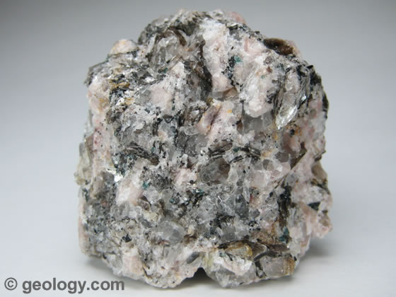
Classified by Texture:
Fast Cooling Lava (Extrusive)
Fine-Grained, small crystals, smooth
Slow Cooling Magma (Intrusive)
Coarse-Grained, large crystals, rough

Slide 33
Intrusive Igneous Rocks
Coarse-grained: takes longer to cool, giving mineral crystals more time to grow

Slide 34
Extrusive Igneous Rocks
Fine-grained: cools quickly with tiny crystals or no crystals

Slide 35
Igneous Rocks
Mafic: dark colored rocks that are rich in calcium, iron, and magnesium, poor in silicon
Felsic: light colored rocks that are rich in elements such as aluminum, potassium, silicon, and sodium
Glassy: smooth, shiny surface. No visible grains.

Slide 36
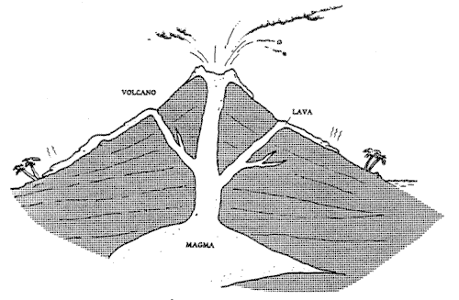
Label the blanks as magma or lava.

Slide 37
Label the blanks as magma or lava.
Lava
Lava
Magma

Slide 38
Label where intrusive and extrusive igneous rock form.

Slide 39
Label where the 2 major types of igneous rock form.
Extrusive
Extrusive
Intrusive

Slide 40
How do igneous rocks form?
Igneous rocks are classified according to their origin, texture, and mineral composition.
Igneous rocks form either from lava, above the earth’s surface or magma, below the earth’s surface.
They also differ in texture according to the size and shape of their mineral grains. (course-grained or fine-grained)
Igneous rocks differ in mineral composition depending on how much silica and other minerals are present. (felsic or mafic)

Slide 41
How do igneous rocks form?
Dark igneous rocks form from magma or lava low in silica content (mafic).
Light igneous rocks form from magma high in silica content (felsic).
Light-colored rocks are less dense than the dark-colored rocks.

Slide 42
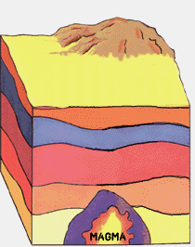
Igneous Rocks
Igneous rock begins as magma.
Magma freezes between
700 °C and 1,250 °C
Magma is a mixture of
many minerals
http://www.fi.edu/fellows/payton/rocks/create/igneous.htm

Slide 43
QUIZ YOURSELF!
http://www.fi.edu/fellows/payton/rocks/create/igneous.htm

Slide 44
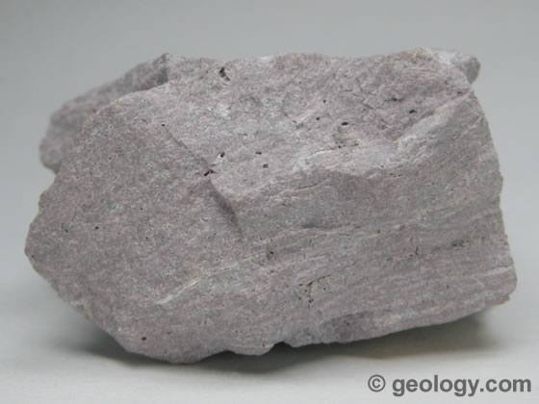
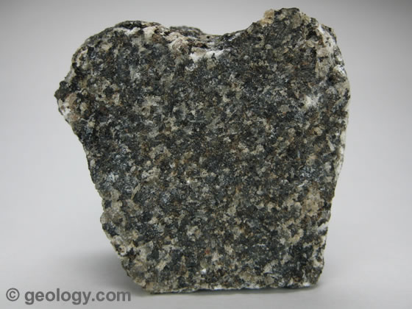
Igneous Rocks
Granite
Rhyolite
Gabbro
Basalt

Slide 45
Igneous Rocks
Coarse-Grained
Fine-Grained
Felsic
Granite
Rhyolite
Mafic
Gabbro
Basalt

Slide 46
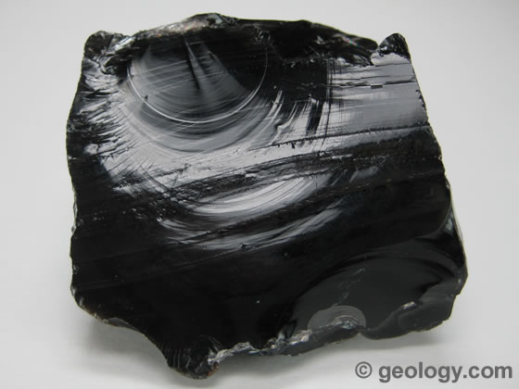
Igneous Rocks
Obsidian
What is Obsidian?
Obsidian is a dark-colored volcanic glass that forms from the very rapid cooling of molten rock material. It cools so rapidly that crystals do not form.
Obsidian is a dark-colored volcanic glass that forms from the very rapid cooling of molten rock material. It cools so rapidly that crystals do not form.
Is this rock Felsic or Mafic?
Is it fine-grained or coarse-grained?
Is this rock Intrusive or Extrusive?
Mafic, fine grained, extrusive

Slide 47
Igneous Rocks
Obsidian
What is Obsidian?
Obsidian is a dark-colored volcanic glass that forms from the very rapid cooling of molten rock material. It cools so rapidly that crystals do not form.
Obsidian is a dark-colored volcanic glass that forms from the very rapid cooling of molten rock material. It cools so rapidly that crystals do not form.
mafic
No-grain (glassy)
Extrusive
Mafic, fine grained, extrusive

Slide 48
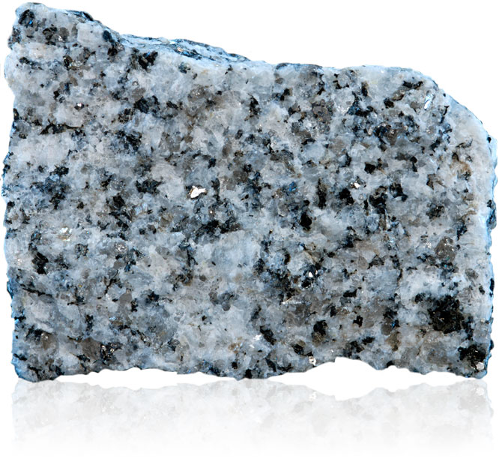
Igneous Rocks: Granite Rock
Granite forms underground when magma cools slowly. The mineral crystals have time to grow, which is why you see individual colors of crystals
Composition?
Texture?
Type?
Mafic, fine grained, extrusive

Slide 49
Igneous Rocks: Granite Rock
Granite forms underground when magma cools slowly. The mineral crystals have time to grow, which is why you see individual colors of crystals
Felsic
coarse-grained
Intrusive
Mafic, fine grained, extrusive

Slide 50
1’s An intrusive igneous rock would have what type of texture? Why?

Slide 51
1’s An intrusive igneous rock would have what type of texture? Why?
Coarse-Grained, large crystals. Smooth & rough.
It is hotter in the earth than on the outside of the earth so it takes longer for magma to cool down.

Slide 52
2’s An extrusive igneous rock would have what type of texture? Why?

Slide 53
2’s An extrusive igneous rock would have what type of texture? Why?
Fine-Grained or glassy texture
It is cooler on the surface of the Earth so the rocks can cool faster.

Slide 54
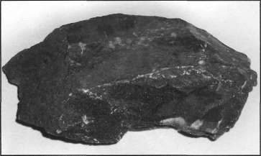
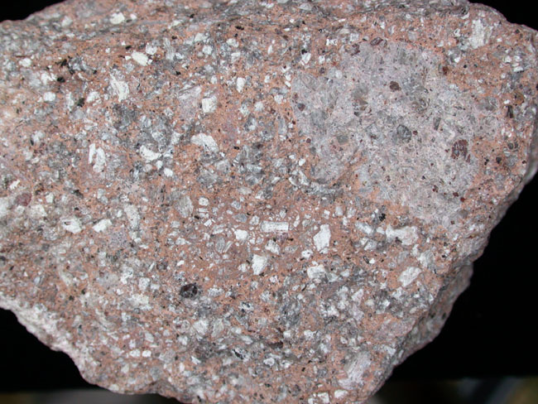
Classified by Mineral Composition:
Mafic describes dark colored rocks because of low silica (basalt, peridotite)
Felsic describes light colored rocks because of high silica (granite, rhyolite )

Slide 55
Intrusive Rock vs. Extrusive Rock
 | Intrusive Rock | Extrusive Rock
Where it formed
Cool fast or slow?
Texture
Grain Size
Composition
Examples

Slide 56
Intrusive Rock vs. Extrusive Rock
 | Intrusive Rock | Extrusive Rock
Where it formed | Below ground | Above ground
Cool fast or slow? | Cool slow | Cool fast
Texture | Coarse-grain | Fine-Grain
Grain Size | Large grain | Small grain
Composition | Felsic | Mafic
Examples | Granite | Obsidian

Slide 57
Mineral Composition Igneous Rocks
Granite is made of:
Feldspar, Mica, Quartz, Horneblende (dark)
Rhyolite is made of:
Feldspar, Mica, Quartz, Horneblende
Obsidian is made of:
Quartz, Iron, Magnesium

