Slide 1


Safety and Rules of the Lab
Notes:
http://www.rockwoodwaterandgas.com/sitebuildercontent/sitebuilderpictures/.pond/SAFETY.jpg.w300h388.jpg
http://images.google.com/imgres?imgurl=http://68.90.81.6/ScienceTAKS/Integration/Science%2520TAKS%2520Objective%25201/safety4.jpg&imgrefurl=http://68.90.81.6/ScienceTAKS/Integration/Science%2520TAKS%2520Objective%25201/safetysymbols.htm&h=95&w=93&sz=3&hl=en&start=32&um=1&tbnid=AOIrcMWCY6-NPM:&tbnh=80&tbnw=78&prev=/images%3Fq%3DLab%2BSafety%2BSymbols%26start%3D20%26ndsp%3D20%26svnum%3D10%26um%3D1%26hl%3Den%26rls%3DGGLB,GGLB:1969-53,GGLB:en%26sa%3DN

Slide 2


Safety Symbols
Know safety symbols
They appear in your laboratory activities
They will alert you
to possible dangers
They will remind you to work carefully
Notes:
http://images.google.com/imgres?imgurl=http://www.utpb.edu/utpb_adm/BusinessAffairs/OfficeOfEHS/images/safety_main.jpg&imgrefurl=http://www.utpb.edu/utpb_adm/BusinessAffairs/OfficeOfEHS/index_frame.htm&h=360&w=358&sz=49&tbnid=M4hbjYJ8bTeETM:&tbnh=121&tbnw=120&prev=/images%3Fq%3Dsafety%2Bimages%26um%3D1&start=1&sa=X&oi=images&ct=image&cd=1

Slide 3
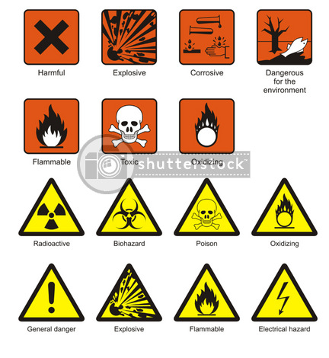
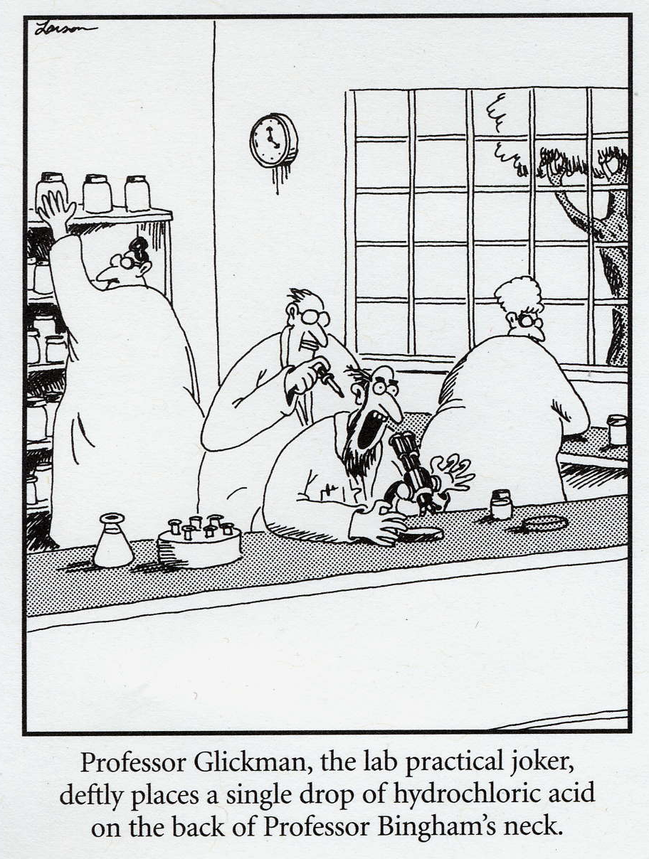

Use Your Head
Exercise Caution and Good Judgment
Follow all instructions given by the teacher
Notify the teacher immediately regarding any accident or unsafe areas

Slide 4
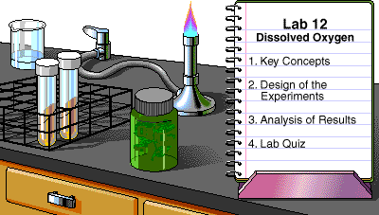
Follow Directions
Read lab instructions ahead of time
Always follow lab procedures exactly
Never do an unauthorized experiment

Slide 5


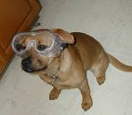
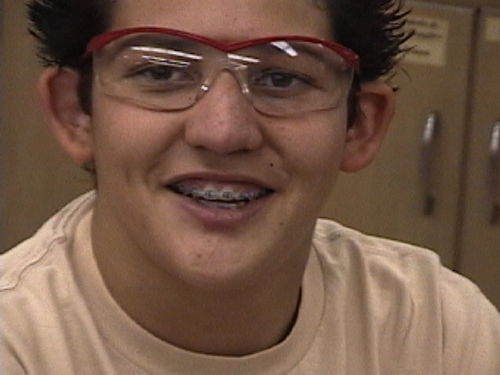
Eye Safety
Wear safety goggles when working with chemicals, flames, heating devices, or of possibility of flying debris
If you wear contact lenses let your teacher know
Notes:
http://images.google.com/imgres?imgurl=http://www.morrisonlabs.com/images/lab%2520safety/labkidsmistakes.jpg&imgrefurl=http://www.morrisonlabs.com/lab_safety.htm&h=319&w=600&sz=32&hl=en&start=101&um=1&tbnid=ijK8pYVbZiTVaM:&tbnh=72&tbnw=135&prev=/images%3Fq%3Dlab%2Bsafety%2Bimages%26start%3D100%26ndsp%3D20%26svnum%3D10%26um%3D1%26hl%3Den%26rls%3DGGLB,GGLB:1969-53,GGLB:en%26sa%3DN

Slide 6


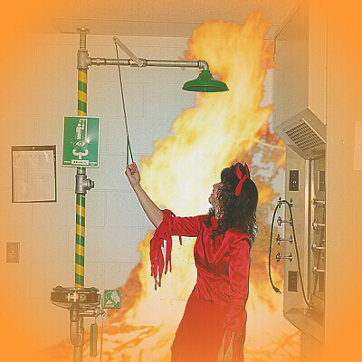
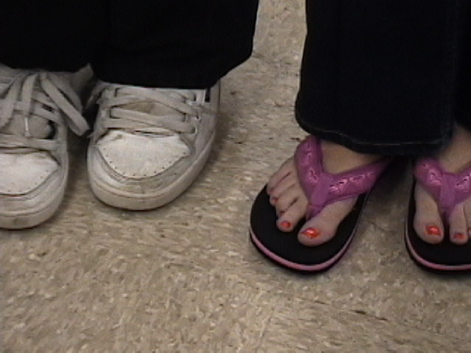
Proper Attire
Keep all long hair
tied back
Do not wear loose clothing that could catch on fire
Foot wear that completely covers the foot is required
Notes:
http://images.google.com/imgres?imgurl=http://sme.clc.uc.edu/labsafety/Amy%2520%26%2520Shower.JPG&imgrefurl=http://sme.clc.uc.edu/labsafety/index.htm&h=400&w=400&sz=166&hl=en&start=41&um=1&tbnid=kaMEXKY4mzKodM:&tbnh=124&tbnw=124&prev=/images%3Fq%3Dlab%2Bsafety%2Bimages%26start%3D40%26ndsp%3D20%26svnum%3D10%26um%3D1%26hl%3Den%26rls%3DGGLB,GGLB:1969-53,GGLB:en%26sa%3DN
http://images.google.com/imgres?imgurl=http://www.morrisonlabs.com/images/lab%2520safety/labkidsmistakes.jpg&imgrefurl=http://www.morrisonlabs.com/lab_safety.htm&h=319&w=600&sz=32&hl=en&start=101&um=1&tbnid=ijK8pYVbZiTVaM:&tbnh=72&tbnw=135&prev=/images%3Fq%3Dlab%2Bsafety%2Bimages%26start%3D100%26ndsp%3D20%26svnum%3D10%26um%3D1%26hl%3Den%26rls%3DGGLB,GGLB:1969-53,GGLB:en%26sa%3DN

Slide 7


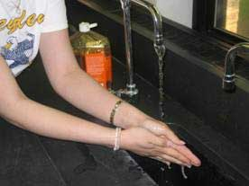

Hand Safety
If a chemical spills on your skin, notify the teacher and rinse with water for 15 minutes
Wash hands after every lab
Handle glassware, sharp tools and heated containers carefully
Notes:
http://images.google.com/imgres?imgurl=http://68.90.81.6/ScienceTAKS/Integration/Science%2520TAKS%2520Objective%25201/safety4.jpg&imgrefurl=http://68.90.81.6/ScienceTAKS/Integration/Science%2520TAKS%2520Objective%25201/safetysymbols.htm&h=95&w=93&sz=3&hl=en&start=32&um=1&tbnid=AOIrcMWCY6-NPM:&tbnh=80&tbnw=78&prev=/images%3Fq%3DLab%2BSafety%2BSymbols%26start%3D20%26ndsp%3D20%26svnum%3D10%26um%3D1%26hl%3Den%26rls%3DGGLB,GGLB:1969-53,GGLB:en%26sa%3DN

Slide 8
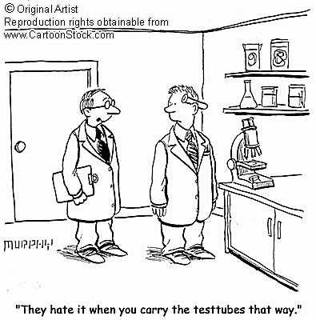
Protect Yourself
Hand Safety
Notes:
http://images.google.com/imgres?imgurl=http://www.cartoonstock.com/newscartoons/cartoonists/mfl/lowres/mfln160l.jpg&imgrefurl=http://www.cartoonstock.com/directory/s/science_lab.asp&h=400&w=370&sz=27&hl=en&start=2&um=1&tbnid=XdURqFQR7vf2GM:&tbnh=124&tbnw=115&prev=/images%3Fq%3Dscience%2Blab%2Bsafety%2Bicons%26svnum%3D10%26um%3D1%26hl%3Den%26rls%3DGGLB,GGLB:1969-53,GGLB:en%26sa%3DG

Slide 9


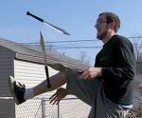
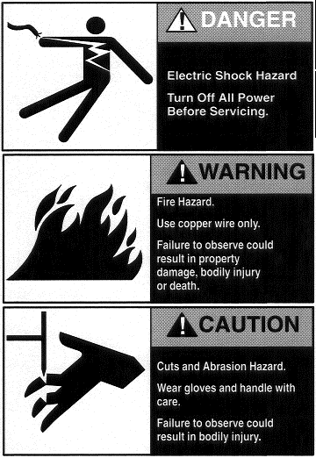
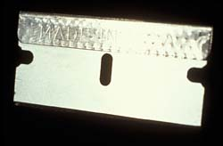
Sharp Objects
 | • When using knifes or other sharp objects always walk with the points
Always cut away from fingers and body
Always carry sharp objects
with points and tips facing
down and away
Never try to catch falling
sharp instruments
Grasp sharp instruments
only by the handles
Notes:
http://images.google.com/imgres?imgurl=http://68.90.81.6/ScienceTAKS/Integration/Science%2520TAKS%2520Objective%25201/safety4.jpg&imgrefurl=http://68.90.81.6/ScienceTAKS/Integration/Science%2520TAKS%2520Objective%25201/safetysymbols.htm&h=95&w=93&sz=3&hl=en&start=32&um=1&tbnid=AOIrcMWCY6-NPM:&tbnh=80&tbnw=78&prev=/images%3Fq%3DLab%2BSafety%2BSymbols%26start%3D20%26ndsp%3D20%26svnum%3D10%26um%3D1%26hl%3Den%26rls%3DGGLB,GGLB:1969-53,GGLB:en%26sa%3DN

Slide 10
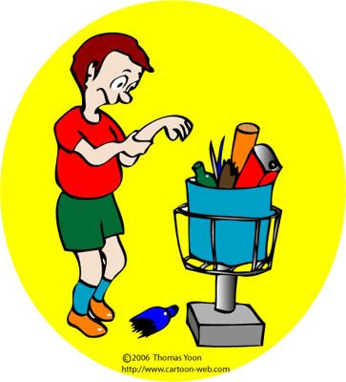
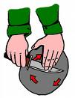
Sharp Objects
 | • When using knifes or other sharp objects always walk with the points
 | • When using knifes or other sharp objects always walk with the points
Notify teacher if you get cut
Broken glass and sharp objects do not go in trash cans
Teacher will clean up
broken glass
Notes:
http://images.google.com/imgres?imgurl=http://68.90.81.6/ScienceTAKS/Integration/Science%2520TAKS%2520Objective%25201/safety4.jpg&imgrefurl=http://68.90.81.6/ScienceTAKS/Integration/Science%2520TAKS%2520Objective%25201/safetysymbols.htm&h=95&w=93&sz=3&hl=en&start=32&um=1&tbnid=AOIrcMWCY6-NPM:&tbnh=80&tbnw=78&prev=/images%3Fq%3DLab%2BSafety%2BSymbols%26start%3D20%26ndsp%3D20%26svnum%3D10%26um%3D1%26hl%3Den%26rls%3DGGLB,GGLB:1969-53,GGLB:en%26sa%3DN

Slide 11

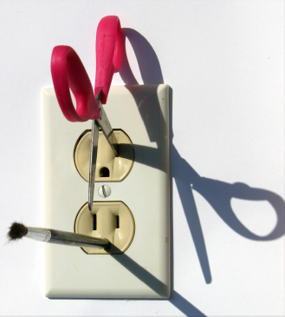
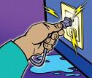

Electrical Safety
Only electrical plugs are to be placed into an electrical outlet
Unplug electrical equipment after use
Keep all electrical cords, wires, and appliances
away from
water
Notes:
http://images.google.com/imgres?imgurl=http://68.90.81.6/ScienceTAKS/Integration/Science%2520TAKS%2520Objective%25201/safety4.jpg&imgrefurl=http://68.90.81.6/ScienceTAKS/Integration/Science%2520TAKS%2520Objective%25201/safetysymbols.htm&h=95&w=93&sz=3&hl=en&start=32&um=1&tbnid=AOIrcMWCY6-NPM:&tbnh=80&tbnw=78&prev=/images%3Fq%3DLab%2BSafety%2BSymbols%26start%3D20%26ndsp%3D20%26svnum%3D10%26um%3D1%26hl%3Den%26rls%3DGGLB,GGLB:1969-53,GGLB:en%26sa%3DN

Slide 12
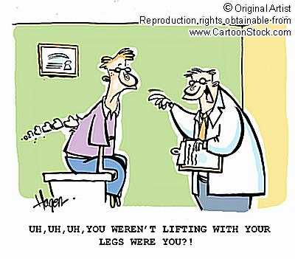
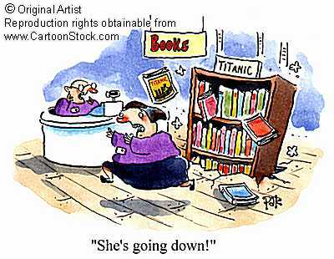

Physical Safety
Handle all equipment carefully
Do not place a cord where
someone can trip over it
Push all chairs in and out of the
way
Keep books picked up out
of walking isles
Notes:
http://images.google.com/imgres?imgurl=http://68.90.81.6/ScienceTAKS/Integration/Science%2520TAKS%2520Objective%25201/safety4.jpg&imgrefurl=http://68.90.81.6/ScienceTAKS/Integration/Science%2520TAKS%2520Objective%25201/safetysymbols.htm&h=95&w=93&sz=3&hl=en&start=32&um=1&tbnid=AOIrcMWCY6-NPM:&tbnh=80&tbnw=78&prev=/images%3Fq%3DLab%2BSafety%2BSymbols%26start%3D20%26ndsp%3D20%26svnum%3D10%26um%3D1%26hl%3Den%26rls%3DGGLB,GGLB:1969-53,GGLB:en%26sa%3DN
http://www.cartoonstock.com/newscartoons/cartoonists/rha/lowres/rhan190l.jpg

Slide 13
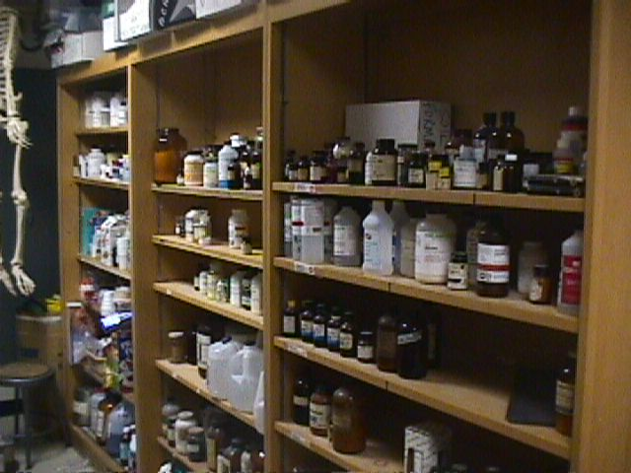
You Should Never…
Enter store room unless given permission
Take any chemicals from lab or store room
Touch any equipment, chemicals, or other materials until instructed to do so

Slide 14


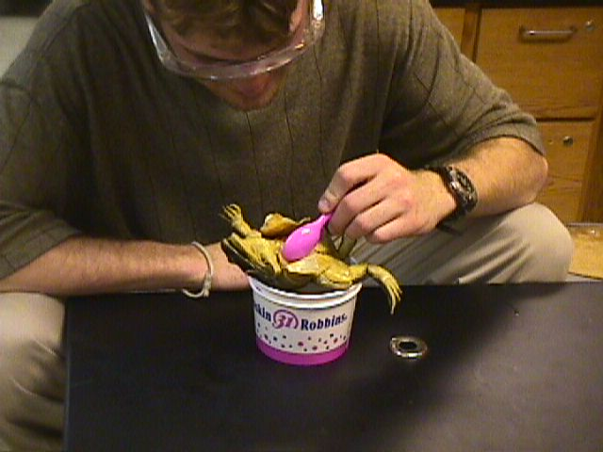
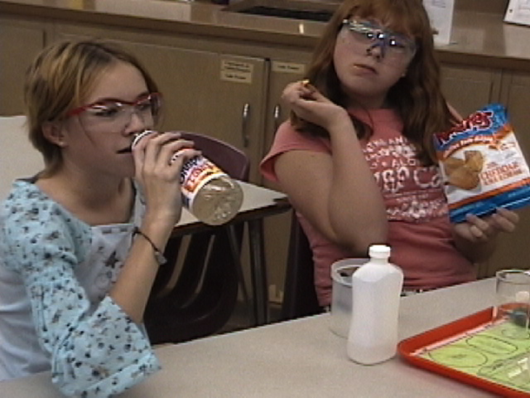
You Should Never…
Eat or drink in the lab
Use lab glassware to eat or drink out of
Notes:
http://images.google.com/imgres?imgurl=http://68.90.81.6/ScienceTAKS/Integration/Science%2520TAKS%2520Objective%25201/safety4.jpg&imgrefurl=http://68.90.81.6/ScienceTAKS/Integration/Science%2520TAKS%2520Objective%25201/safetysymbols.htm&h=95&w=93&sz=3&hl=en&start=32&um=1&tbnid=AOIrcMWCY6-NPM:&tbnh=80&tbnw=78&prev=/images%3Fq%3DLab%2BSafety%2BSymbols%26start%3D20%26ndsp%3D20%26svnum%3D10%26um%3D1%26hl%3Den%26rls%3DGGLB,GGLB:1969-53,GGLB:en%26sa%3DN

Slide 15
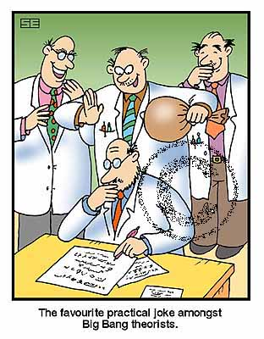
You Should Never…
Engage in….
  practical jokes
  horse play
  rough house
  Smell chemicals (waft don’t whiff)
Notes:
http://www.cartoonstock.com/lowres/sea0209l.jpg

Slide 16


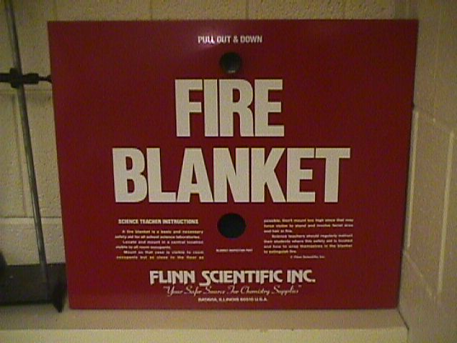


In case of an emergency…
Know the locations of:
  fire extinguisher
  fire blanket
  body shower
  eyewash
  station
  first aid kit
If you spill a harmful chemical on yourself or in your eyes, start rinsing immediately and send your partner to get teacher’s help

Slide 17

Remember to…
Stay at your work station
Maintain a clean work area
Read and follow all directions
Report any spills, accidents,
or injury to the teacher immediately
Clean and put away all equipment at the end of the
lab period
Dispose of waste products according to instruction

Slide 18
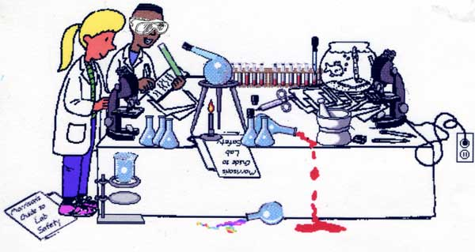

So Do It Right!
Notes:
http://www.blinn.edu/brazos/natscience/lab/man.gif
http://images.google.com/imgres?imgurl=http://www.morrisonlabs.com/images/lab%2520safety/labkidsmistakes.jpg&imgrefurl=http://www.morrisonlabs.com/lab_safety.htm&h=319&w=600&sz=32&hl=en&start=101&um=1&tbnid=ijK8pYVbZiTVaM:&tbnh=72&tbnw=135&prev=/images%3Fq%3Dlab%2Bsafety%2Bimages%26start%3D100%26ndsp%3D20%26svnum%3D10%26um%3D1%26hl%3Den%26rls%3DGGLB,GGLB:1969-53,GGLB:en%26sa%3DN

