Slide 1
Chemical
Weathering
Mechanical
Weathering
or
Look at each picture and decide if it is an example or chemical weathering or mechanical weathering
Ch
Chemical
Use white board:
And write
M
Mechanical

Slide 2
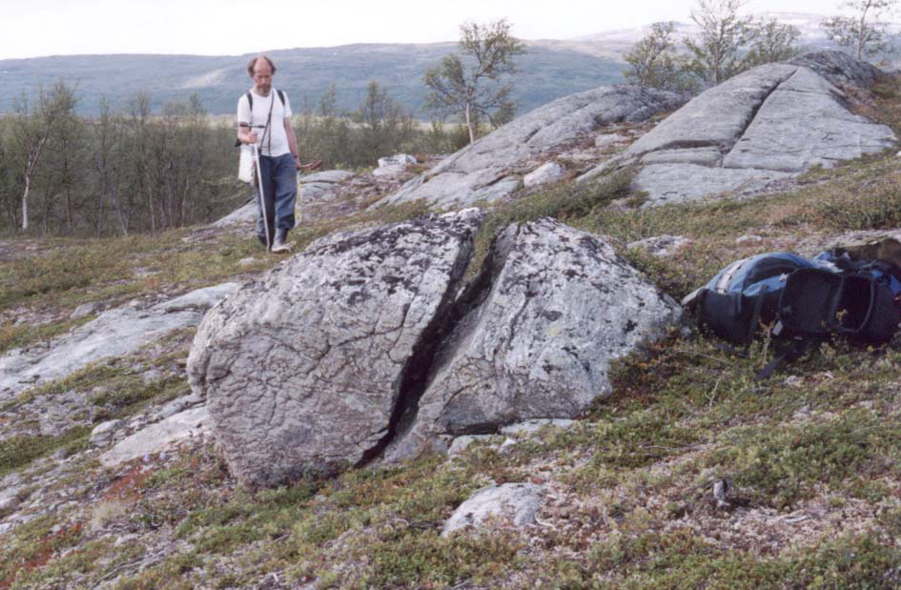
Chemical
Weathering
Mechanical
Weathering
or
Ice Wedging

Slide 3
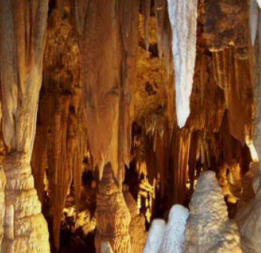
Chemical
Weathering
Mechanical
Weathering
or
Stalactites
Stalagmites
The rocks have changed to
Stalagmites and Stalactites

Slide 4
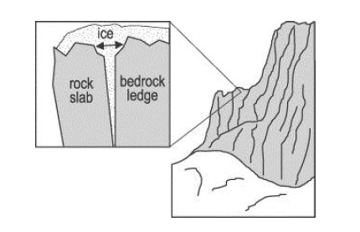
Chemical
Weathering
Mechanical
Weathering
or
Ice Wedging

Slide 5
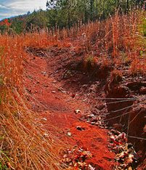
Chemical
Weathering
Mechanical
Weathering
or
The iron in the soil is rusting (changing)

Slide 6
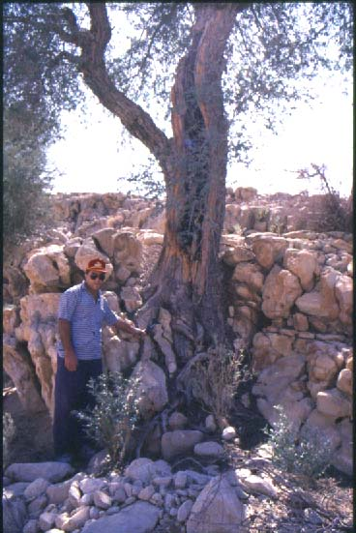
Chemical
Weathering
Mechanical
Weathering
or
Tree roots expanding

Slide 7
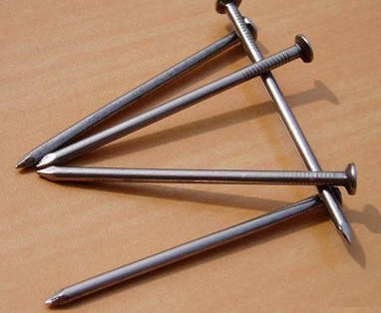
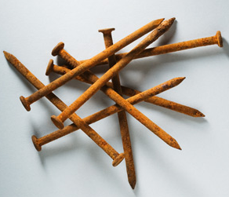
Chemical
Weathering
Mechanical
Weathering
or
The iron nails are rusting (changing)

Slide 8
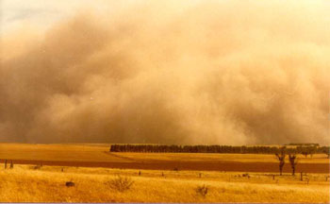
Chemical
Weathering
Mechanical
Weathering
or
“Dust Bowl” Wind weathering and erosion

Slide 9
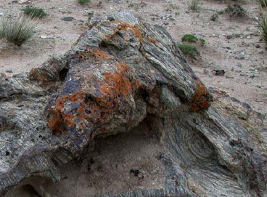
Chemical
Weathering
Mechanical
Weathering
or
Brown area
“Lichens” growing on the rock and changing the surface

Slide 10
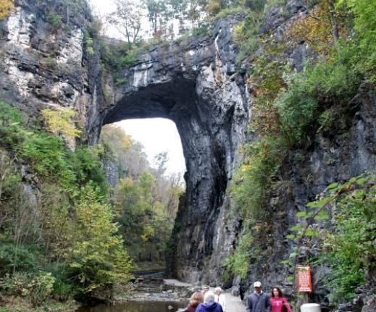
Chemical
Weathering
Mechanical
Weathering
or
Both chemical and mechanical:
Tree roots, water, acid, everything

Slide 11
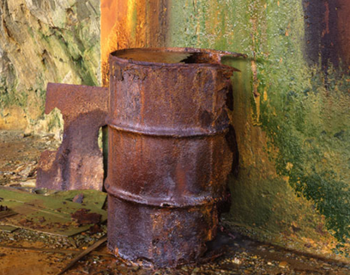
Chemical
Weathering
Mechanical
Weathering
or
The metal is rusting (changing)

