Slide 1
Mechanical / Physical Weathering

Slide 2
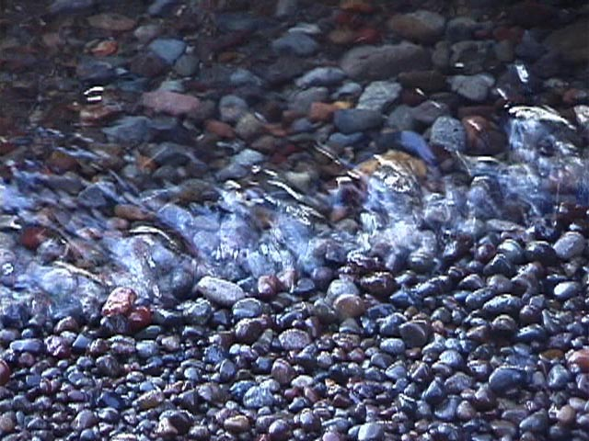
How did the pebbles get this way? Why are they not sharp? What agent of weathering caused this?

Slide 3
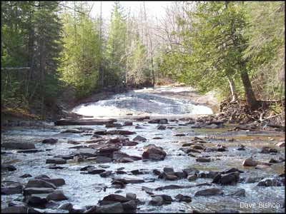
Flowing Water
As rocks and pebbles roll along the bottom of flowing water, they bump and scrape against each other (abrasion), causing these rocks to become rounded and smooth.

Slide 4
As rocks and pebbles roll along the bottom of flowing water, they bump and scrape against each other (abrasion), causing these rocks to become rounded and smooth.
2. Water

Slide 5
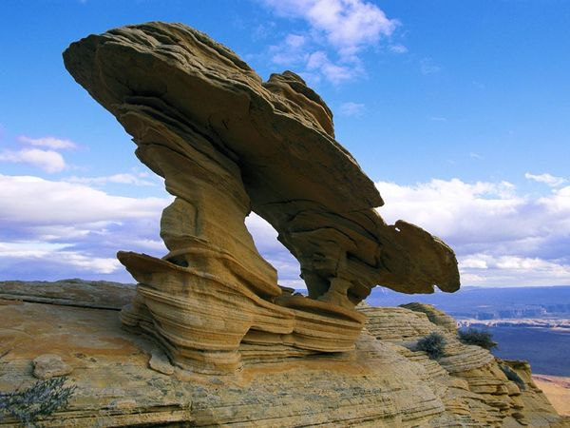
What agent of mechanical weathering created these following pictures in the desert?

Slide 6
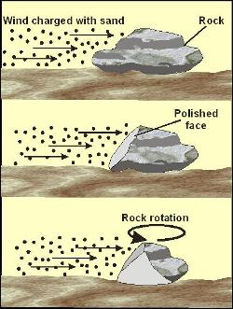
WIND
blows sand and silt against exposed rock eventually wearing away the rock’s surface.
(acts like sandpaper)
Causes Abrasion

Slide 7
3. Wind
Blows sand and silt against exposed rock, eventually wearing away the rock’s surface. (acts like sandpaper; abrasion)

Slide 8
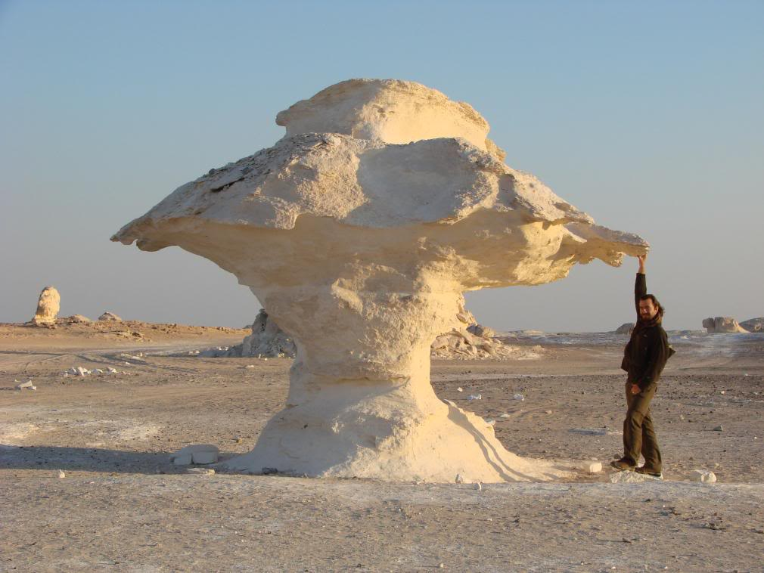
Other examples of Weathering by Wind
Abrasion by wind:
https://www.youtube.com/watch?v=yk3yqPSi_nw
Abrasion by wind (don’t use sound
Notes:
aroundtheworld365.blogspot.com

Slide 9
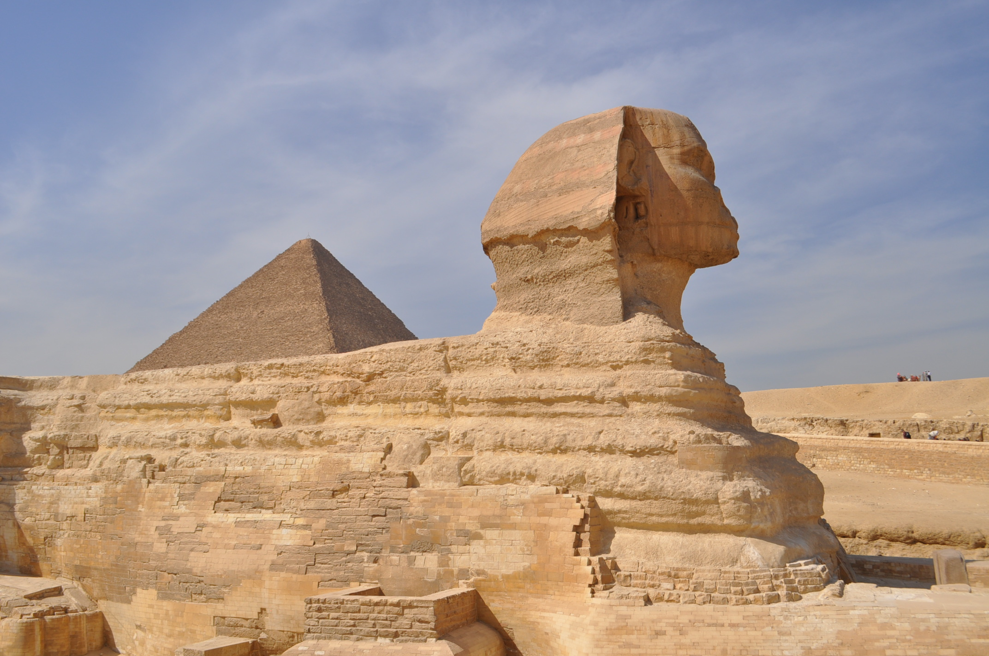
The Great Sphinx
Notes:
http://www.phenomenalplace.com/2011/04/great-pyramid-of-giza.html

Slide 10
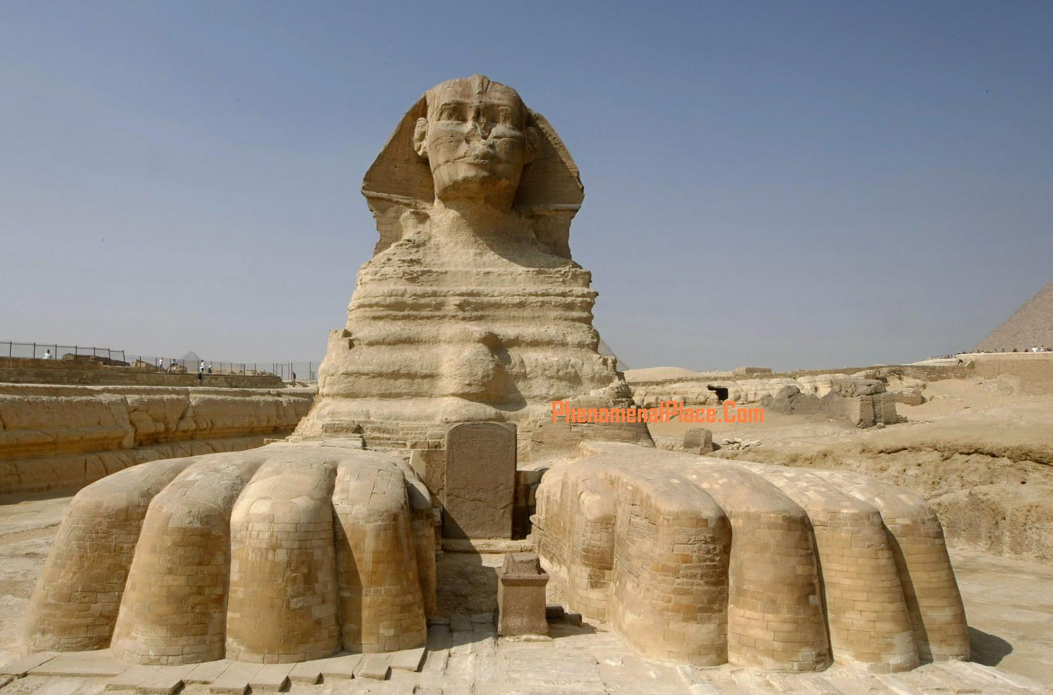
The Great Sphinx
Notes:
http://www.phenomenalplace.com/2011/04/great-pyramid-of-giza.html

Slide 11
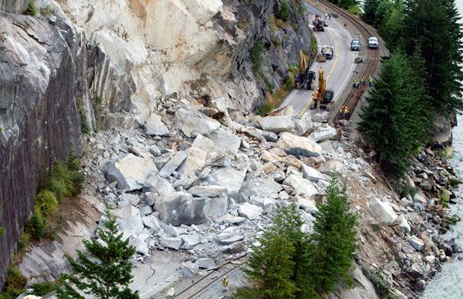
What agent of weathering caused this?
http://www.cbc.ca/news/canada/british-columbia/story/2008/07/30/bc-highway-rockslide-whistler.html
Notes:
Landslide in Brazil Jan. 2011
http://www.cbc.ca/news/canada/british-columbia/story/2008/07/30/bc-highway-rockslide-whistler.html

Slide 12
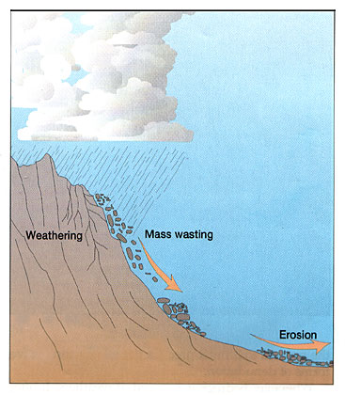
GRAVITY
Rocks are pulled down and grind against each other during a rock slide, creating smaller and smaller rock fragments. Anytime one rock hits another rock, abrasion takes place.
http://www.wimp.com/rockslide/
Rock slide video

Slide 13
3. Gravity
Rocks are pulled down and grind against each other during a rock slide, creating smaller and smaller rock fragments. Anytime one rock hits another rock, abrasion takes place.

Slide 14
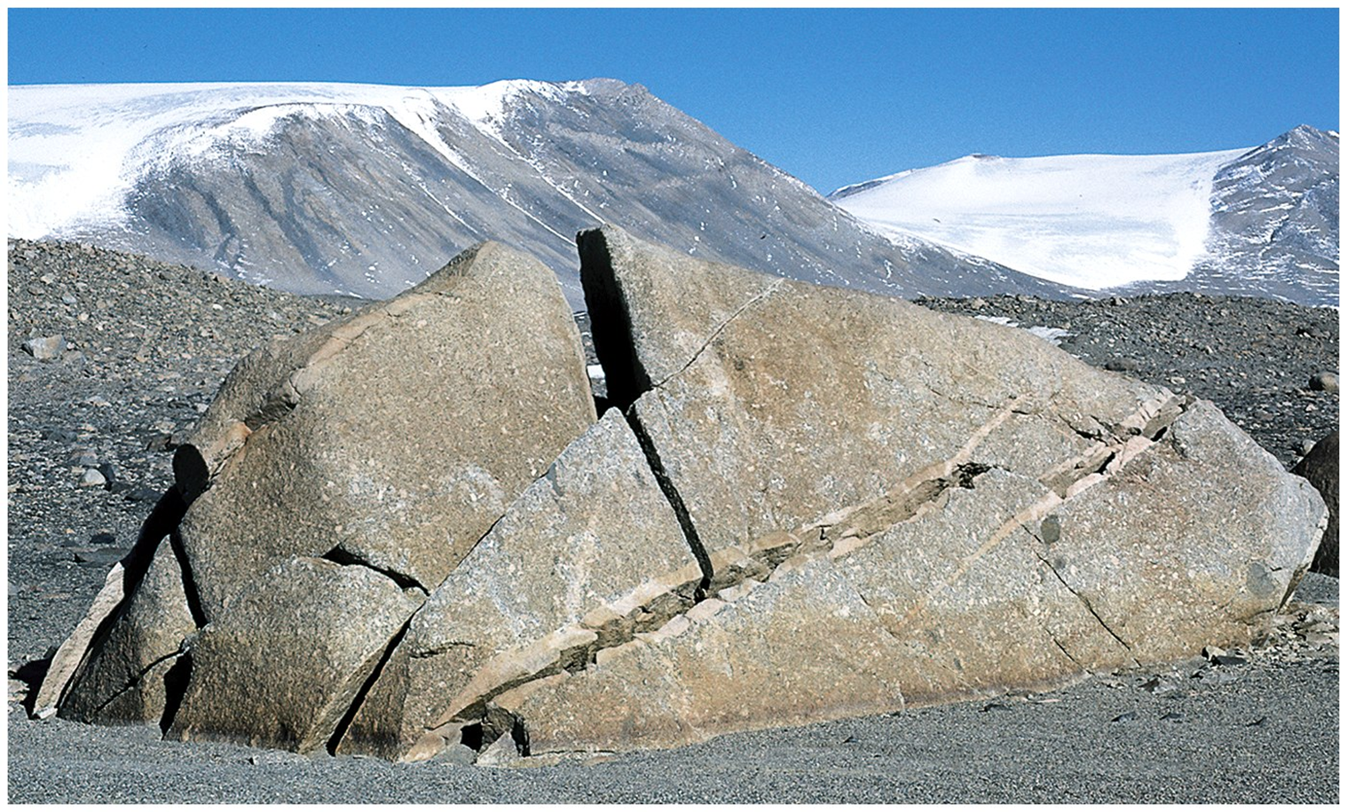
What agent of weathering caused this?

Slide 15
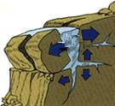
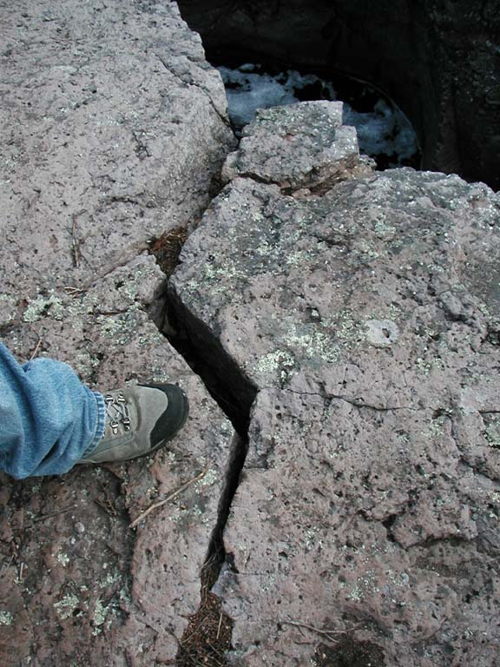
Frost Wedging/ Ice Wedging

Slide 16
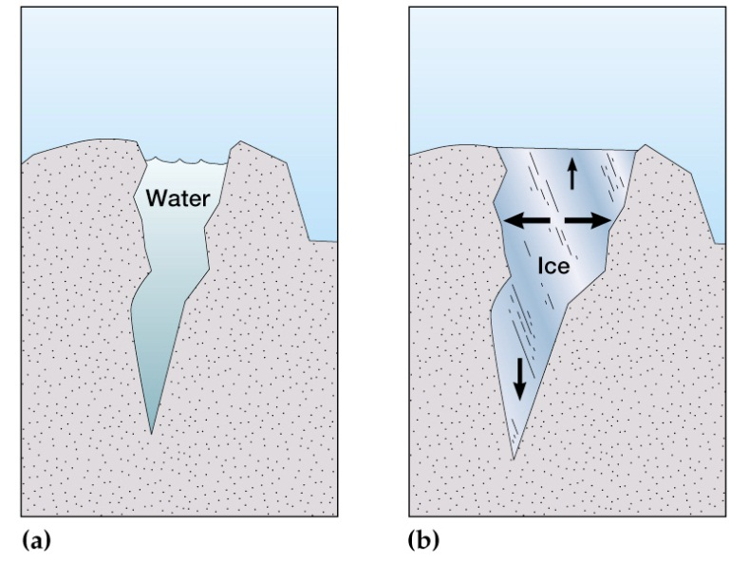
ICE
Water seeps into cracks during warm weather.
When the temperature drops, the water freezes and expands, causing the ice to push against the sides of the crack.
This causes the crack in the rock to widen.
These 3 steps repeat until the rock is broken apart.

Slide 17
Water seeps into cracks during warm weather.
When the temperature drops, the water freezes and expands, causing the ice to push against the sides of the crack.
This causes the crack in the rock to widen.
These 3 steps repeat until the rock is broken apart.
3. Ice

Slide 18
Animations
A great animation about freeze-thaw weathering.
http://www.geolsoc.org.uk/ks3/gsl/education/resources/rockcycle/page4268.html

Slide 19
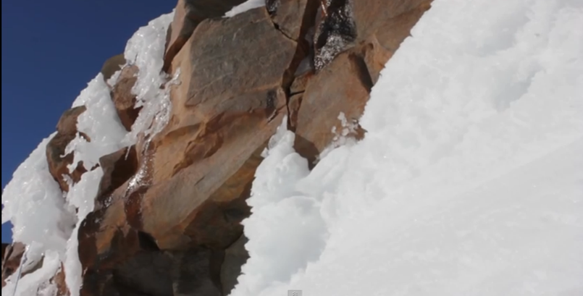
Frost Wedging aka Ice Wedging

Slide 20
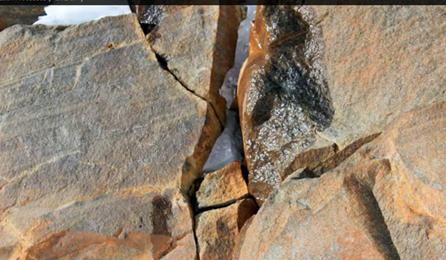
Frost Wedging aka Ice Wedging

Slide 21
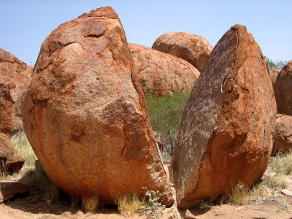
National Geographic Photos
Frost Wedging aka Ice Wedging

Slide 22
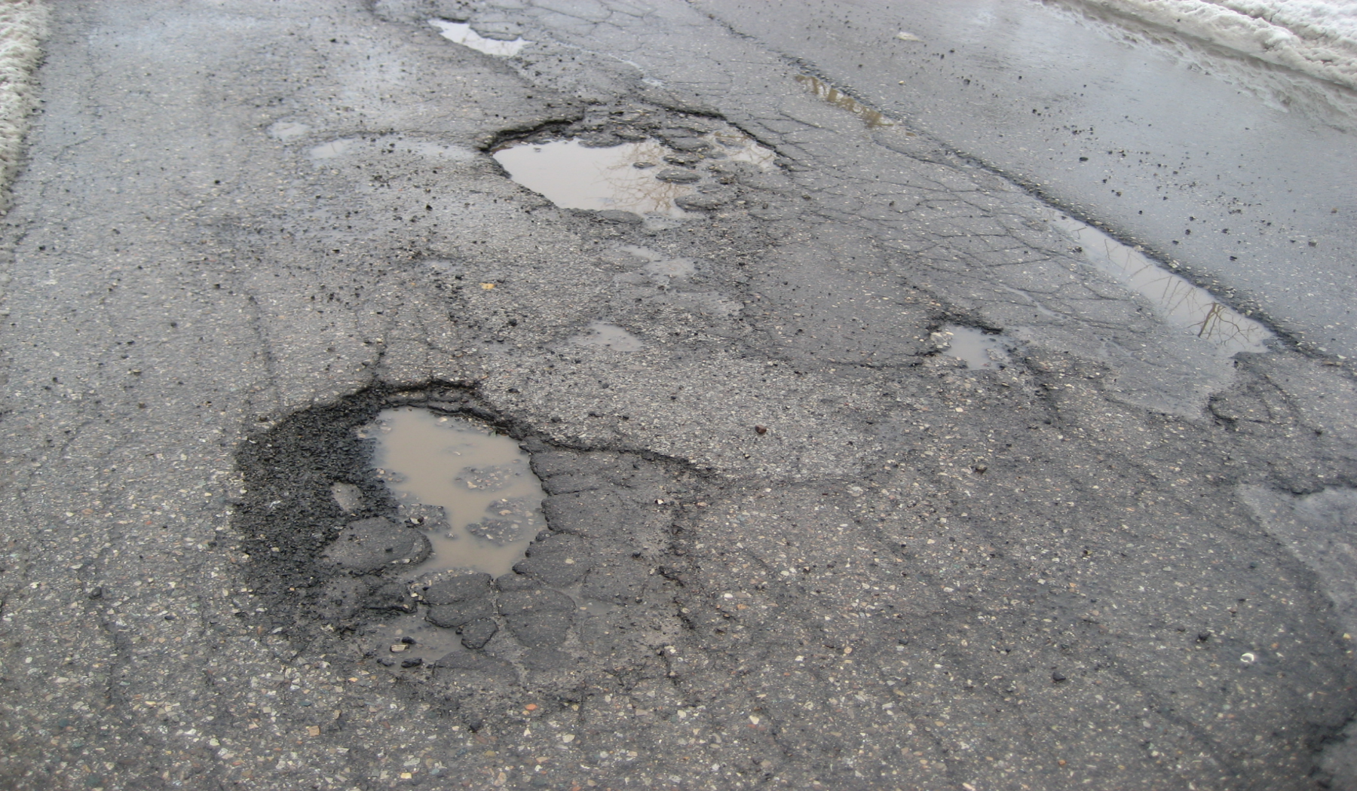
Potholes- caused by ice wedging and temperature change.
Notes:
backreaction.blogspot.com

Slide 23
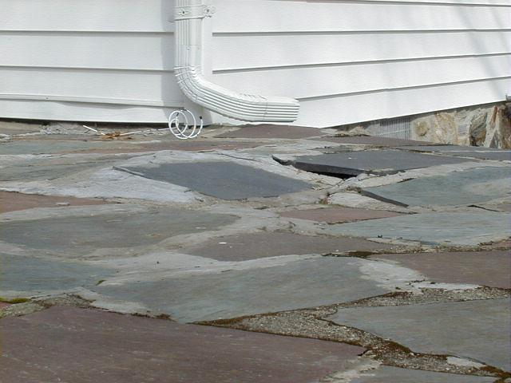
Frost Heaving

Slide 24
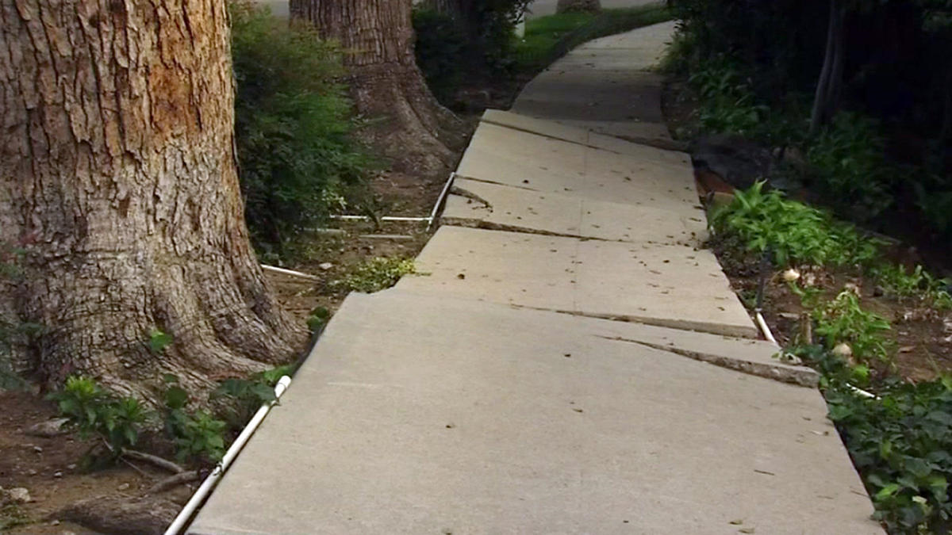
What agent of weathering caused this?

Slide 25
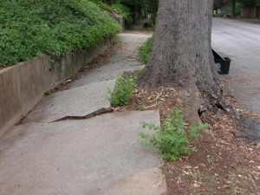
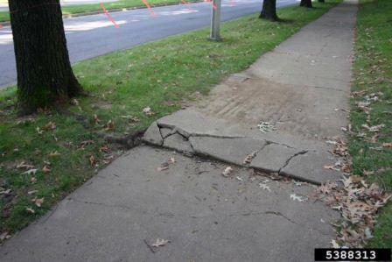
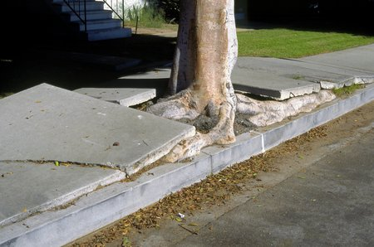
Plants
Notes:
http://www.city-data.com/forum/houston/1144104-root-barrier-totally-diy-project-report.html
http://www.extension.org/pages/61636/problems-with-parking-park-strips

Slide 26
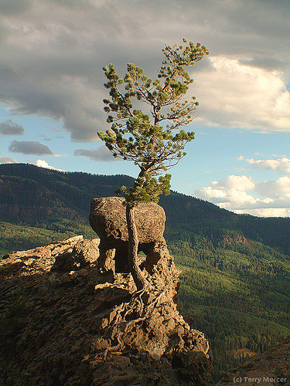
PLANTS
Roots grow into cracks in the rocks. As the roots grow, they press on the sides of the crack, making it wider, until the rock breaks apart.
Ex. Tree roots breaking up sidewalk

Slide 27
Roots grow into cracks in the rocks. As the roots grow, they press on the sides of the crack, making it wider, until the rock breaks apart.
Ex. Tree roots breaking up sidewalk
5. Plants

Slide 28
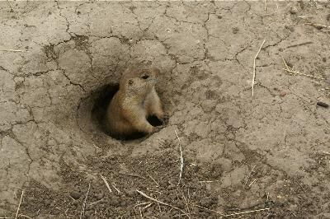
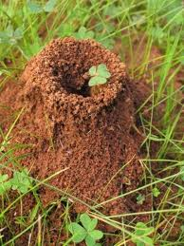
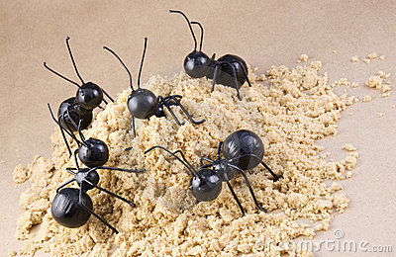
What is causing the changes in Earth’s surface that you are seeing in these pictures?
Notes:
http://www.ehow.com/info_7934416_moth-balls-gopher-repellent.html
http://www.dreamstime.com/royalty-free-stock-photography-worker-ants-ant-hill-concept-image11140847

Slide 29
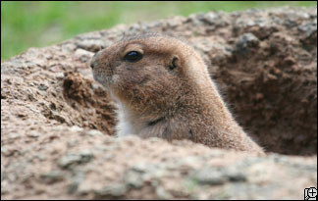
Animals
Burrowing animals break up and loosen sediment, pushing it to the surface. This exposes it to other forces of weathering.
Ex. Rabbits, worms, ants, coyotes, & mice, prairie dogs, insects, gophers

Slide 30
Burrowing animals break up and loosen sediment, pushing it to the surface. This exposes it to other forces of weathering.
Ex. Rabbits, worms, ants, coyotes, & mice, prairie dogs, insects, gophers
6. Animals

