Slide 1
Sedimentary Rock
Formed by:
1. Weathering
2. Erosion
3. Deposition
4. Compaction
5. Cementation
Number of types
1. Clastic
2. Organic
3. Chemical
ex. Breccia
ex. Coal
ex. Limestone

Slide 2
Warm Up:
1. What is foliated metamorphic rock?
2. What is non-foliated metamorphic rock?
3. Work on your project in your spare time.

Slide 3
Warm Up:
1. How is metamorphic rock formed?
2. How is igneous rock formed?
3. How is sedimentary rock formed?
4. Complete the Starburst Lab.
Have out your signed parent note.

Slide 4
Work Session:
1. Complete the Starburst Rock Lab and then work on your project.
2. Bill Nye video on “Rocks and Soil”

Slide 5
Warm Up:
1. What is foliated metamorphic rock?
2. What is non-foliated metamorphic rock?
Have out your signed parent note.

Slide 6
Warm Up:
1. What must happen for a sedimentary rock to change into a metamorphic rock?
2. What must happen for a metamorphic rock to change into an igneous rock?
3. What must happen for an igneous rock to change into a sedimentary rock?

Slide 7
Warm Up:
1. Study for the test!!!
2. Work on the Rock Cycle Essay.
3. Work on your project.

Slide 8
Work Session:
1. Rocks and Minerals Test
2. Work on the Rock Cycle Essay.
3. Work on your project.

Slide 9
Closing:
Tell one way a rock can change into another rock.

Slide 10
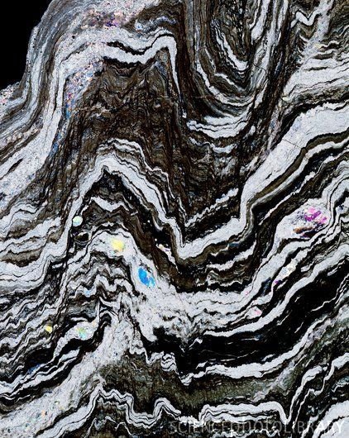
Metamorphism
Notes:
http://www.sciencephoto.com/image/169505/530wm/E4170343-Phyllite,_deformed_metamorphic_rock-SPL.jpg

Slide 11
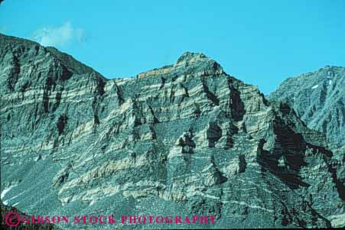
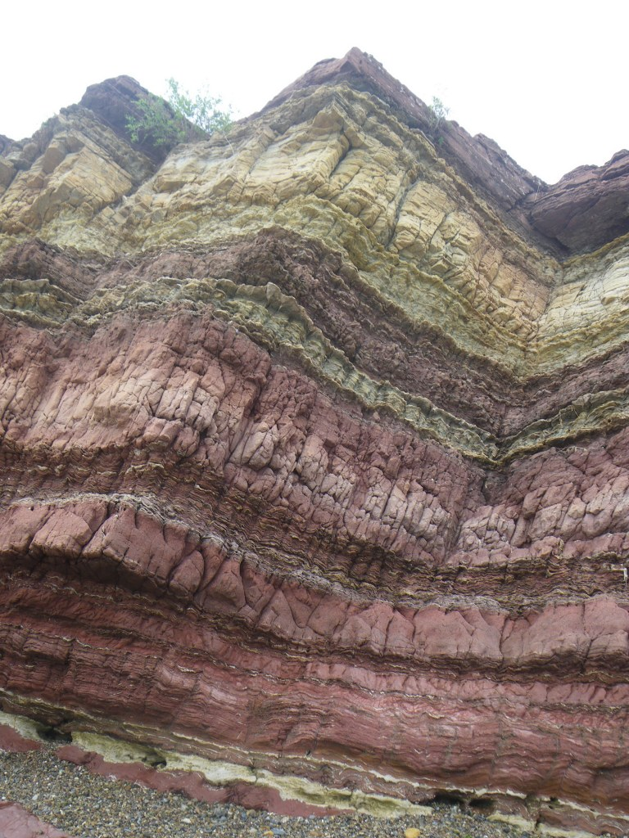
In China…
Notes:
http://margeinchina.wordpress.com/- China
http://www.markgibsonphoto.com/static/7139.html- California

Slide 12
Metamorphosis
http://www.youtube.com/watch?v=L21IGAhO-S4

Slide 13
Why animorphs?

Slide 14
Metamorphosis
Meta= changed
Morphosis= shape

Slide 15
Metamorphosis (caterpillar)
Metamorphism (rocks)

Slide 16
Metamorphic Rock
Rocks in which the structure, texture, or composition of rock have changed due to heat and pressure.

Slide 17
Metamorphic Rock
All 3 types of rock (metamorphic, igneous, & sedimentary) can be changed by heat, pressure, or combo of both

Slide 18
Origins of Metamorphic Rock
Can start out as an igneous or sedimentary rock or a metamorphic rock!
Changes into metamorphic rock at least 2 km below surface

Slide 19
3 Ways Rock Can CHANGE into a Metamorphic Rock
1. extreme heat(50-1000* C or more!)
2. Extreme pressure (from rock layers above)
3. movements in Earth’s crust that rearrange minerals inside a rock into bands (layers/stripes).

Slide 20
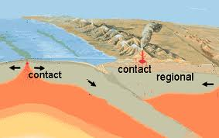
Contact Metamorphism
Notes:
http://www.windows2universe.org/earth/geology/meta_regional.html

Slide 21
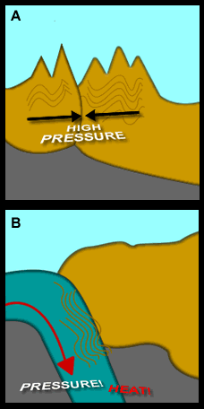
2 Types of Metamorphism
2. regional metamorphism
*Temperature & pressure are increased, causing rock to become deformed and change chemically.
Happens when there is great pressure from pieces of Earth’s crust colliding.
Where does it happen?
deep under mountains or continents

Slide 22
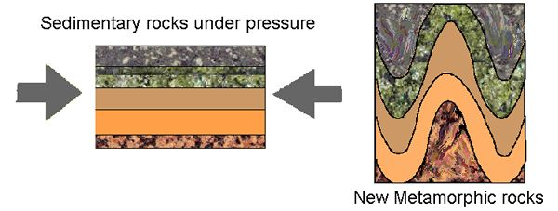
Deformation: (add to notes) a change in the shape of a rock caused by a force placed on it. Forces might cause a rock to be stretched or squeezed

Slide 23
Composition of Metamorphic Rock
Some minerals cannot survive at certain temperatures and pressures, so they change into new minerals.
SEE pg. 109

Slide 24
Foliated Rock
Texture in which the mineral grains are parallel or arranged in bands.
SEE PAGE 109

Slide 25
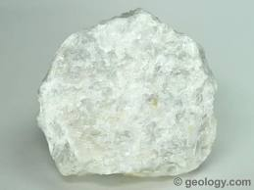
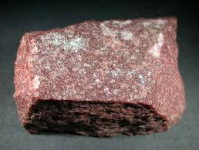
Non- Foliated Rock
Texture of metamorphic rock in which mineral grains are arranged randomly.
2 examples: marble & quartzite
Notes:
http://www.tilewarehousehawaii.com/wp-content/uploads/2010/01/Quartzite-4.jpg

Slide 26
Each time metamorphic rock is exposed to more heat and pressure, it becomes a new metamorphic rock.
Ex. (See Figure 5 on pg. 109)
Gneiss (comes from schist)
Slate (comes from sedimentary shale)

Slide 27
Non-foliated Rocks
.
Texture of metamorphic rock in which mineral grains are arranged randomly
Examples
Marble
Quartzite
Q: How do these become non-foliated metamoprhic rocks?
Starts out as limestone, recrystallization causes mineral grains to grow= Marble.
A: Metamorphism causes recrystallization (process in which mineral crystals change size or composition).

Slide 28
Videos
http://www.youtube.com/watch?v=g_GcLm1FEQA
Sandbox of Grand Canyon layers
Geologist’s Notebook: the 3 rocks
Rocks: The solid earth materials (Rock Formation)
(ESP. SEDIMENTARY ROCK)
RockFinders: Rock Forming: great review and has quiz questions at the end

