Slide 1
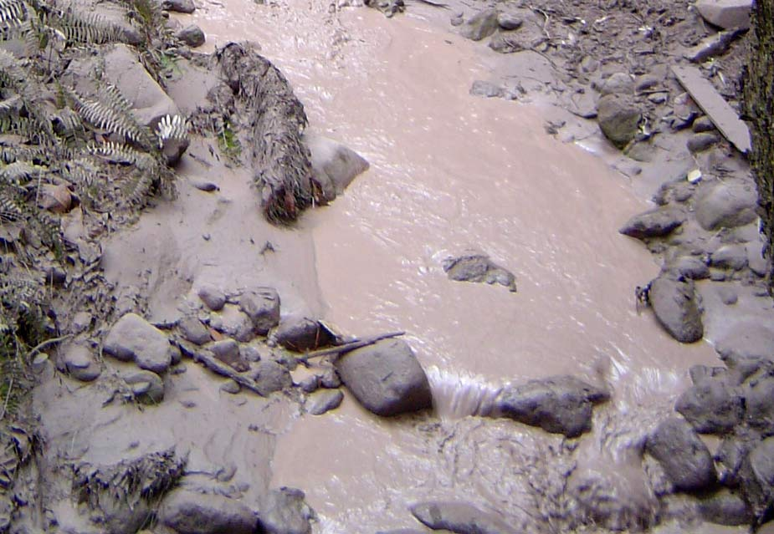

Slide 2
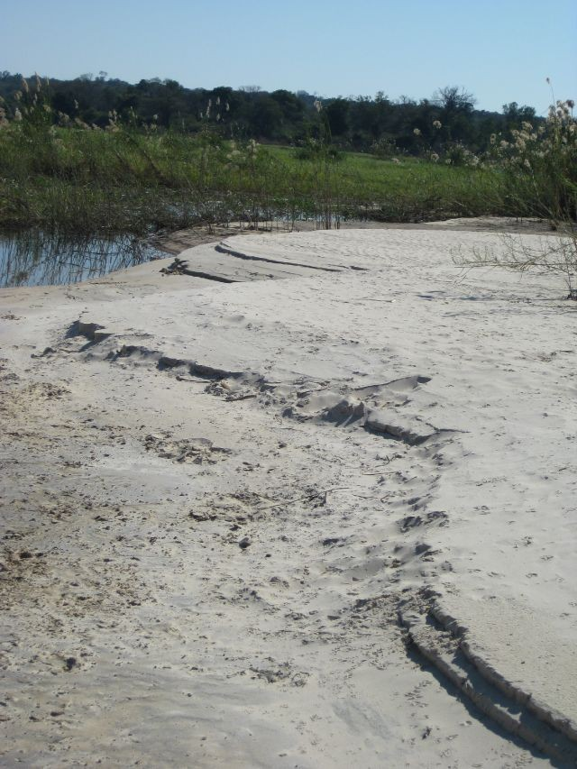

Slide 3
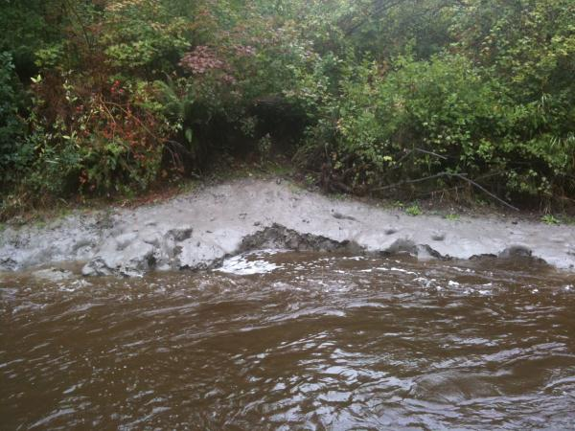

Slide 4
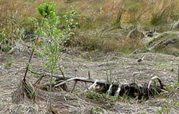

Slide 5
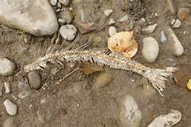

Slide 6
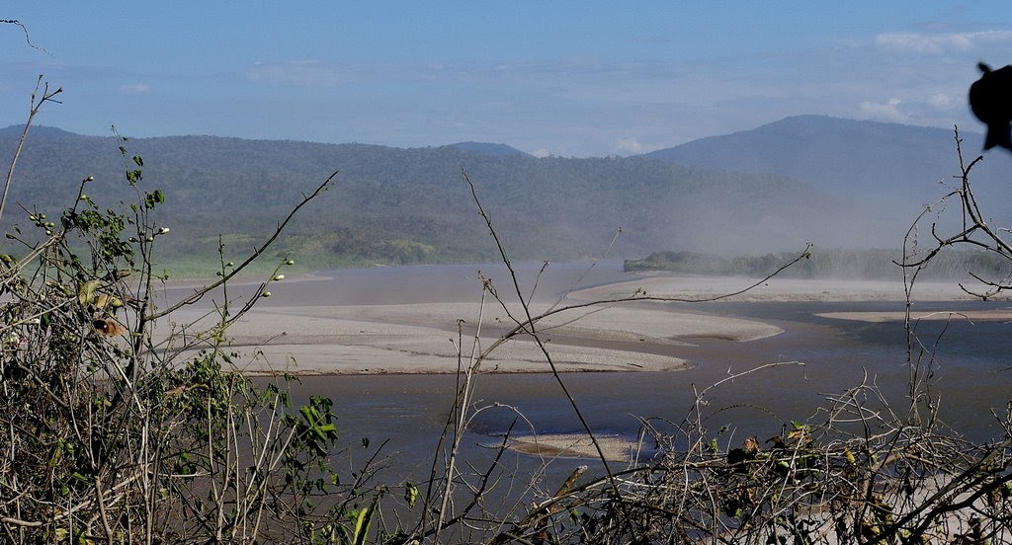

Slide 7
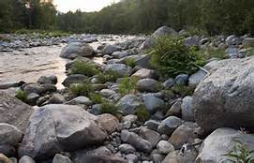

Slide 8
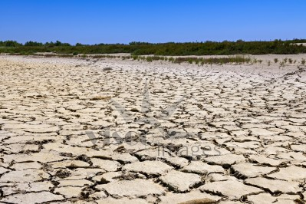

Slide 9
Work Session:
Videos on weathering/erosion and the formation of sedimentary rock.
Weathering, erosion, and deposition matching game.
The 5 processes of sedimentary rock formation cut and paste.

Slide 10
Closing:
What are the 5 processes that happen in order for sedimentary rock to form?

Slide 11
Warm Up:
What does WED CC stand for?

Slide 12
Work Session:
Finish notes on Sedimentary Rock.
The 5 processes of sedimentary rock formation cut and paste.
Work on your Rocks and Minerals Project.

Slide 13
Warm Up:
What are the 3 kinds of sedimentary rock? Explain them.
STUDY your sedimentary rock notes!

Slide 14
Work Session:
Quiz
Work on your Rocks and Minerals Project.

Slide 15
Closing:
What are the 5 processes that happen in order for sedimentary rock to form?

Slide 16
Sedimentary Rock

Slide 17
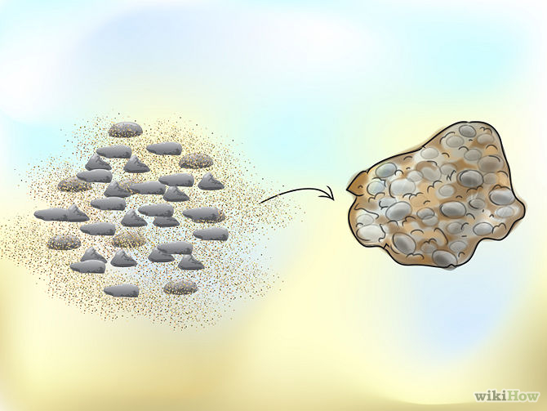
Sediment & Sedimentary Rock
Notes:
http://www.desicomments.com/wallpapers/wallpapers/rocks-wallpapers/
http://www.pinterest.com/pin/195695546280294436/

Slide 18
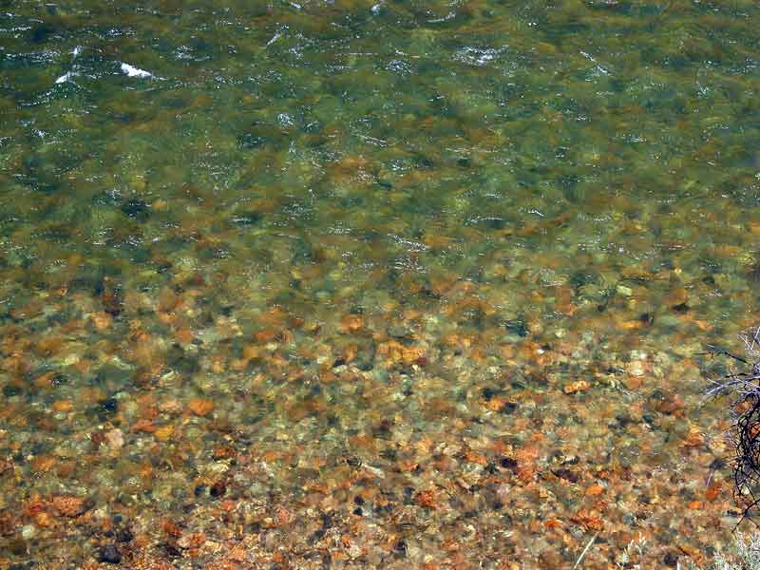
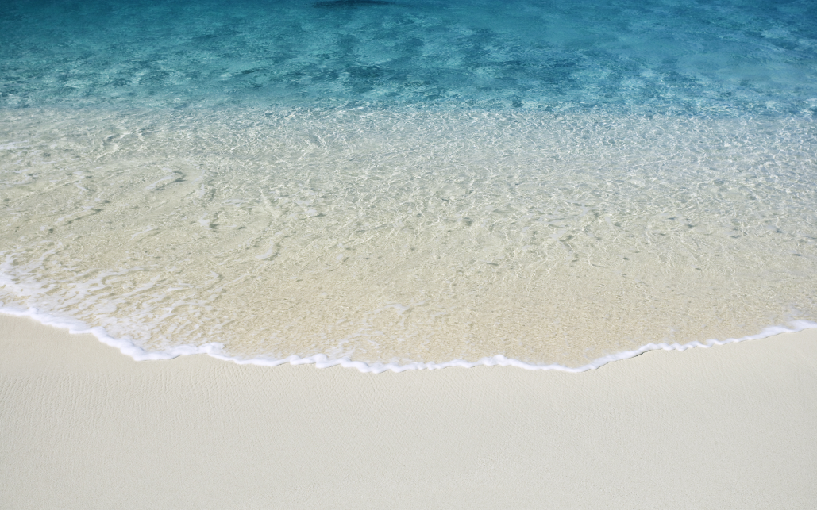
What is Sediment?
What do you walk on when you wade into a stream, river, ocean or lake?
Notes:
http://www.desicomments.com/wallpapers/wallpapers/rocks-wallpapers/
www.westernriverrats.com, www.forwallpaper.com

Slide 19
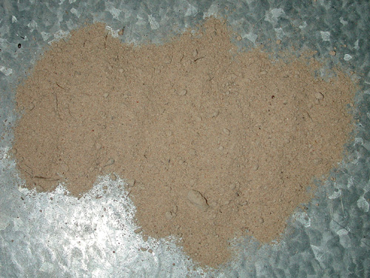
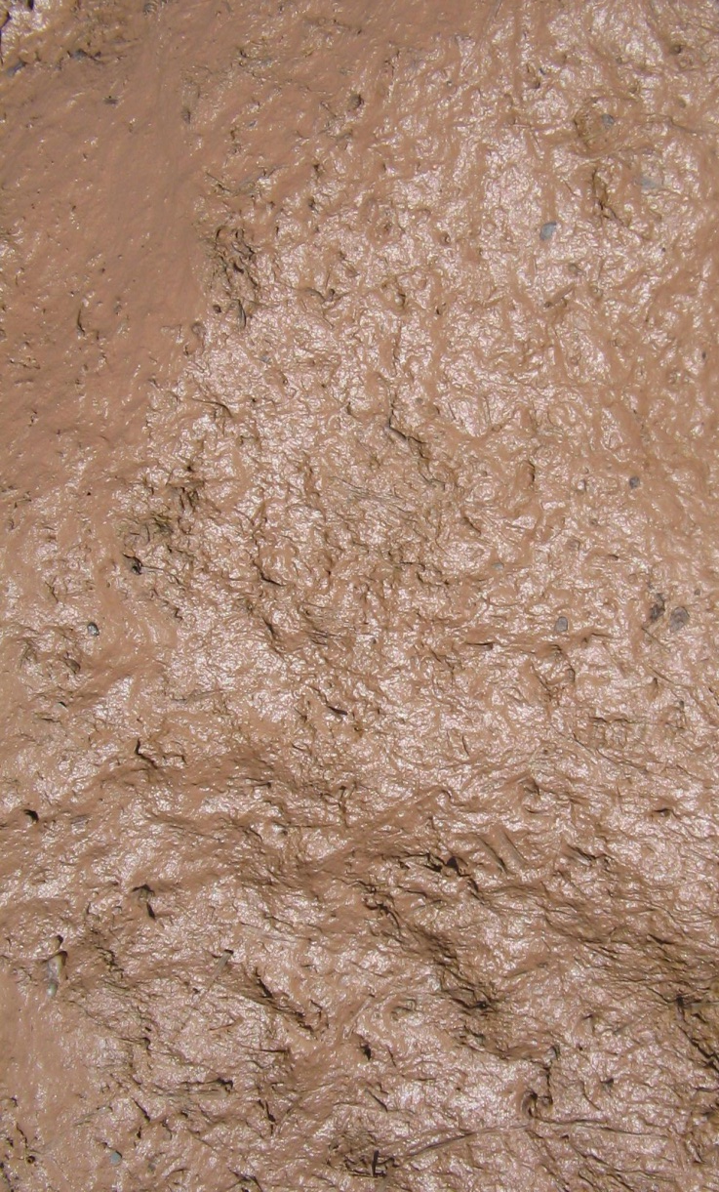
What is Sediment?
Notes:
http://www.renorock.net/dirt_sand.htm
http://commons.wikimedia.org/wiki/File:Mud_closeup.jpg

Slide 20
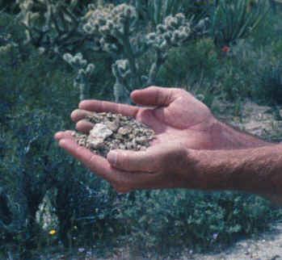
Sediment
Rock & mineral fragments

Slide 21
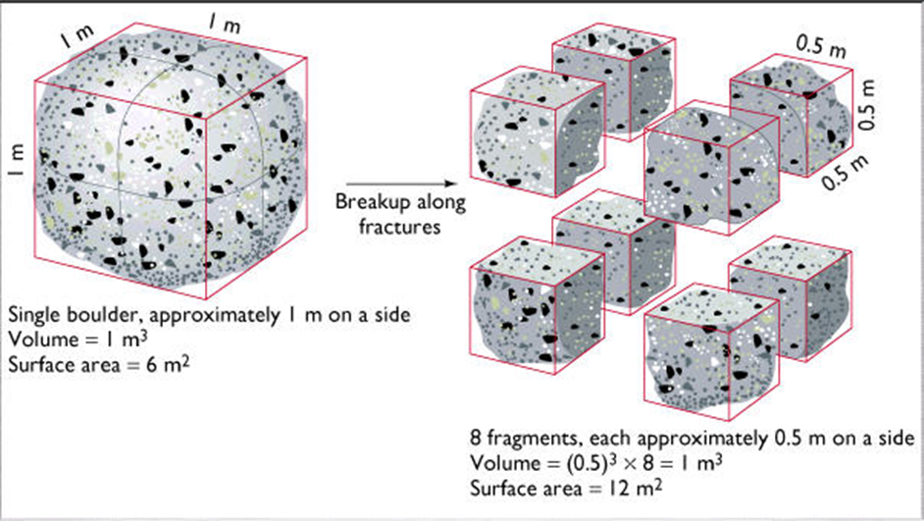
Sedimentary Rocks Terms
Weathering: rock is broken down into smaller pieces or fragments by physical or chemical processes.

Slide 22
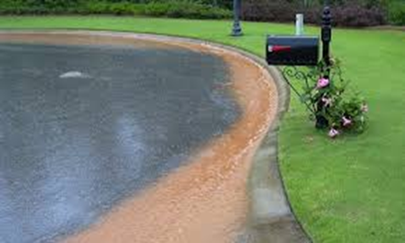
Sedimentary Rocks Terms
Erosion: the process by which wind, water, ice, or gravity transports soil and sediment from one location to another.

Slide 23
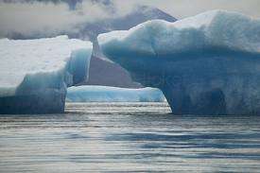
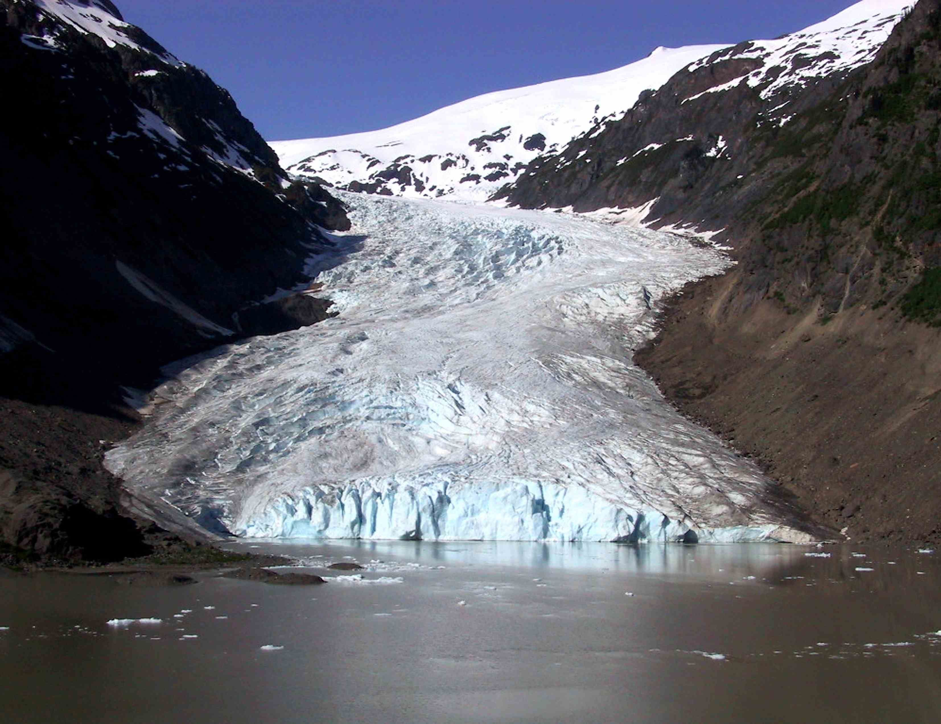
Glaciers

Slide 24
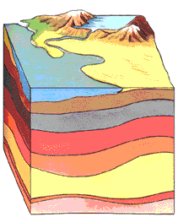
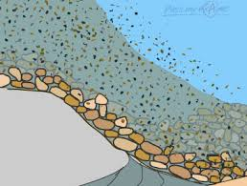
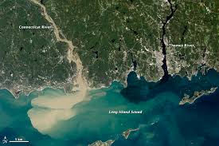
Sedimentary Rocks Terms
Deposition: the process by
which material is laid down.
http://www.fi.edu/fellows/payton/rocks/create/sediment.htm

Slide 25
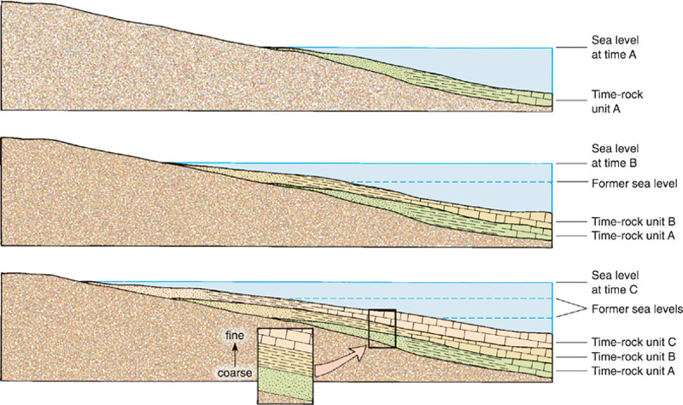
Deposited
Sediment deposited in layers- lithification

Slide 26
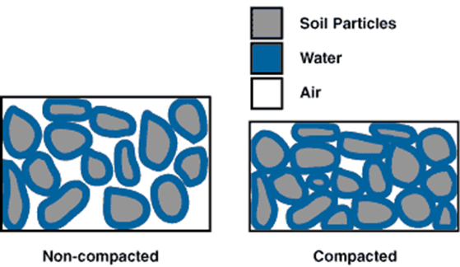
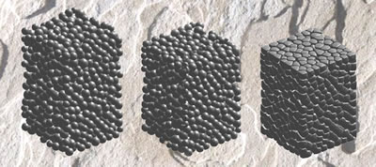
Sedimentary Rocks Terms
Compaction: particles are tightly packed together as fluid and air are squeezed out.

Slide 27
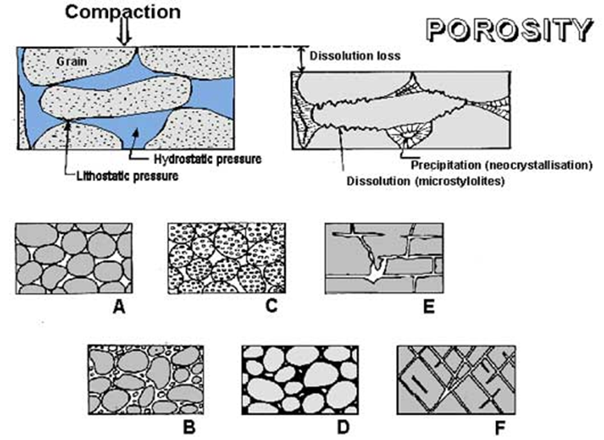
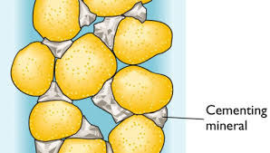
Sedimentary Rocks Terms
* Cementation: describes when grains are cemented together by new minerals (quartz and calcite).

Slide 28
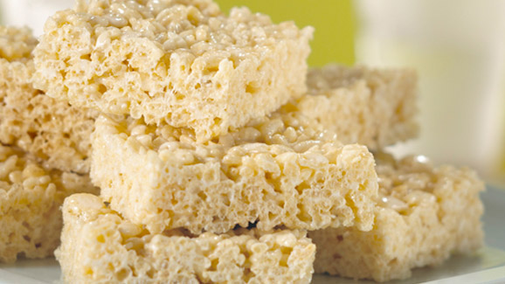
How do Rice Krispy Treats represent cementation? What part would represent the minerals? What part would represent the calcite and quartz?

Slide 29
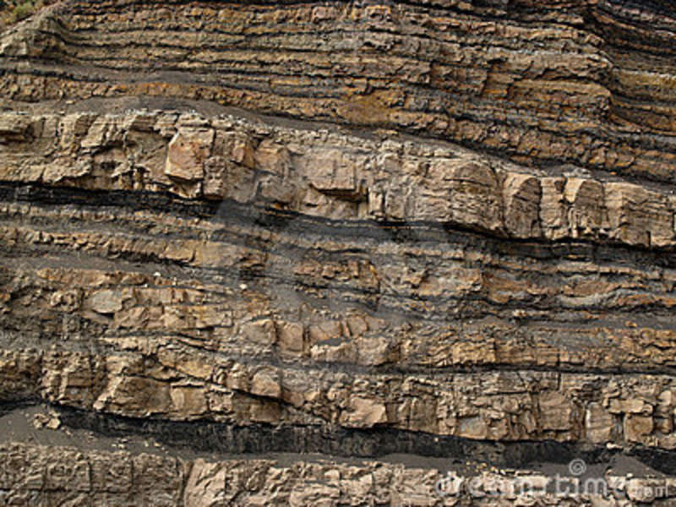
Sedimentary Rock
Sedimentary Rocks are formed
at or near the Earth’s surface
No heat and pressure involved
Strata – layers of rock
Stratification – the process in which sedimentary rocks are arranged in layers
Notes:
http://www.dreamstime.com/stock-image-rock-strata-image3312731

Slide 30
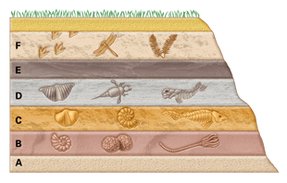
Sediment & Sedimentary Rock
Notes:
http://www.desicomments.com/wallpapers/wallpapers/rocks-wallpapers
www.superteachertools.net

Slide 31
Get out a notebook sheet of paper.
Title it: Processes that Form Sedimentary Rock
Write this saying to remember
the order of the processes:
WED CC
W-Weathering
E-Erosion
D- Deposition
C-Compaction
C-Cementation
http://www.fi.edu/fellows/payton/rocks/create/sediment.htm

Slide 32
Process that Forms Sedimentary Rocks
Rock is weathered into fragments
Erosion moves sediments from one place to another (erosion)
Sediments are deposited in layers, with the older ones
on the bottom (deposition)
The layers become compacted and cemented together
http://www.fi.edu/fellows/payton/rocks/create/sediment.htm

Slide 33
Sedimentary Rocks
There are 3 types of sedimentary rock:
1. clastic
2. organic
3. chemical
http://www.fi.edu/fellows/payton/rocks/create/sediment.htm

Slide 34
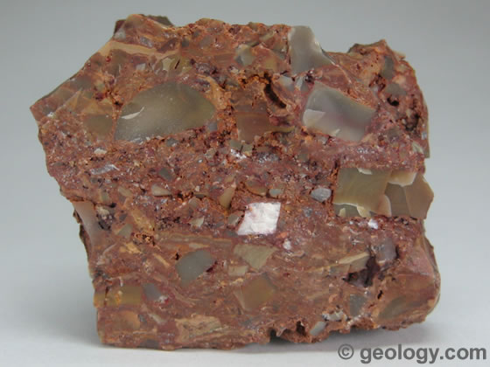
Sedimentary Rock
Clastic – made of fragments of rock cemented together with calcite or quartz.
Ex: Breccia
Breccia is a term most often used for clastic sedimentary rocks that are composed of large angular fragments (over two millimeters in diameter).
The spaces between the large angular fragments can be filled with a matrix of smaller particles or a mineral cement that binds the rock together.

Slide 35
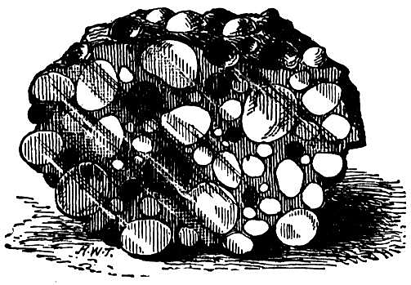
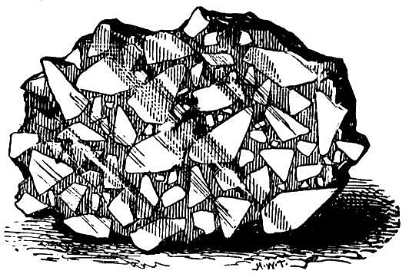
Sedimentary Clastic Rock
Conglomerate
Breccia
Notes:
http://www.desicomments.com/wallpapers/wallpapers/rocks-wallpapers/

Slide 36
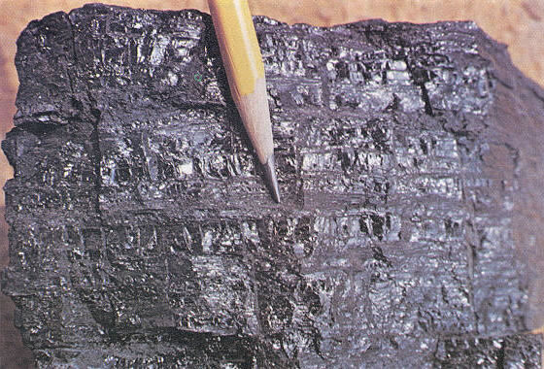
Sedimentary Rock
Organic sedimentary – remains of plants and animals.
Ex. Coal & fossiliferous limestone
Coal is an organic sedimentary rock that forms from the accumulation and preservation of plant materials, usually in a swamp environment.
Coal is a combustible rock and along with oil and natural gas it is one of the three most important fossil fuels.

Slide 37
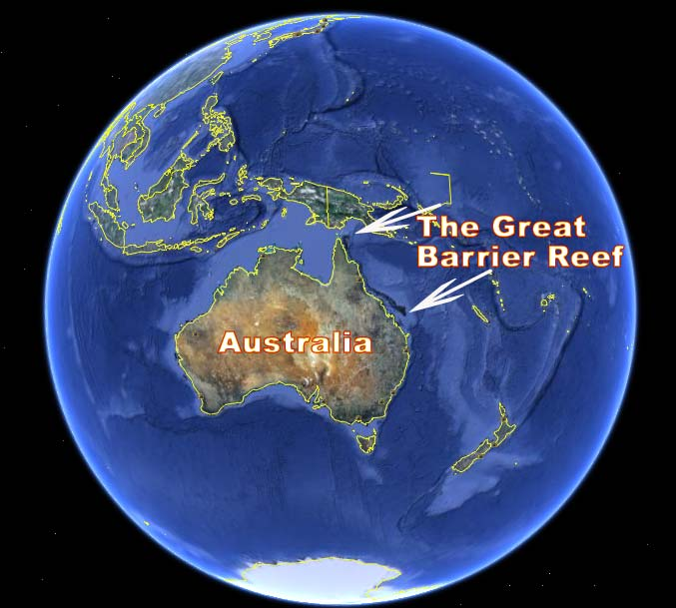

Slide 38
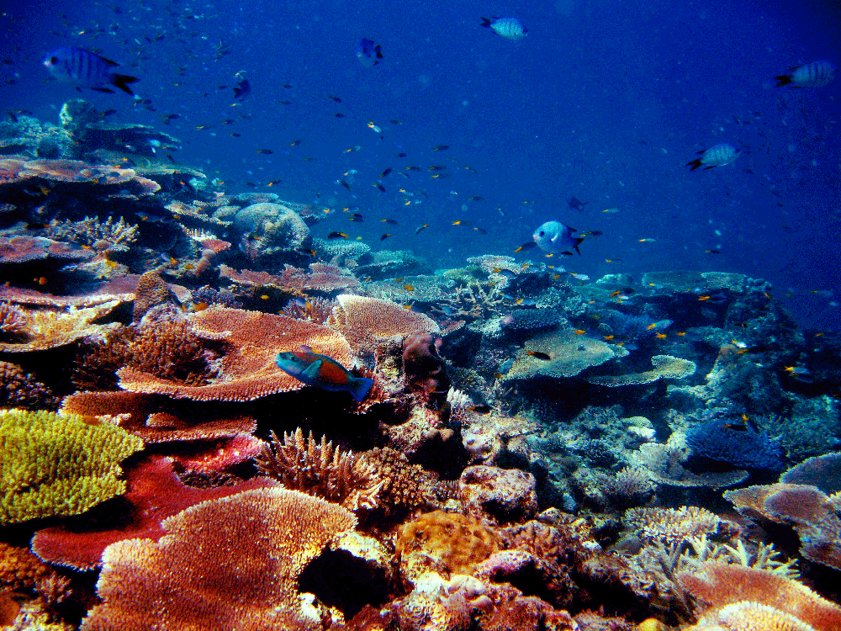
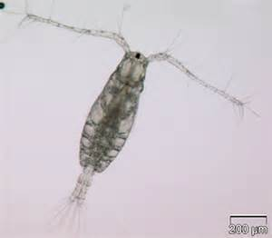
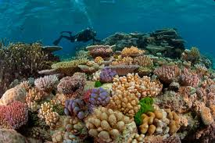
Great Barrier Reef, Australia

Slide 39
Sedimentary Rock
fossiliferous limestone
*forms when tiny organisms that make up coral reefs die & skeletons fall to ocean floor.
Coal
* forms underground when sediment buries partially decomposed plant material.
* millions of years of extreme heat & pressure changes it to coal

Slide 40
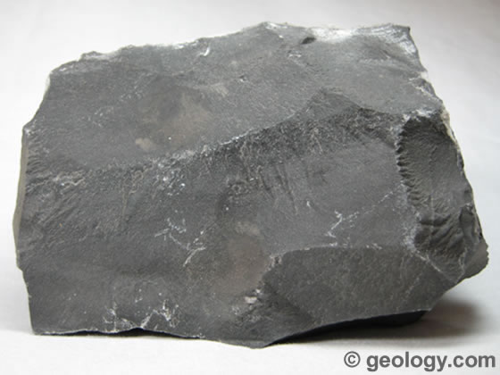
Sedimentary Rock
Chemical sedimentary – minerals crystallize (come out) of solution (like water) to become rock.
* Rainwater dissolves minerals from rocks that it passes over on the way to the ocean. Minerals crystallize.
ex. limestone
Limestone is a sedimentary rock composed primarily of calcium carbonate (CaCO₃) in the form of the mineral calcite. It most commonly forms in clear, warm, shallow marine waters.
It is usually an organic sedimentary rock that forms from the accumulation of shell, coral, algal and fecal debris.

Slide 41
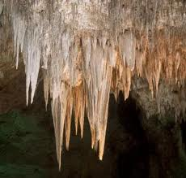
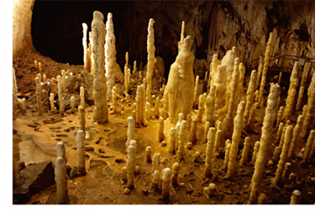
Forms when water has dissolved limestone, evaporates, & leaves deposits.
Stalactites
Stalagmites
Notes:
http://www.ehow.com/info_8524027_limestone-landforms-underground-water-features.html
http://www.thefullwiki.org/Carlsbad_Caverns_National_Park
http://www.stonemania.co.uk/glossary/244-stalagmites

Slide 42
Sedimentary Activity 1. Cut out boxes with the names of the 5 processes & glue at top of page. 2. Cut out boxes with definitions. Match these with the names of the processes. DO NOT GLUE! 3. Match pictures with the definitions. DO NOT GLUE! 4. Raise your hand to have Ms. Axt or Ms. Anuforo check. When we tell you it is correct, you may glue your pieces down.

Slide 43
3 types of Sedimentary Rock Structures
Strata
Ripple Marks
Mud Cracks

Slide 44
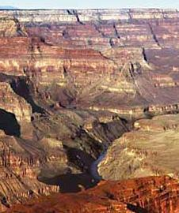
Strata
Layers found in sedimentary rock
Stratification:
Process of sedimentary rock being arranged in layers.
Think of layers of pancakes (with oldest pancake on bottom)

Slide 45
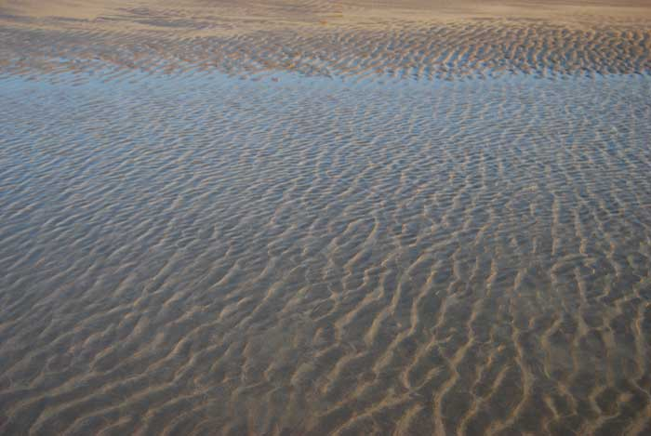
Ripple marks.
Notes:
http://www.jackiemorris.co.uk/april2009.htm

Slide 46
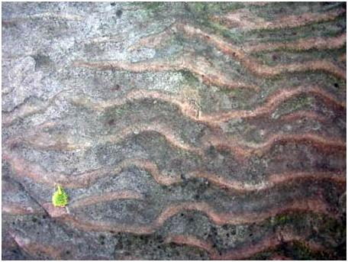
Ripple marks in sandstone.
Records the motion of wind and water waves of lakes, oceans, rivers, and sand dunes.
Ripple Mark Sandstone. University of Waterloo Rock Garden
Notes:
https://uwaterloo.ca/earth-sciences-museum/just-kids/rocks-and-minerals/ripple-mark-sandstone

Slide 47
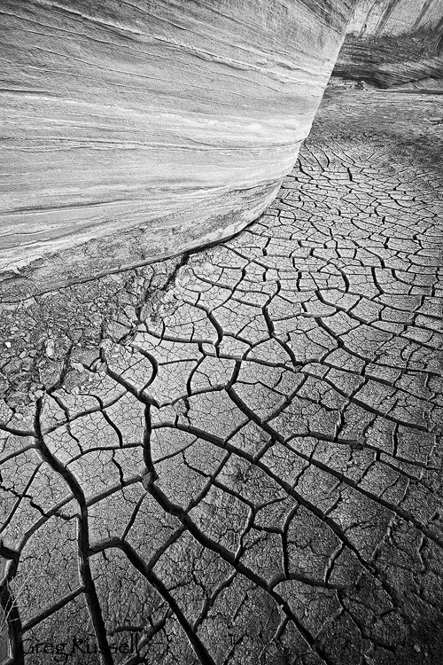
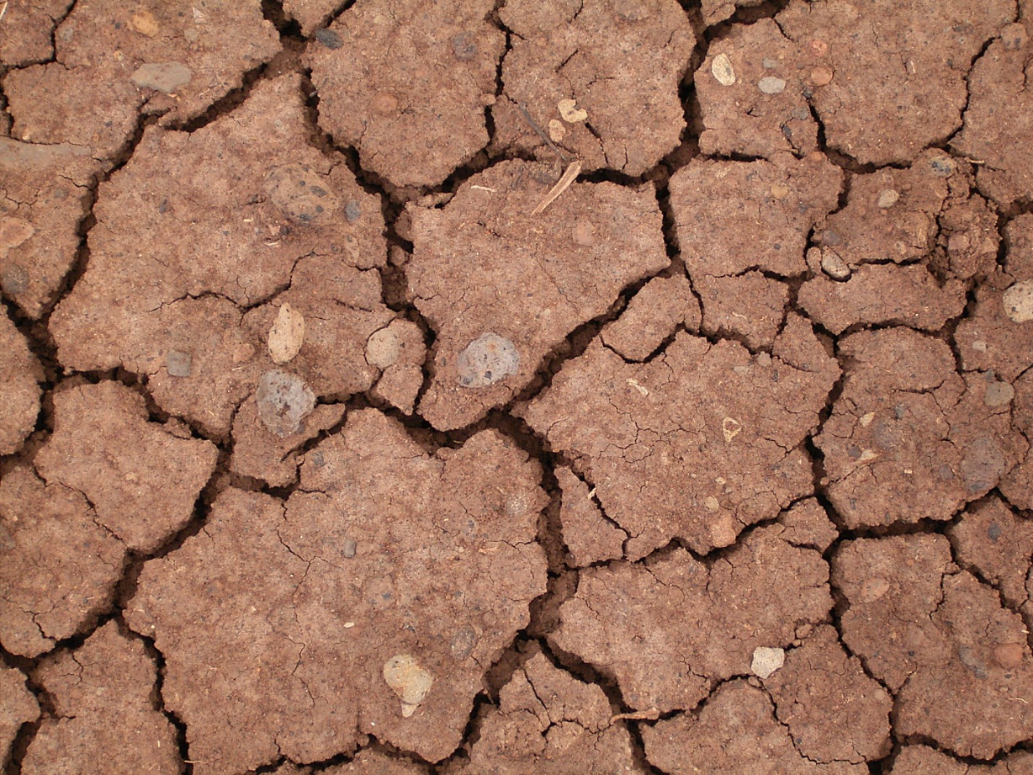
Mud Cracks
Formed when fine-grained sediments at the bottom of a body of shallow water are exposed to air & dry out.
Notes:
https://uwaterloo.ca/earth-sciences-museum/just-kids/rocks-and-minerals/ripple-mark-sandstone
http://commons.wikimedia.org/wiki/File:Dried_mud_(La_Fajana)_01_ies.jpg

Slide 48
Ticket out the Door 1. What processes form sedimentary rock. Describe them. 2. What are the 3 types of sedimentary rock?

Slide 49
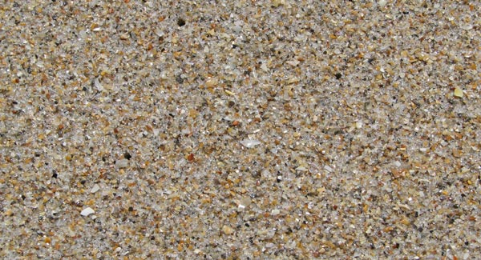
Co coa Beach (Florida) It’s sand is made of….
Notes:
Cocoa Beach. The white quartz has plenty of darker minerals and gray and brown shell fragments.
http://www.beachhunter.net/florida-beach-sand.htm

Slide 50
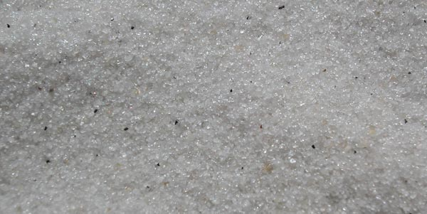
Florida Panhandle This sand is made of…..
Quartz crystals

Slide 51
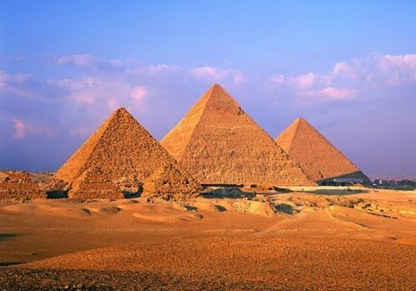
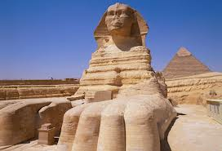
Great Sphinx & Pyramids in Egypt
Notes:
http://www.ehow.com/info_8524027_limestone-landforms-underground-water-features.html
http://www.history.com/shows/chasing-mummies/photos/egyptian-pyramids/photo11
http://www.absolutegranitecare.co.uk/Limestone.html

Slide 52
Great Sphinx & Pyramids in Egypt
made of limestone
Notes:
http://www.ehow.com/info_8524027_limestone-landforms-underground-water-features.html
http://www.history.com/shows/chasing-mummies/photos/egyptian-pyramids/photo11
http://www.absolutegranitecare.co.uk/Limestone.html

Slide 53
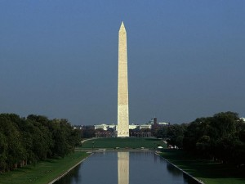
Washington Monument
Notes:
http://www.worldculturepictorial.com/blog/content/worlds-tallest-buildings-part-ii-washington-monument-eiffel-tower-chrysler-building-empire-s

Slide 54
Washington Monument
made of marble, granite and sandstone
Notes:
http://www.worldculturepictorial.com/blog/content/worlds-tallest-buildings-part-ii-washington-monument-eiffel-tower-chrysler-building-empire-s

Slide 55
Cliff
Dwellings,
CO
Notes:
http://www.gly.uga.edu/railsback/BS-MV.html

Slide 56
Cliff
Dwellings,
CO
Made of sandstone
Notes:
http://www.gly.uga.edu/railsback/BS-MV.html

Slide 57
Castle in
Scotland
Notes:
http://www.gly.uga.edu/railsback/BS-CC.html

Slide 58
Castle in
Scotland
Made of sandstone
Notes:
http://www.gly.uga.edu/railsback/BS-CC.html

Slide 59
GA state capitol (Atlanta)
Notes:
http://www.gly.uga.edu/railsback/BS-CC.html

Slide 60
GA state capitol (Atlanta)
Made of limestone
Notes:
http://www.gly.uga.edu/railsback/BS-CC.html

Slide 61
Roman
Ampitheatre
Made of limestone
Notes:
http://www.gly.uga.edu/railsback/BS-CC.html

Slide 62
Rocks

Slide 63
Erosion
The Curious Rocks of Australia
Share
Henry Moore was an English sculptor known for his abstract sculptures in bronze and marble and undulating forms with holes, according to many analysts, inspired by landscapes of Yorkshire. However, thousands of miles away, there is a place where the works of Henry Moore seem to be on display, with a notable curiosity are natural rock formations sculpted by erosion for over thousands of years.
They are surely the most curious rocks of Australia:
The images of the rocks (Remarkables Rocks) are on the island Kangaroo, south of Australia, within a protected area of Flinders Chase National Park. The rock carvings are found on a rocky granite eroded by thousands of years. The park is also a sanctuary for endangered species introduced from the mainland

Slide 64
Rocks

Slide 65
Erosion
Notes:
http://www.sharewonders.com/the-curious-rocks-of-australia/

Slide 66
Erosion
Notes:
http://www.sharewonders.com/the-curious-rocks-of-australia/

Slide 67
Arches National Park, Utah
If you are an outdoor person and are looking for an outdoor adventure then Arches National Park is a great place to visit. Situated in Utah, United States, it is one of the world greatest collection of geological structures.
It is famous for its arches and has more than two thousand of these geological wonders. Most famous of which is the Delicate arch.
These arches are made up of sandstone and have bearded thousands of years of climate change. Apart from its famous arches, the National Park also contains balanced rocks and pinnacles. All of these with amazingly diverse texture and colors.
The Arches National Park is home to many animals and birds. Desert bighorn sheep, Cottontail rabbit and Kangaroo rat are among the animals found. Rattle snakes are also found in the park, so use caution.
If you plan to visit Arches National Park, be sure to equip yourself well for the journey. Keep plenty of water as it gets very hot in the summers. Staying on the hiking trail is a good idea, as it will not only help preserve the cryptobiological soil and will keep you safe from dangerous animals.
Make sure you see the Delicate Arch, Wolfe Ranch, Petrified Dunes, and the double arch while you visit.
Rock Climbing, Hiking and photography are some of the things you can do in Arches National Park. There is only one designated campground in the park namely Devil’s Garden Campground and you should make a reservation before arriving.
Arches National Park is a destination you should opt for if you are into geology and rock formations!
Notes:
http://www.sharewonders.com/arches-national-park/

Slide 68
Arches National Park in Utah
Notes:
http://www.sharewonders.com/arches-national-park/

Slide 69
Clastic sedimentary rocks are sedimentary rocks formed out of broken down bits of rocks. There are several kinds of clastic sedimentary rocks; they are categorized by the size and sometimes the shape of the pieces that make up the rock. The kinds of clastic sedimentary rocks are called: Conglomerates, breccias, sandstone, mudstone, siltstone.
Conglomerates are made from bits of rounded gravel that were deposited by the agent, usually water. Over time the wet pile of sediments becomes so heavy that the gravel gets compacted together, and minerals in the water cement the bits of gravel together. The only difference between conglomerates and breccias is: Conglomerates are made from rounded gravel and breccias are make from angular graves.
Notes:
http://www.desicomments.com/wallpapers/wallpapers/rocks-wallpapers/

Slide 70
Sandstone is basically the same. Piles of sand are piled up by water or wind and over time the piles get so heavy the sand is pressed together and cemented by minerals found in ground water. There are some interesting things that can be found in sandstone. Fossils are often found in sandstone. Also, have you ever been to the beach or a lake and looked out into the water and noticed that the sand is piled up in ripples by the motion of the waves? Sometimes the sand will get buried and the ripple pattern is preserved. Over time the sand will harden into rock and the ripple marks will still be in the rock. I have found this “ripple marked” sandstone. Somewhere in my house I still have some.
Sometimes sand dunes will become so large they harden into rock preserving the hump shape of the sand dune. There is a very famous fossil that was found in China in one of these preserved sand dunes. The fossil is called the “fighting dinosaurs.” Paleontologists think a velociraptor and protoceratops were fighting and were trapped by a collapsing sand dune.
Notes:
http://www.kidsgeo.com/geology-for-kids/0027C-sedimentary-rocks.php

Slide 71
Sedimentary Rock Types IV Written for the KidsKnowIt Network by: Brandon Guymon
Mudstone is the same as sandstone except the particles of rock that make up the mudstone are too small to be called sand. As the name sounds, the rock used to be mud that was buried and hardened into rock. Siltstone is made from even smaller particles than mudstone. Fossils can also be found in mudstone and siltstone. These types of rocks are sometimes called slate. In the United States, the national monument named Fossil Butte is near mudstone and siltstone formations that hold hundreds of fish fossils.
Like “ripple marked” sandstone, mudstone can have marks made by water on it. Sometimes when mud hardens the surface cracks; these cracks can be preserved and harden into rock. Even more rare, the marks made by falling raindrops will be preserved in the rock. I have found the mud crack-marked rocks, but not the rain-marked rocks. I'll have to keep looking.
Notes:
http://www.desicomments.com/wallpapers/wallpapers/rocks-wallpapers/

Slide 72
Written for the KidsKnowIt Network by: Brandon Guymon
Sedimentary rocks are formed from the broken down pieces of other rocks or debris cemented together by intense pressure and minerals deposited by water. There are many kinds of sedimentary rocks. Scientists divide the types of sedimentary rocks into four kinds. These are: clastic, biochemical, chemical, and other. We will talk about each kind.
Notes:
http://www.desicomments.com/wallpapers/wallpapers/rocks-wallpapers/

Slide 73
Biochemical sedimentary rocks are formed from the debris of life. For example, limestone is formed from out of decayed animal shells. Animals use calcium to form their shells. After the animal dies, the shell falls apart and the calcium combines with other elements and minerals and hardens into rock. Fossils are very common in this type of rock. I have found fossil trilobites in this rock. Another example of this type of rock is coquina. Coquina is formed from pieces of seashells cemented together. My geology professor had some, it was really neat to look at. Coal and chert are also common biochemical sedimentary rocks.
Chemical sedimentary rocks are formed when water evaporates and leaves behind minerals that harden into rock. A great example of this kind of rock is salt. So remember when you're eating salt, you're eating a rock. It's a rock called halite.
Work at a salt mine. Salt mineral.
The other category of sedimentary rock is very rare, usually caused by an impact like an asteroid. The asteroid hits so hard it breaks up rocks and fuses them together into a new sedimentary rock. Another example is hot rock spewed from a volcano, but not hot enough to melt the rock it touches; it hardens around other bits of rock forming a new sedimentary rock. Like I said, this is very rare.
Sedimentary rocks only form about 8 percent of the rocks on Earth that cover the other types of rocks like a thin coat of paint. Even though they are only a tiny percentage of the rocks on Earth, they are very important. They tell us a lot about the history of life on earth because sedimentary rocks are the only type of rock that can hold fossils and they are formed in layers with the oldest rocks on the bottom and the newest rocks on the top.
Notes:
http://www.desicomments.com/wallpapers/wallpapers/rocks-wallpapers/

Slide 74
http://www.toptenz.net/top-10-black-sand-beaches.php
Top 10 black sandy beaches to visit
Notes:
http://www.desicomments.com/wallpapers/wallpapers/rocks-wallpapers/

