Slide 1
Todays agenda
Success Starter: Pop quiz
Opening: 5 MINUTE WARM UP
Work SESSION: Severe weather VIDEO & nOTES
Closing: Charades

Slide 2
11/13/17 Happy Monday☺ Warm up:
What does severe weather mean?
How do you stay safe?
What do you do when severe weather occurs in your area?

Slide 3
When do you do what’s right?
Is there a right and wrong time?
Someone watching you
Motivation
Do you think about what you can get in return?

Slide 5
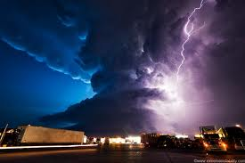
Severe Weather

Slide 7
What is an air mass?
An air mass is a large body of air where temperature and moisture content are similar throughout.
What are some examples of the different types of air masses?
Which air mass influences weather in GA?

Slide 9
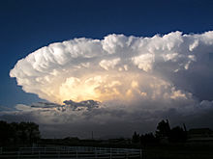

Slide 10
Thunderstorms
Small, intense weather systems that produce strong winds, heavy rain, lightning, and thunder are called thunderstorms.
Thunderstorms occur along cold fronts.
Two conditions required for a thunderstorm:
Warm and moist air near the Earth’s surface
Unstable atmosphere

Slide 11
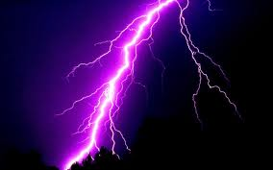
Lightning
Lightning is an electric discharge that occurs between a positively charged area and negatively charged area.
Thunder is the sound that results from the rapid expansion of air along the lightning strike.

Slide 12
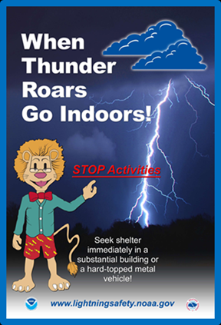
You ALWAYS see lightning before you hear thunder because light travels faster than sound.
The safest place to be is low to the ground.

Slide 14
Tornadoes
A tornado is a rapidly whirling, funnel-shaped cloud that reaches down from a storm cloud to touch Earth’s surface.
75% of the world’s tornadoes occur in the United states.
Most tornadoes last for only a few minutes.

Slide 15
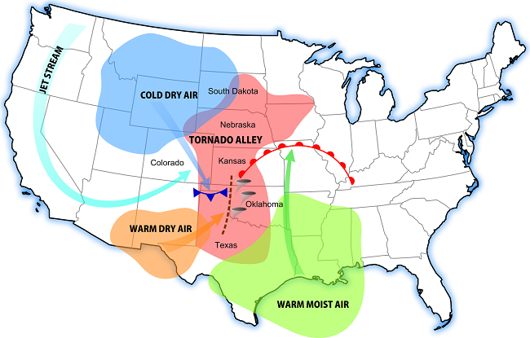

Slide 16
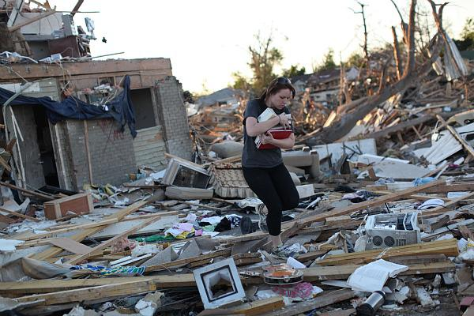
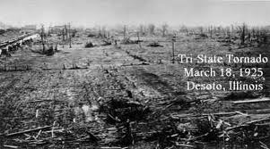
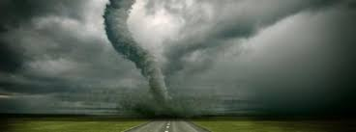
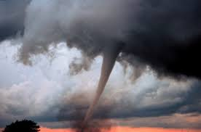
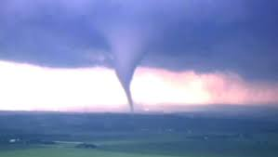

Slide 17
How Tornadoes Form
Tornadoes develop at the base of cumulonimbus clouds.
Tornadoes occur most often in the spring and early summer.
A warm, humid air mass must be present (maritime tropical).

Slide 19
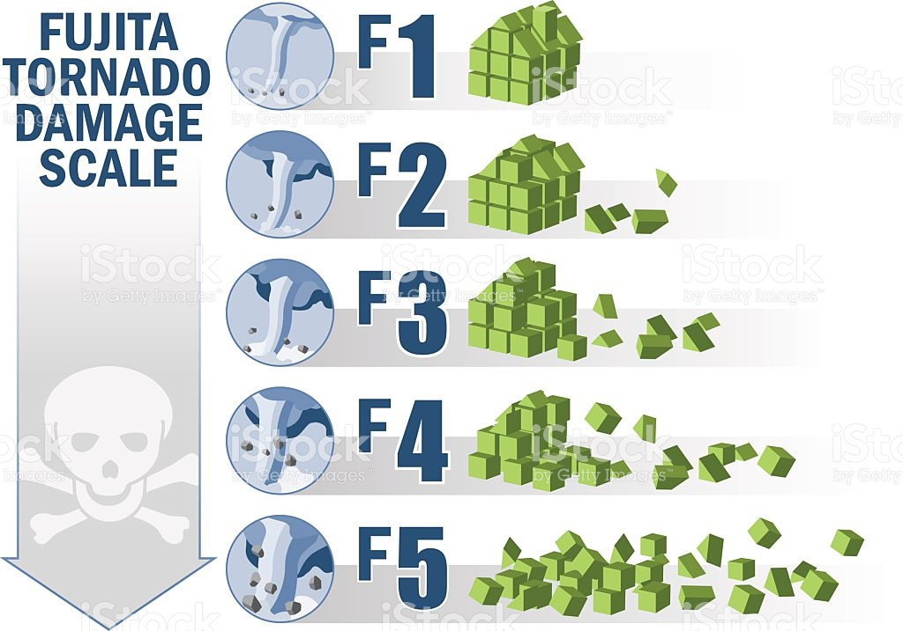

Slide 20
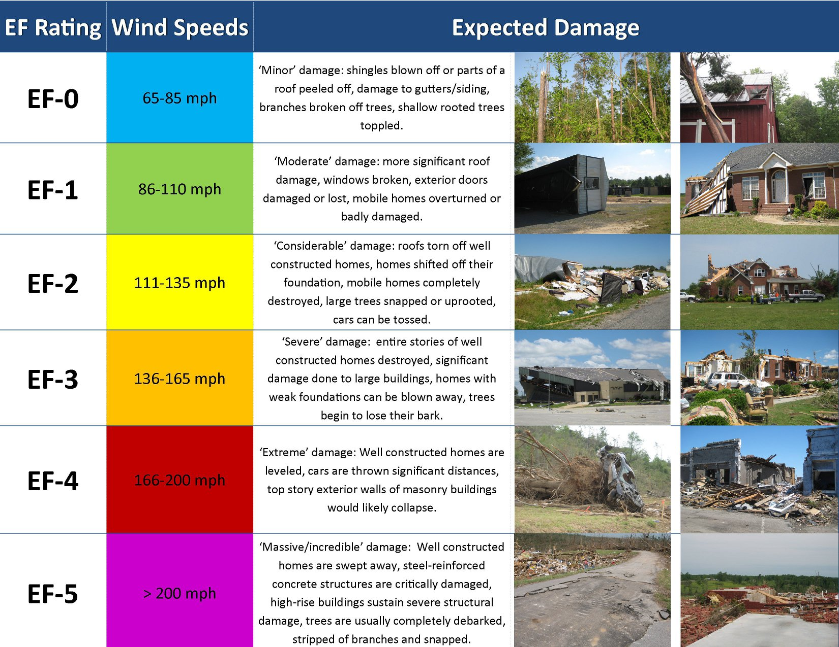

Slide 21
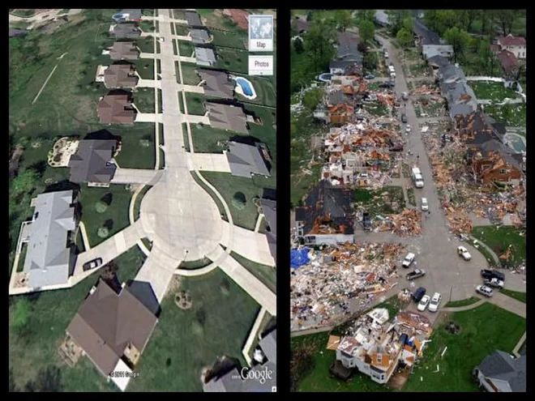
After an EF4 Tornado

Slide 22
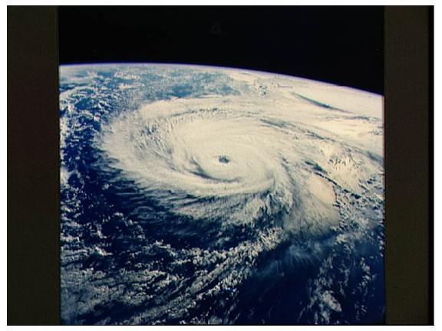
Eye of the hurricane

Slide 23
Hurricanes
A tropical storm that has winds of at least 120 km/h is called a hurricane.
Hurricanes are one of the most powerful storms on Earth.
Hurricanes form in tropical oceans (Pacific, South Atlantic, and Indian oceans).

Slide 24
How Does a Hurricane Form?
It begins as a group of thunderstorms moving over tropical ocean waters.
A hurricane gets its energy from the warm, humid air at the ocean’s surface.
As the air rises and forms clouds, more air is drawn into the system.

Slide 25
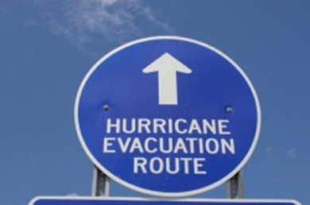
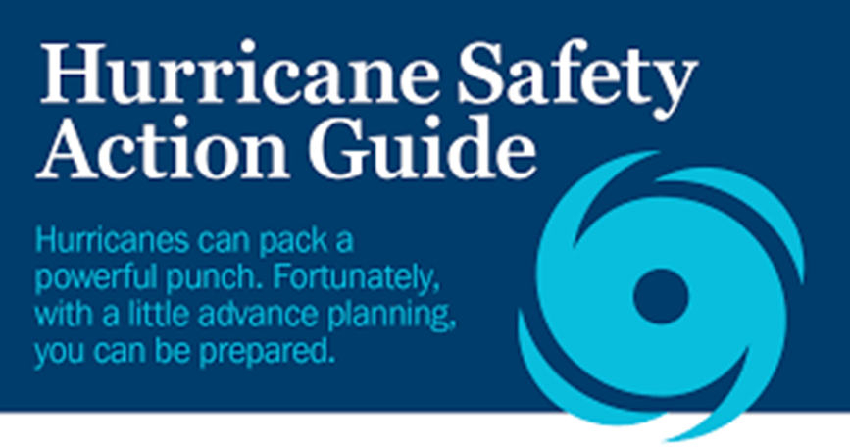
Hurricane Safety
Evacuate. Leave the area if necessary.
Stay away from windows and doors.

Slide 29
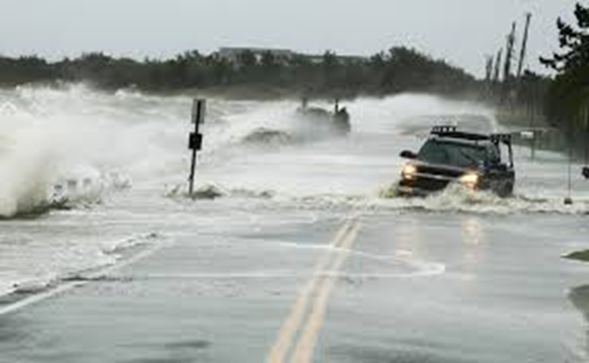
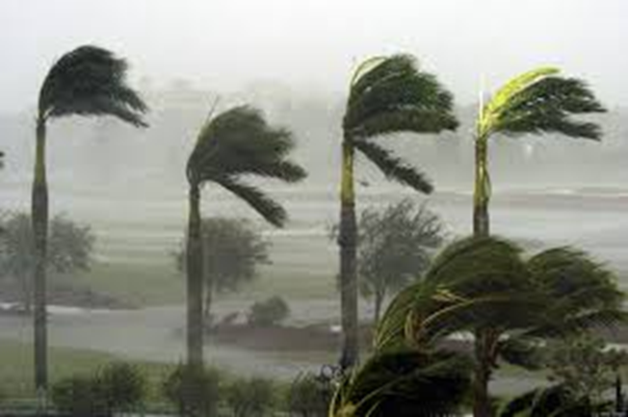
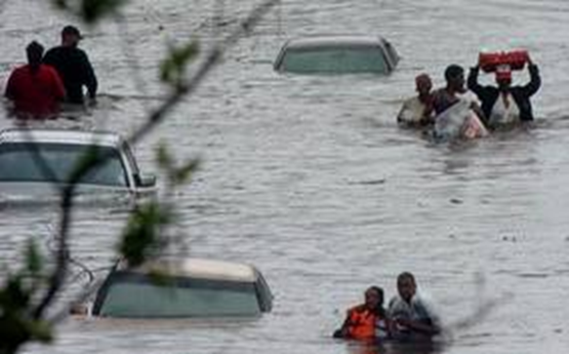
Damage Caused by Hurricanes
Trees and telephone lines can be knocked down
Storm surge
Flooding

Slide 30
Severe Weather Safety
When it’s lightning: stay away from trees, water, windows, and metal objects.
During a tornado: find shelter and stay in a basement, bathroom, closet, or hallway away from windows.
During a hurricane: evacuate if necessary, have a hurricane kit, stay away from windows, and cut off all utilities if evacuating.

Slide 31
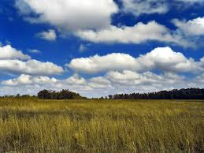
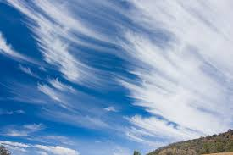
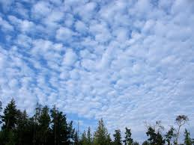
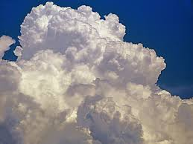
Clouds and weather

