Slide 1
Warm up:
What is the Corilosis Effect?
Standards:
S6E4a. Demonstrate that land and water absorb and lose heat at different rates and explain the resulting effects on weather patterns.
S6E4b. Relate unequal heating of land and water surfaces to form large global wind systems…
S6E2c. Relate the tilt of the earth to the distribution of sunlight throughout the year and its effect on climate.
Notes:
Instructional Approach(s): The teacher should introduce the essential question and the standards that align to the essential question

Slide 2
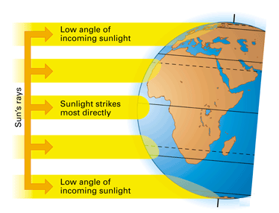
In previous lessons, you learned that the uneven heating of Earth’s surface by the Sun causes some areas to be warmer than others. This is due to some areas receive direct and indirect sunlight.
http://www.atmosedu.com/meteor/Animations/43_Angle%20of%20Sun/43.html
Notes:
Instructional Approach(s): The teacher should present the information on the slide. Use the animation to illustrate the unequal heating of the earth’s surface.

Slide 3
This uneven heating of land forms wind systems.
Notes:
Instructional Approach(s): The teacher should present the information on the slide.

Slide 4
Wind is caused by differences in air pressure. Areas of high pressure move to areas of low pressure.
Air pressure is related to density. Let’s review density.
Notes:
Instructional Approach(s): The teacher should present the information on the slide while the students record the important information on their notes.

Slide 5
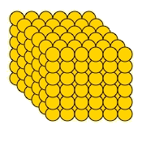
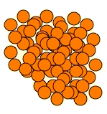
Which one has greater density? Greater pressure?
Greater Density
Greater Pressure
Lower Density
Lower Pressure
Notes:
Instructional Approach(s): The teacher should use the slide to review density.

Slide 6
We will consider Density and Pressure to be the same.
What about temperature? What did you learn about temperature and density?
Notes:
Instructional Approach(s): The teacher should pose the question to the class and ask for student responses. Remind students that higher temperature means lower density and vice versa.

Slide 7
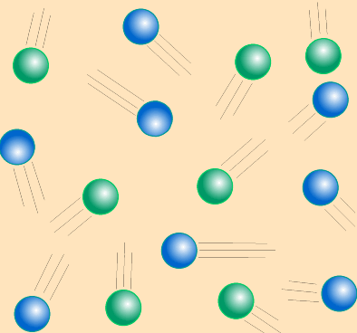
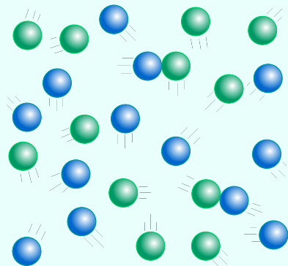
Look at the images below. Identify which image has: Higher Temperature, Higher Density, Higher Pressure.
Higher Temperature
Lower Temperature
Lower Density
Higher Density
Lower Pressure
Higher Pressure
Notes:
Instructional Approach(s): The teacher should use the slide to review the relationship between temperature, density, and pressure.

Slide 8
Temperature, Density and Pressure
Density increases,
Pressure increases
Temperature increases
Temperature decreases
Density decreases,
Pressure decreases
Notes:
Instructional Approach(s): The teacher should present the information on the slide while the students record the important information on their notes.

Slide 9
Wind is caused by differences in air pressure. Areas of high pressure move to areas of low pressure.
Let’s apply these concepts back to wind.
Notes:
Instructional Approach(s): The teacher should present the information on the slide.

Slide 10
In which direction would the wind move below.
Higher Temperature
Lower Temperature
Lower Density
Higher Density
Lower Pressure
Higher Pressure
Notes:
Instructional Approach(s): The teacher should pose the question to the class. The teacher can call on specific students, ask for volunteers, or ask students to discuss it with an elbow partner and then discuss with the class.

Slide 11
Why?
Higher Temperature
Lower Temperature
Lower Density
Higher Density
Lower Pressure
Higher Pressure
Notes:
Instructional Approach(s): The teacher should present the information on the slide. The particles are more crowded in the lower temperature (colder) area and want to spread out

Slide 12
Think of it this way…matter naturally wants to move from where it is crowded to where it is less crowded. This concept is true for all of science.
Higher Temperature
Lower Temperature
Higher Density
Lower Density
Lower Pressure
Higher Pressure
Notes:
Instructional Approach(s): The teacher should present the information on the slide. Ask the students why the word naturally is underlined. If given the choice, matter will move from high pressure, high density to low pressure, low density. However, there are times when matter is forced to stay the same or move in the opposite direction. They will learn this concept in 7th grade science in cells.

Slide 13
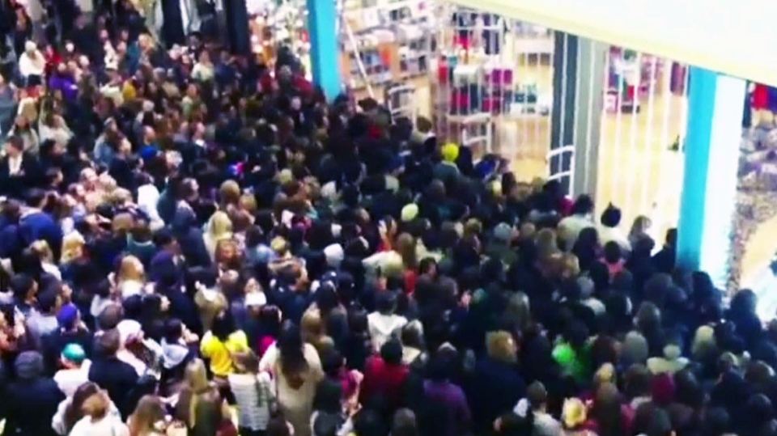
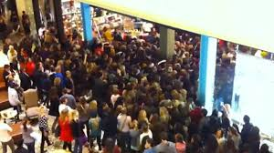
Particles naturally want to move from where they are more crowded to where they are less crowded.
Notes:
Instructional Approach(s): The teacher should use the slide to reinforce the movement of particles.

Slide 14
Which areas of the earth have air that is low pressure (low density)?
Areas that receive direct sunlight. Why? They have higher temperatures.
Notes:
Instructional Approach(s): The teacher should discuss the question with the class. Students should record the answers on their notes.

Slide 15
Which areas of the earth have air that is high pressure (high density)? Areas that receive indirect sunlight. Why? They have lower temperatures.
Notes:
Instructional Approach(s): The teacher should discuss the question with the class. Students should record the answers on their notes.

Slide 16
Distributed Summarizing:
Turn to a seat partner and describe how wind moves. Together discuss the following question: What makes wind travel at faster speeds?
Notes:
Instructional Approach(s): Have students turn to a partner and discuss the question on the slide. Partners can be determined by the students or the teacher can provide more specific directions such as turn to the person directly in front/behind you or to the right/left of you, etc. It may be necessary to have a group of three if you have an uneven number of students. Do not allow more than 30 seconds to 1 minute of discussion time. The teacher should be walking around listening and redirecting discussions as needed. The teacher can briefly discuss student responses. Answer: The greater the difference in density (pressure) between areas, the faster the wind will blow.

Slide 17
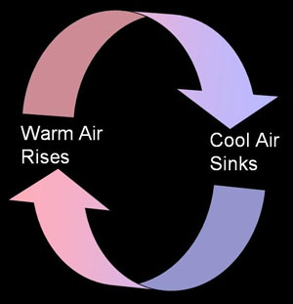
Differences in density and pressure cause wind and air movement. The movement of air occurs in convection currents.
Convection currents are simply the transfer of heat by the circulation or movement of the heated parts of a liquid or gas.
Notes:
Instructional Approach(s): The teacher should present the information on the slide while the students record the important information on their notes.

Slide 18
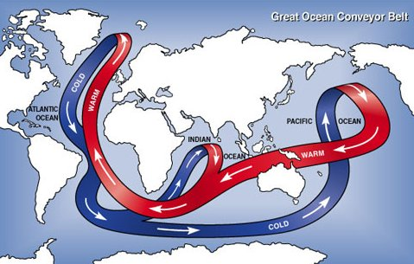
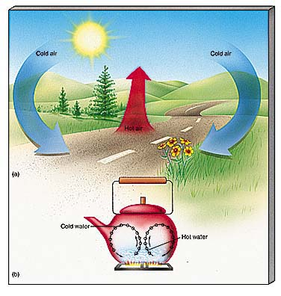
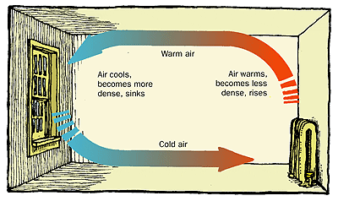
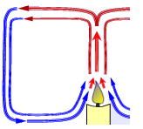
Everyday Examples of Convection Currents
http://www.healthyheating.com/Definitions/heat-transfer-convection.htm#.VD7SIfmjOSo
Notes:
Instructional Approach(s): The teacher should use the images and link on the slide to illustrate examples of convection currents. Remind students that in the water cycle, warm air rises, cools and condenses.

Slide 19
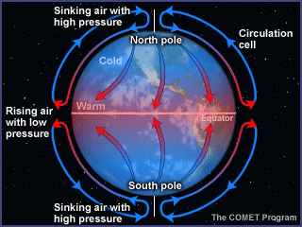
Large Convection Currents are formed because of the temperature differences between the equator and the poles. This produces global wind systems.
Notes:
Instructional Approach(s): The teacher should present the information on the slide while the students record the important information on their notes.

Slide 20
The sinking of cold, dense air and the rising of warm, less dense air do not explain everything about wind. What other factor have we discussed previously that affects the direction of winds on the earth’s surface?
Notes:
Instructional Approach(s): The teacher should present the information on the slide and pose the question to the class.

Slide 21
Surface winds and surface currents are affected by the rotation of the Earth (the Coriolis Effect)
Because Earth rotates toward the east, winds appear to curve to the right in the northern hemisphere and to the left in the southern hemisphere
Notes:
Instructional Approach(s): The teacher should present the information on the slide while the students record the important information on their notes.

Slide 22
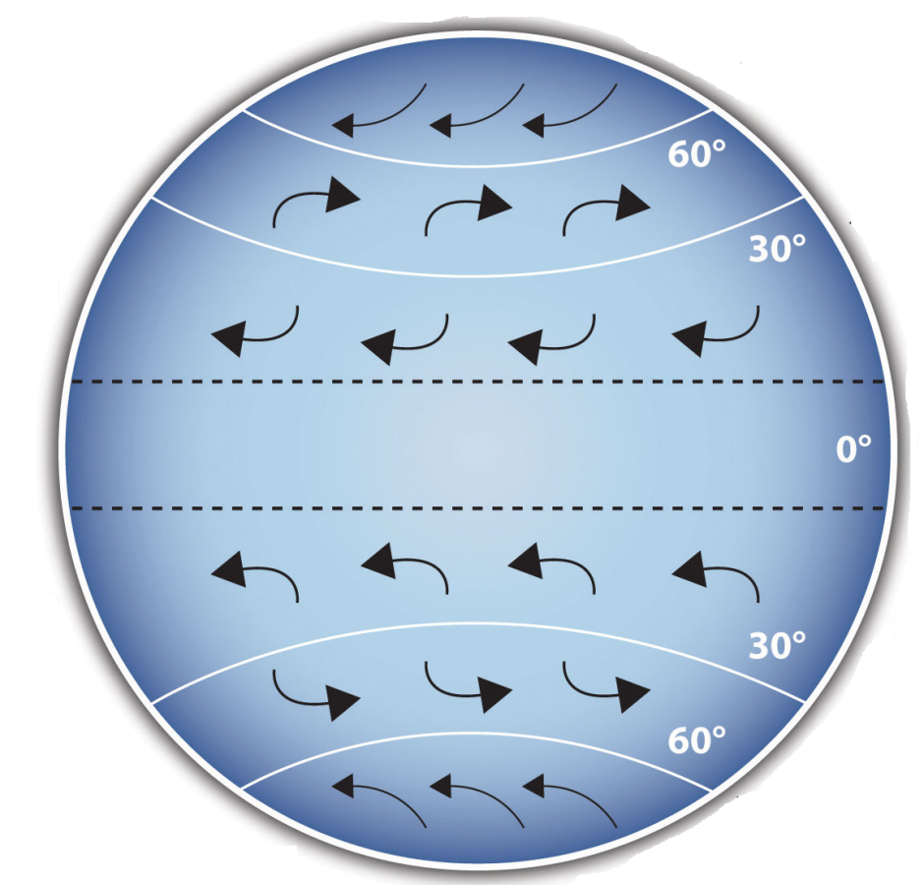
The effect of the earth’s rotation (Coriolis Effect) on Winds
http://www.classzone.com/books/earth_science/terc/content/visualizations/es1904/es1904page01.cfm?chapter_no=visualization
http://www.classzone.com/books/earth_science/terc/content/visualizations/es1905/es1905page01.cfm?chapter_no=visualization
Notes:
Instructional Approach(s): The teacher should present the information on the slide to illustrate the Coriolis Effect.

Slide 23
The flow of air caused by unequal heating of the Earth’s surface and the rotation of the Earth (Coriolis Effect) creates distinct wind patterns on Earth’s surface.
These wind systems not only influence the weather, they also determine when and where ships and planes travel most efficiently.
Notes:
Instructional Approach(s): The teacher should present the information on the slide while the students record the important information on their notes.

Slide 24
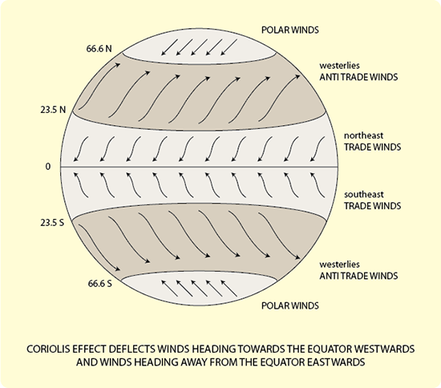
Below is a diagram showing the global wind patterns that distribute heat and moisture around the globe.
Notes:
Instructional Approach(s): The teacher should present the information on the slide. The students should draw arrows indicating the direction of wind on their own diagram in their notes.

Slide 25
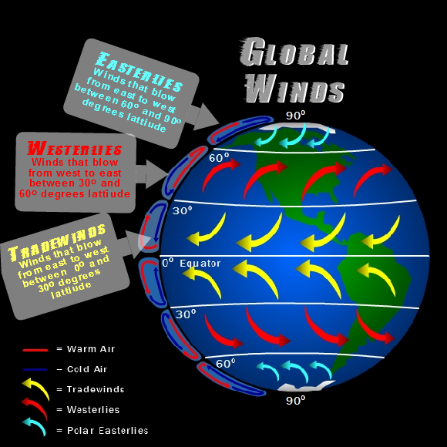
Notes:
Instructional Approach(s): The teacher should use the image on the diagram to illustrate the direction of winds.

Slide 26
Distributed Summarizing:
Turn to a seat partner and describe the factors that influence global wind patterns.
Notes:
Instructional Approach(s): Have students turn to a partner and discuss the question on the slide. Partners can be determined by the students or the teacher can provide more specific directions such as turn to the person directly in front/behind you or to the right/left of you, etc. It may be necessary to have a group of three if you have an uneven number of students. Do not allow more than 30 seconds to 1 minute of discussion time. The teacher should be walking around listening and redirecting discussions as needed. The teacher can briefly discuss student responses.

Slide 27
Warm Up:
Describe the factors that influence global wind patterns. (use your notes and infer what happens!)
Work on activity from yesterday.
Notes:
Instructional Approach(s): Have students turn to a partner and discuss the question on the slide. Partners can be determined by the students or the teacher can provide more specific directions such as turn to the person directly in front/behind you or to the right/left of you, etc. It may be necessary to have a group of three if you have an uneven number of students. Do not allow more than 30 seconds to 1 minute of discussion time. The teacher should be walking around listening and redirecting discussions as needed. The teacher can briefly discuss student responses.

Slide 28
Work Session:
Bill Nye Video “Wind”
Complete any unfinished work (Directed Reading & Activity from yesterday)
Notes:
Instructional Approach(s): Have students turn to a partner and discuss the question on the slide. Partners can be determined by the students or the teacher can provide more specific directions such as turn to the person directly in front/behind you or to the right/left of you, etc. It may be necessary to have a group of three if you have an uneven number of students. Do not allow more than 30 seconds to 1 minute of discussion time. The teacher should be walking around listening and redirecting discussions as needed. The teacher can briefly discuss student responses.

Slide 29
Global wind systems determine the major weather patterns for the entire planet.
Smaller wind systems affect local weather. Two such wind systems are sea breezes and land breezes.
Notes:
Instructional Approach(s): The teacher should present the information on the slide while the students record the important information on their notes.

Slide 30
Look at the temperatures of the land and the sea in this diagram. Which direction would the wind blow? Why?
High
Pressure
65°F
85°F
Low Pressure
Notes:
Instructional Approach(s): The teacher should present the information on the slide. The teacher can call on students to respond or ask for student responses. When ready, click the mouse to reveal the answers.

Slide 31
A sea breeze occurs when wind is moving from the sea towards land.
High
Pressure
65°F
85°F
Low Pressure
Notes:
Instructional Approach(s): The teacher should present the information on the slide.

Slide 32
Land heats up and cools down faster than water. How does this affect wind?
Notes:
Instructional Approach(s): The teacher should present the information on the slide.

Slide 33
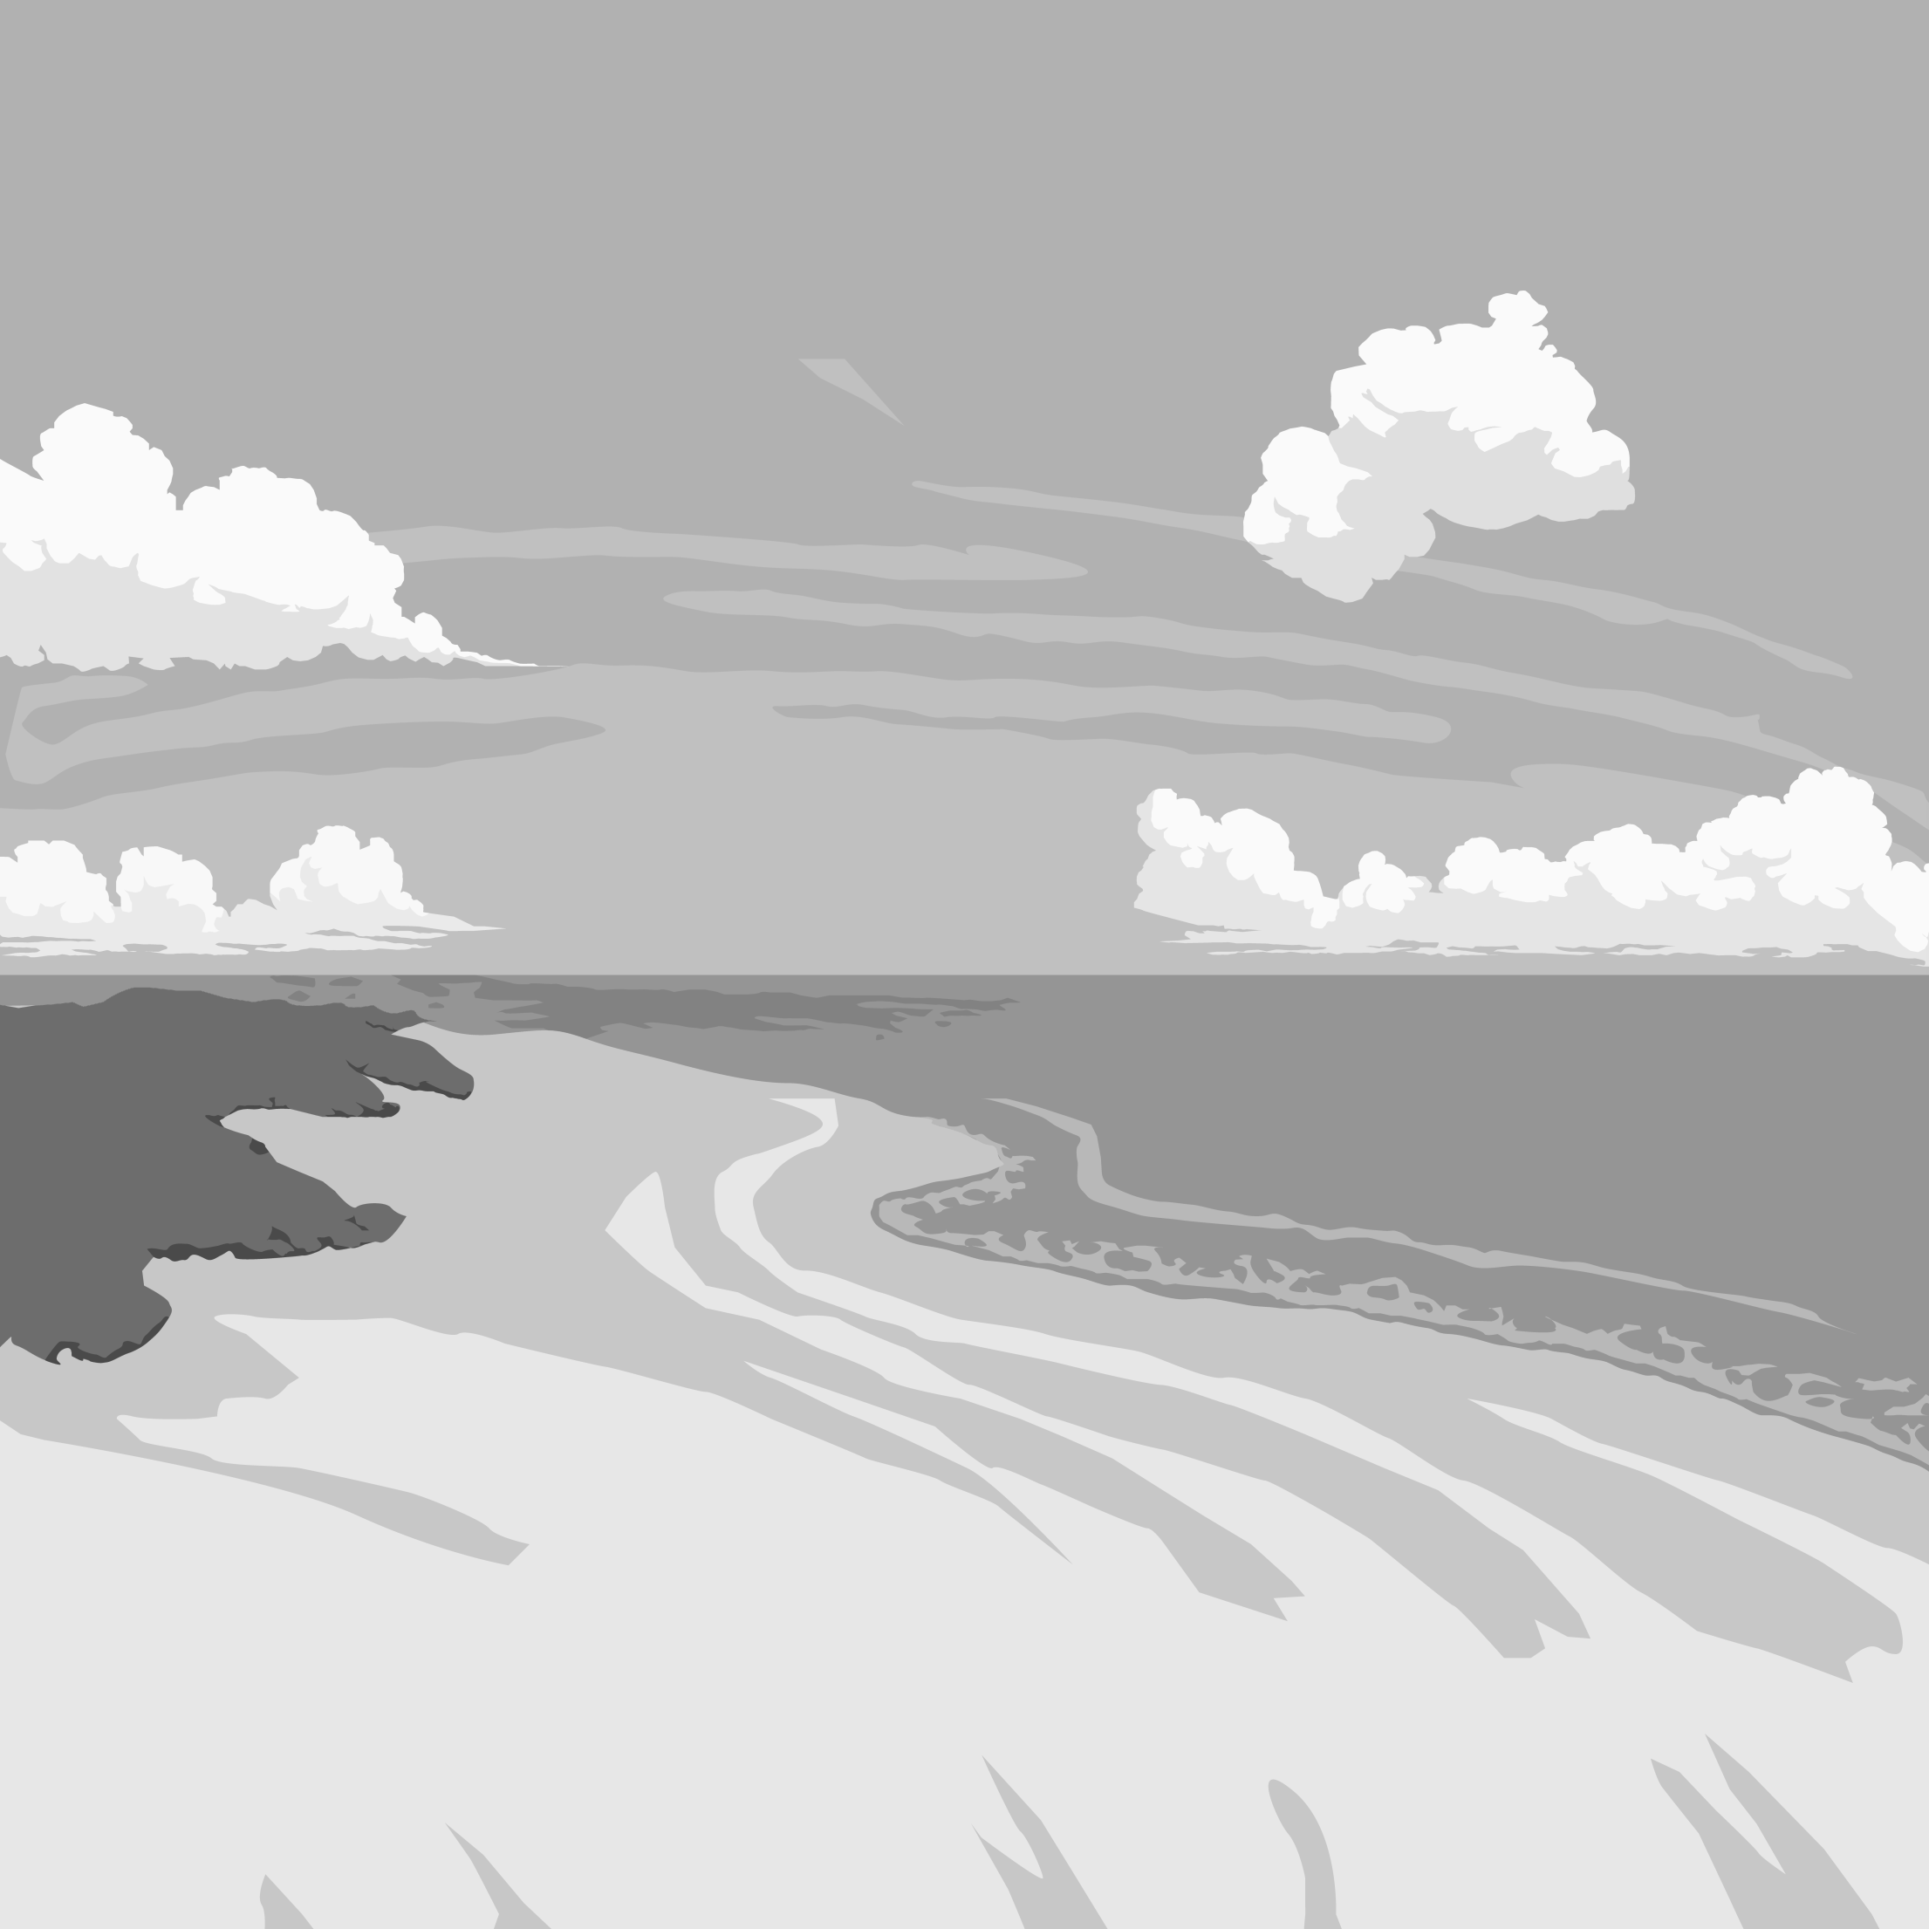
At night when the earth’s surface is no longer being heated by the sun, the land cools much more rapidly than ocean water. What happens to the wind?
Low
Pressure
65°F
55°F
High Pressure
Notes:
Instructional Approach(s): The teacher should present the information on the slide. The teacher can call on students to respond or ask for student responses. When ready, click the mouse to reveal the answers.

Slide 34
A land breeze occurs when wind is moving from the land to the sea.
Low
Pressure
65°F
55°F
High Pressure
Notes:
Instructional Approach(s): The teacher should present the information on the slide.

Slide 35
How do sea breezes and land breezes affect local weather?
http://www.nc-climate.ncsu.edu/edu/k12/.breezes
Notes:
Instructional Approach(s): The teacher should present the information on the slide.

Slide 36
Sea Breeze and Land Breeze
https://www.youtube.com/watch?v=ZQV72Yzmjyc
http://www.classzone.com/books/earth_science/terc/content/visualizations/es1903/es1903page01.cfm?chapter_no=visualization
Notes:
Instructional Approach(s): The teacher should use the links to illustrate sea and land breezes

Slide 37
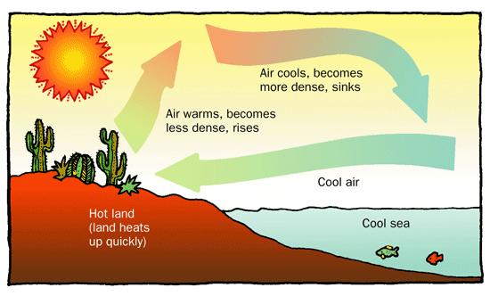
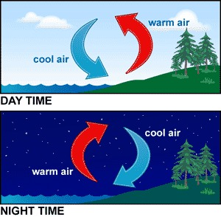
Sea
Breeze
Land
Breeze
Notes:
Instructional Approach(s): The teacher should use the images to illustrate sea and land breezes

Slide 38
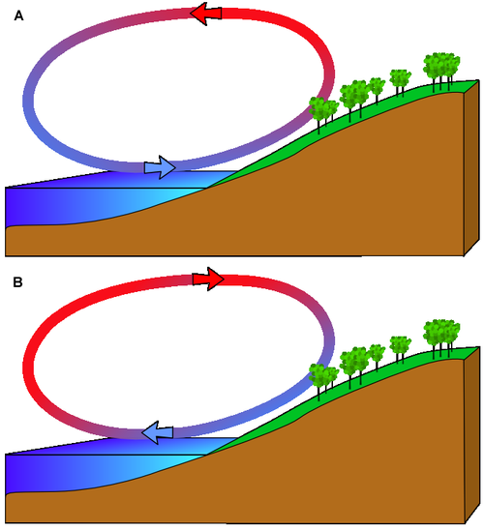
Identify which diagram illustrates a Sea Breeze and a Land Breeze. Explain why. Include high and low air pressure in your explanation.
Notes:
Instructional Approach(s): The teacher can have students answer the questions individually or with a partner.

Slide 39
Warm Up:
Air moves from an area of ______ pressure to ____ pressure.
As temperature increases, air pressure ________.
The ______ _______ causes wind to have a curved path.
Notes:
Instructional Approach(s): Have students turn to a partner and discuss the question on the slide. Partners can be determined by the students or the teacher can provide more specific directions such as turn to the person directly in front/behind you or to the right/left of you, etc. It may be necessary to have a group of three if you have an uneven number of students. Do not allow more than 30 seconds to 1 minute of discussion time. The teacher should be walking around listening and redirecting discussions as needed. The teacher can briefly discuss student responses. Answer: The greater the difference in density (pressure) between areas, the faster the wind will blow.

Slide 40
Work Session:
Check Study Guide
Wind Test
Atmosphere Test
Rd. pg. 490-495 questions 1-9
Notes:
Instructional Approach(s): Have students turn to a partner and discuss the question on the slide. Partners can be determined by the students or the teacher can provide more specific directions such as turn to the person directly in front/behind you or to the right/left of you, etc. It may be necessary to have a group of three if you have an uneven number of students. Do not allow more than 30 seconds to 1 minute of discussion time. The teacher should be walking around listening and redirecting discussions as needed. The teacher can briefly discuss student responses. Answer: The greater the difference in density (pressure) between areas, the faster the wind will blow.

Slide 41
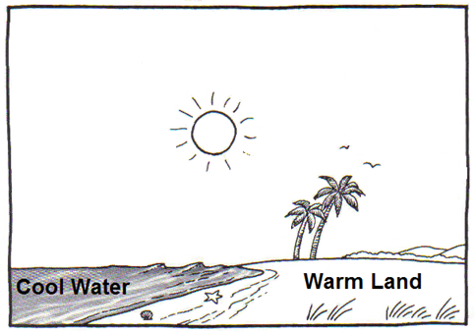
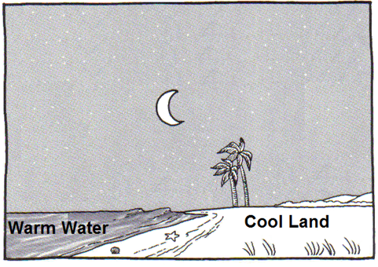
Label and draw the following in the diagrams on your notes: sea breeze, land breeze, high pressure, low pressure, arrows showing the direction of the wind.
Notes:
Instructional Approach(s): The students should label the diagrams on their notes. Click to the next slide to show the answers.

Slide 42
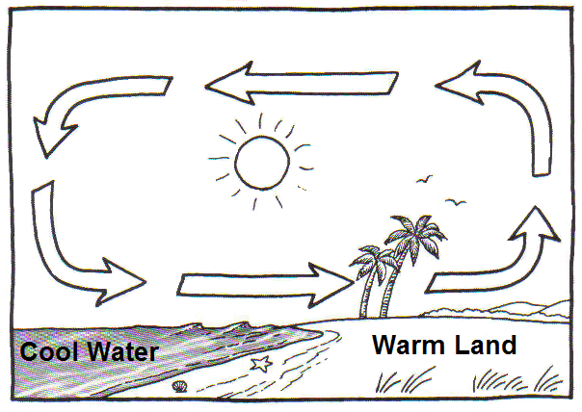
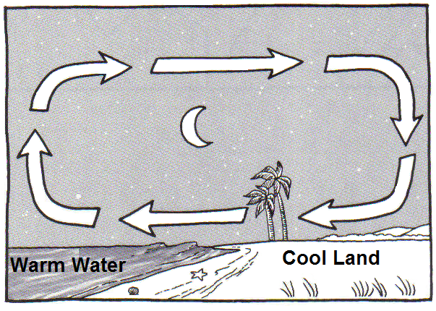
High Pressure
Land Breeze
Low Pressure
Sea Breeze
Low Pressure
High Pressure
Notes:
Instructional Approach(s): The teacher should use the slide to ensure students have the correct answers on their notes.

Slide 43
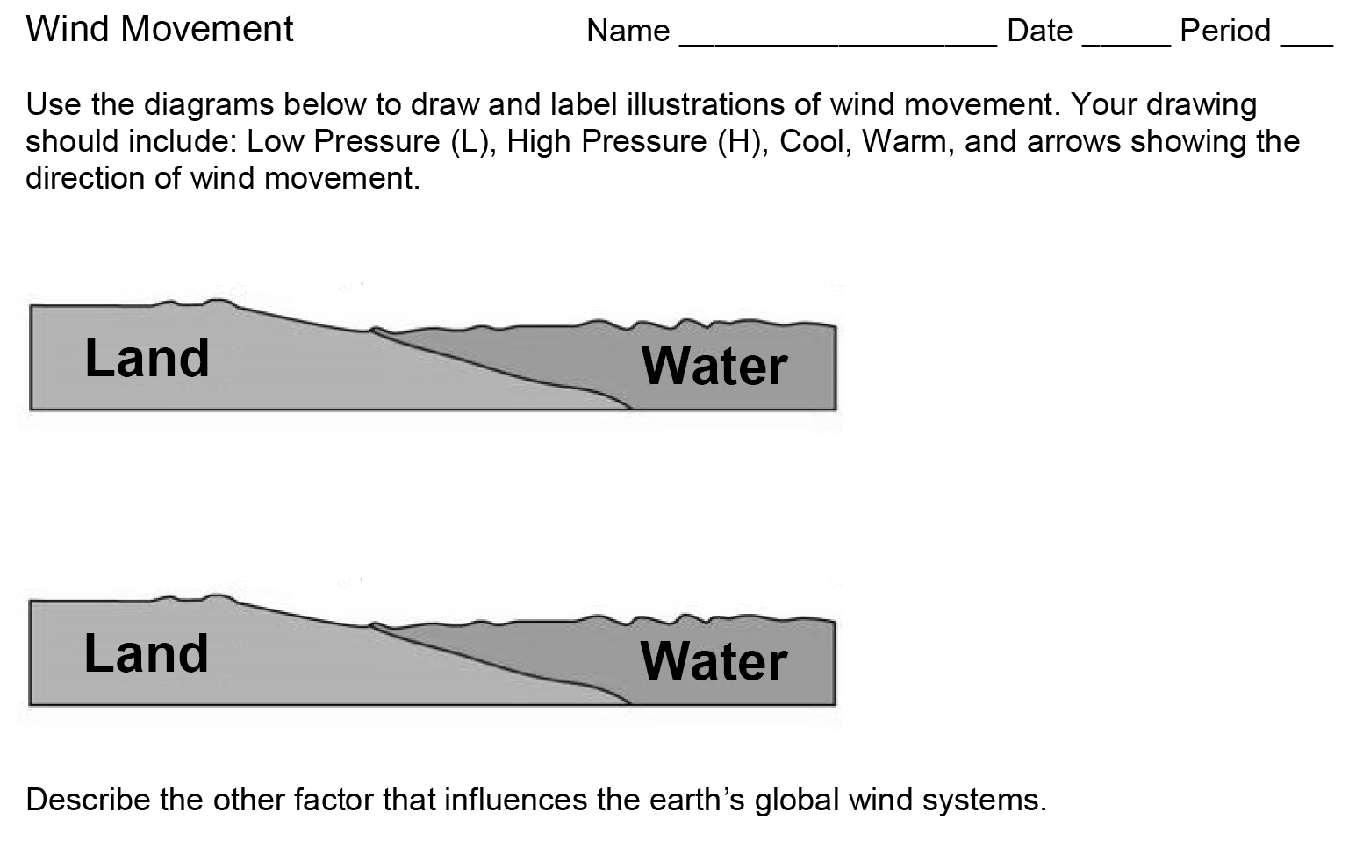
Summarizing Strategy:
Notes:
Instructional Approach(s): Each student should complete the summarizer. The teacher should use the summarizer to determine the level of student mastery and if differentiation is needed.

Slide 44
Warm Up:
Name the layers of the atmosphere in order beginning with the layer closest to the Earth.
What gas makes up most of our atmosphere?
What is the second most abundant gas in our atmosphere?
Notes:
Instructional Approach(s): The teacher should introduce the essential question and the standards that align to the essential question

Slide 45
Work Session:
Review/Questions
Atmosphere Test
Finish the directed reading on Atmosphere
Finish Enrichment Activity
Wind Study Guide
Weather Fortune Teller
Notes:
Instructional Approach(s): The teacher should introduce the essential question and the standards that align to the essential question

Slide 46
Closing:
Homework: Wind Study Guide due Friday (5 pts. on test)
“Wind” Test Friday (you will not pass unless you study!)
Notes:
Instructional Approach(s): The teacher should introduce the essential question and the standards that align to the essential question

Slide 47
Warm Up:
Trade Winds blow from _______ to ______ and are found between the _______ degree and _____ degree latitude line.
Westerlies blow from ________ to __________ and are found between the _______ degree and _______ degree latitude line.
Notes:
Instructional Approach(s): The teacher should introduce the essential question and the standards that align to the essential question

Slide 48
Work Session:
1. Review PPT/Notes
2. Study Jam Video/GO
3. Land/sea breeze practice drawings
4. Glue notes into IAN
5. Wind Summarizer
Notes:
Instructional Approach(s): The teacher should introduce the essential question and the standards that align to the essential question

Slide 49
Missing Work: 1st Period
Atmosphere/Wind Enrichment: (Jennifer, Jeremy, Eduardo, Malachi, Alex, Orlando, Alejandro, Marquis, Bryan, Elijah)
Notes:
Instructional Approach(s): The teacher should introduce the essential question and the standards that align to the essential question

Slide 50
Missing Work: 2nd Period
Atmosphere/Wind Enrichment: ()
Notes:
Instructional Approach(s): The teacher should introduce the essential question and the standards that align to the essential question

Slide 51
Missing Work: 3rd Period
Atmosphere/Wind Enrichment: ()
Notes:
Instructional Approach(s): The teacher should introduce the essential question and the standards that align to the essential question

Slide 52
Missing Work: 4th Period
Atmosphere/Wind Enrichment: ()
Notes:
Instructional Approach(s): The teacher should introduce the essential question and the standards that align to the essential question

Slide 53
Closing:
Go over “Wind Summarizer”.
Homework: Wind Study Guide due Friday (5 pts. on test)
“Wind” Test Friday (you will not pass unless you study!)
Notes:
Instructional Approach(s): The teacher should introduce the essential question and the standards that align to the essential question

Slide 54
Summarizing Strategy:
Notes:
Instructional Approach(s): Each student should complete the summarizer. The teacher should use the summarizer to determine the level of student mastery and if differentiation is needed.

